Slide 1
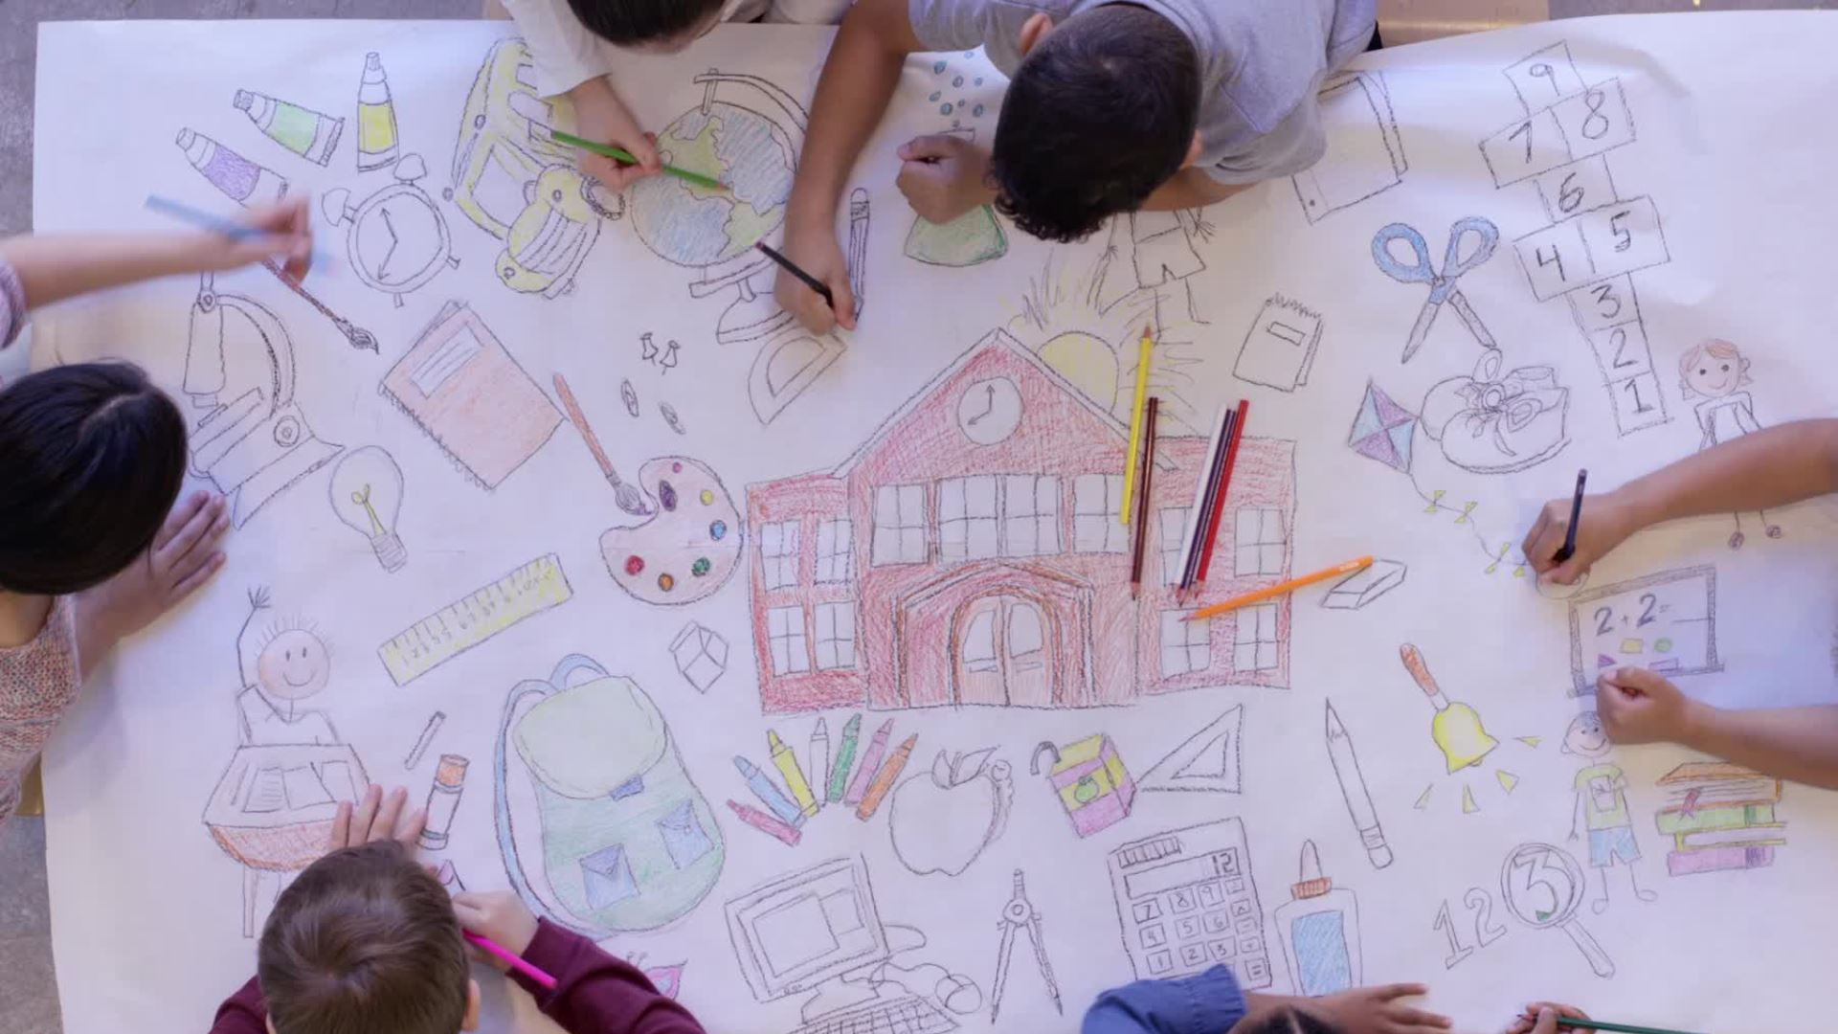
Interactive Classroom Activities
Karina Jackson
Coordinator of Curriculum & Instruction
BYU English Language Center

Slide 2
First and Last
Play with the people in your row.
  Partner One: Say a word
      Example: Go
  Partner Two: Say a word that starts with the last letter
      Example: One
  Partner Three: Repeat
      Example: Elephant
  Partner Four: Repeat
      Example: Tough
  Partner Five: Repeat
      Example: Full

Slide 3
What is an activity you love to do with your students?
Talk with a partner

Slide 4

Characteristics of Task-Based Learning
Meaning is primary.
Learners are not given other people’s meanings to simply repeat.
There is some sort of relationship to comparable real-world activities.
Task completion has some priority.
The assessment of the task is in terms of outcome.
(Nunan, 2014, p.459)

Slide 5
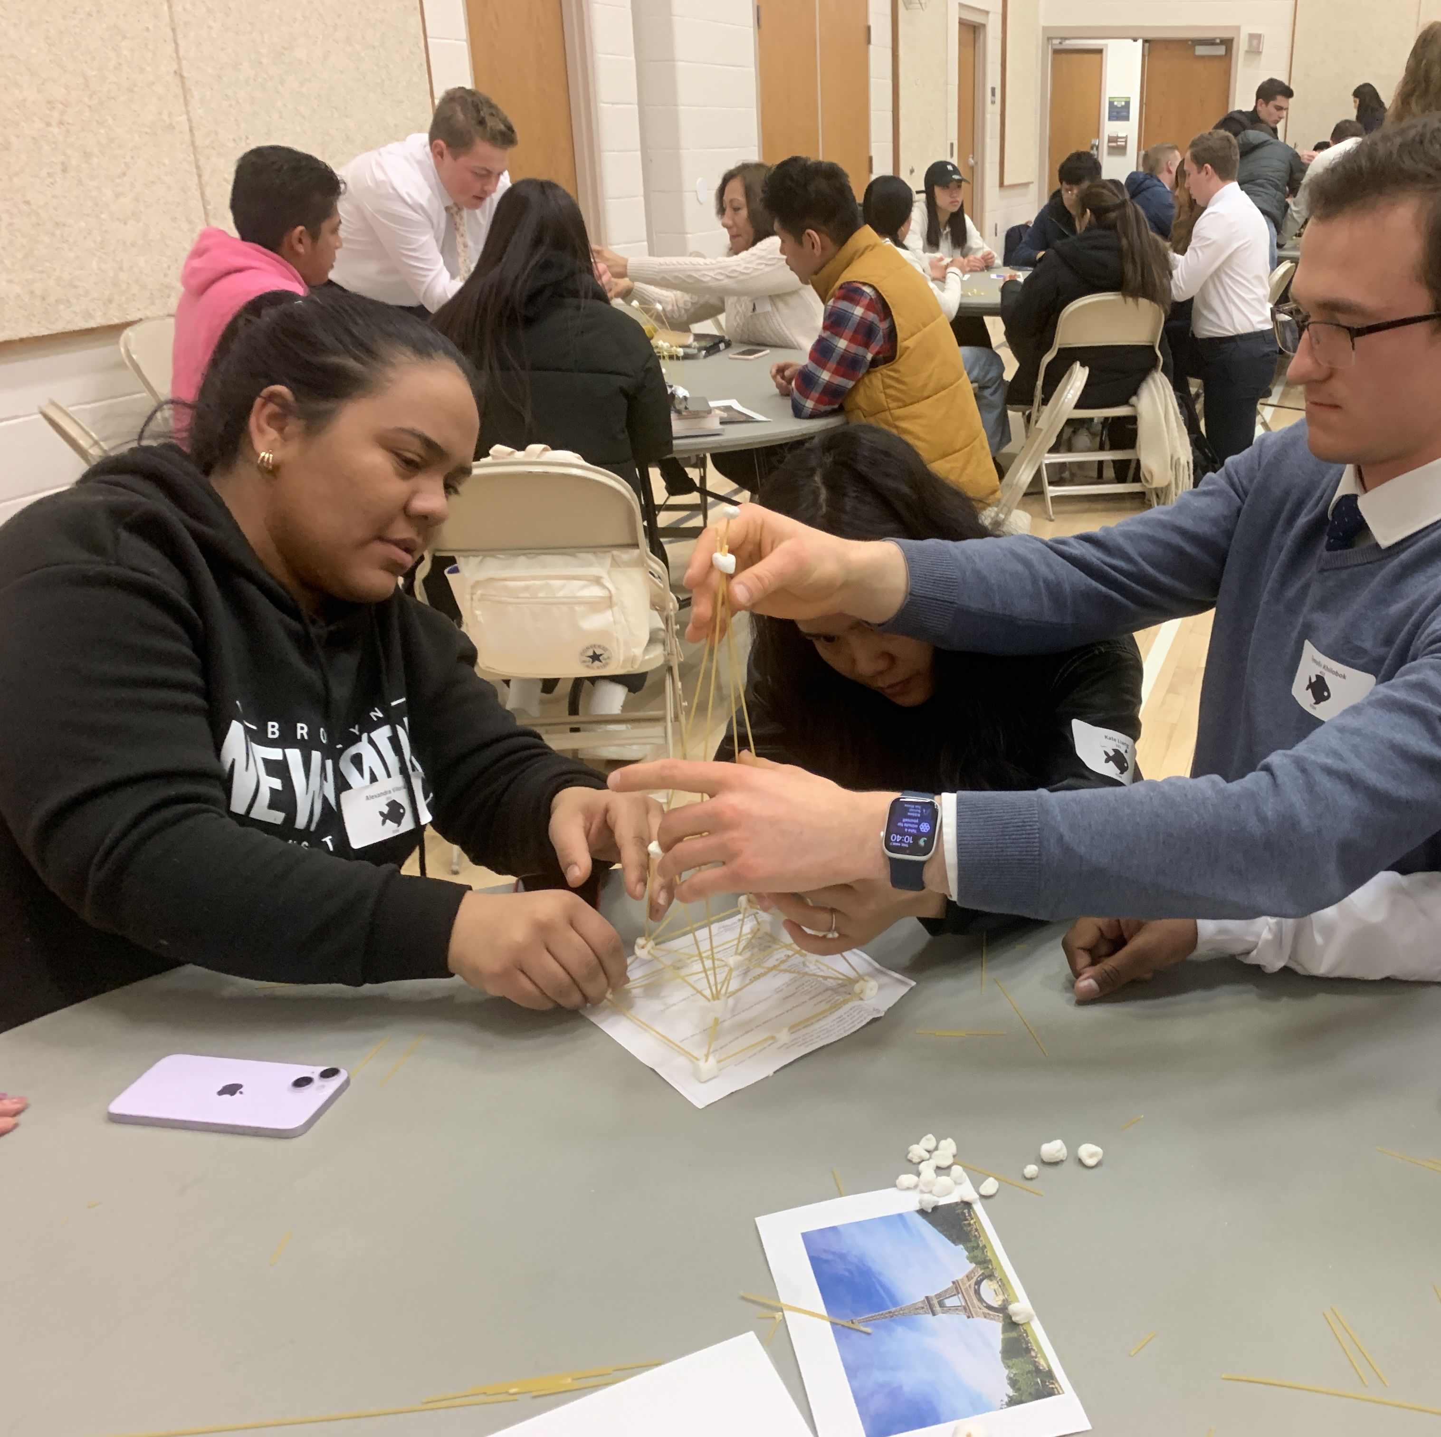
Focus on a real-world objective
Negotiating with a team
Working with time constraints
Solving a problem
Communicating across cultures
Creative use of resources

Slide 6
Example: Spaghetti Towers
Materials
20 spaghetti pieces
20 marshmallows
A picture of the tower
The Steps
Working with a team, prototyping
Build a tower from spaghetti and marshmallows that looks like a real famous place
Base, connect, strengthen, support
Modals: we should, we could, it might, etc
A tower that can stand alone, looks like the photo, all team members participated

Slide 7
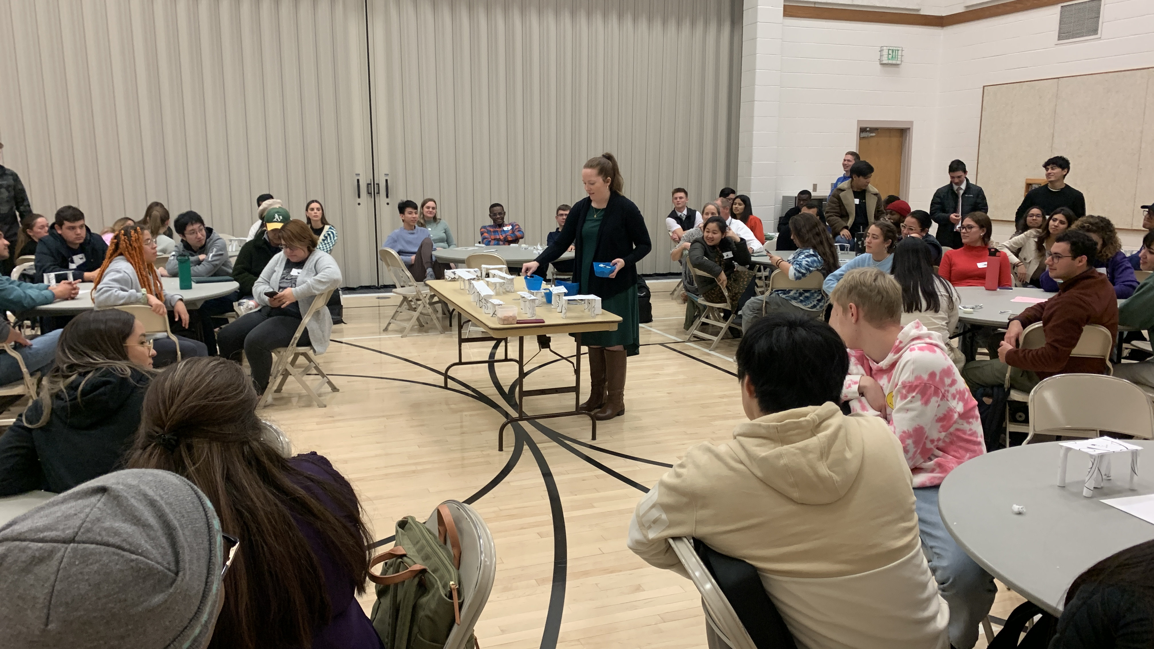
Create a clear task

Slide 8
Example: Paper Bridges
Materials
2 pieces of paper
Tape
Weights
The Steps
Working with a team, limited resources, problem-solving
Build a bridge from paper that can support the weights
Legs, top, width, height, length
We need (noun) and We need to (verb)
A bridge the correct height, length, and width, can support some weight. Listened to instructions.

Slide 9
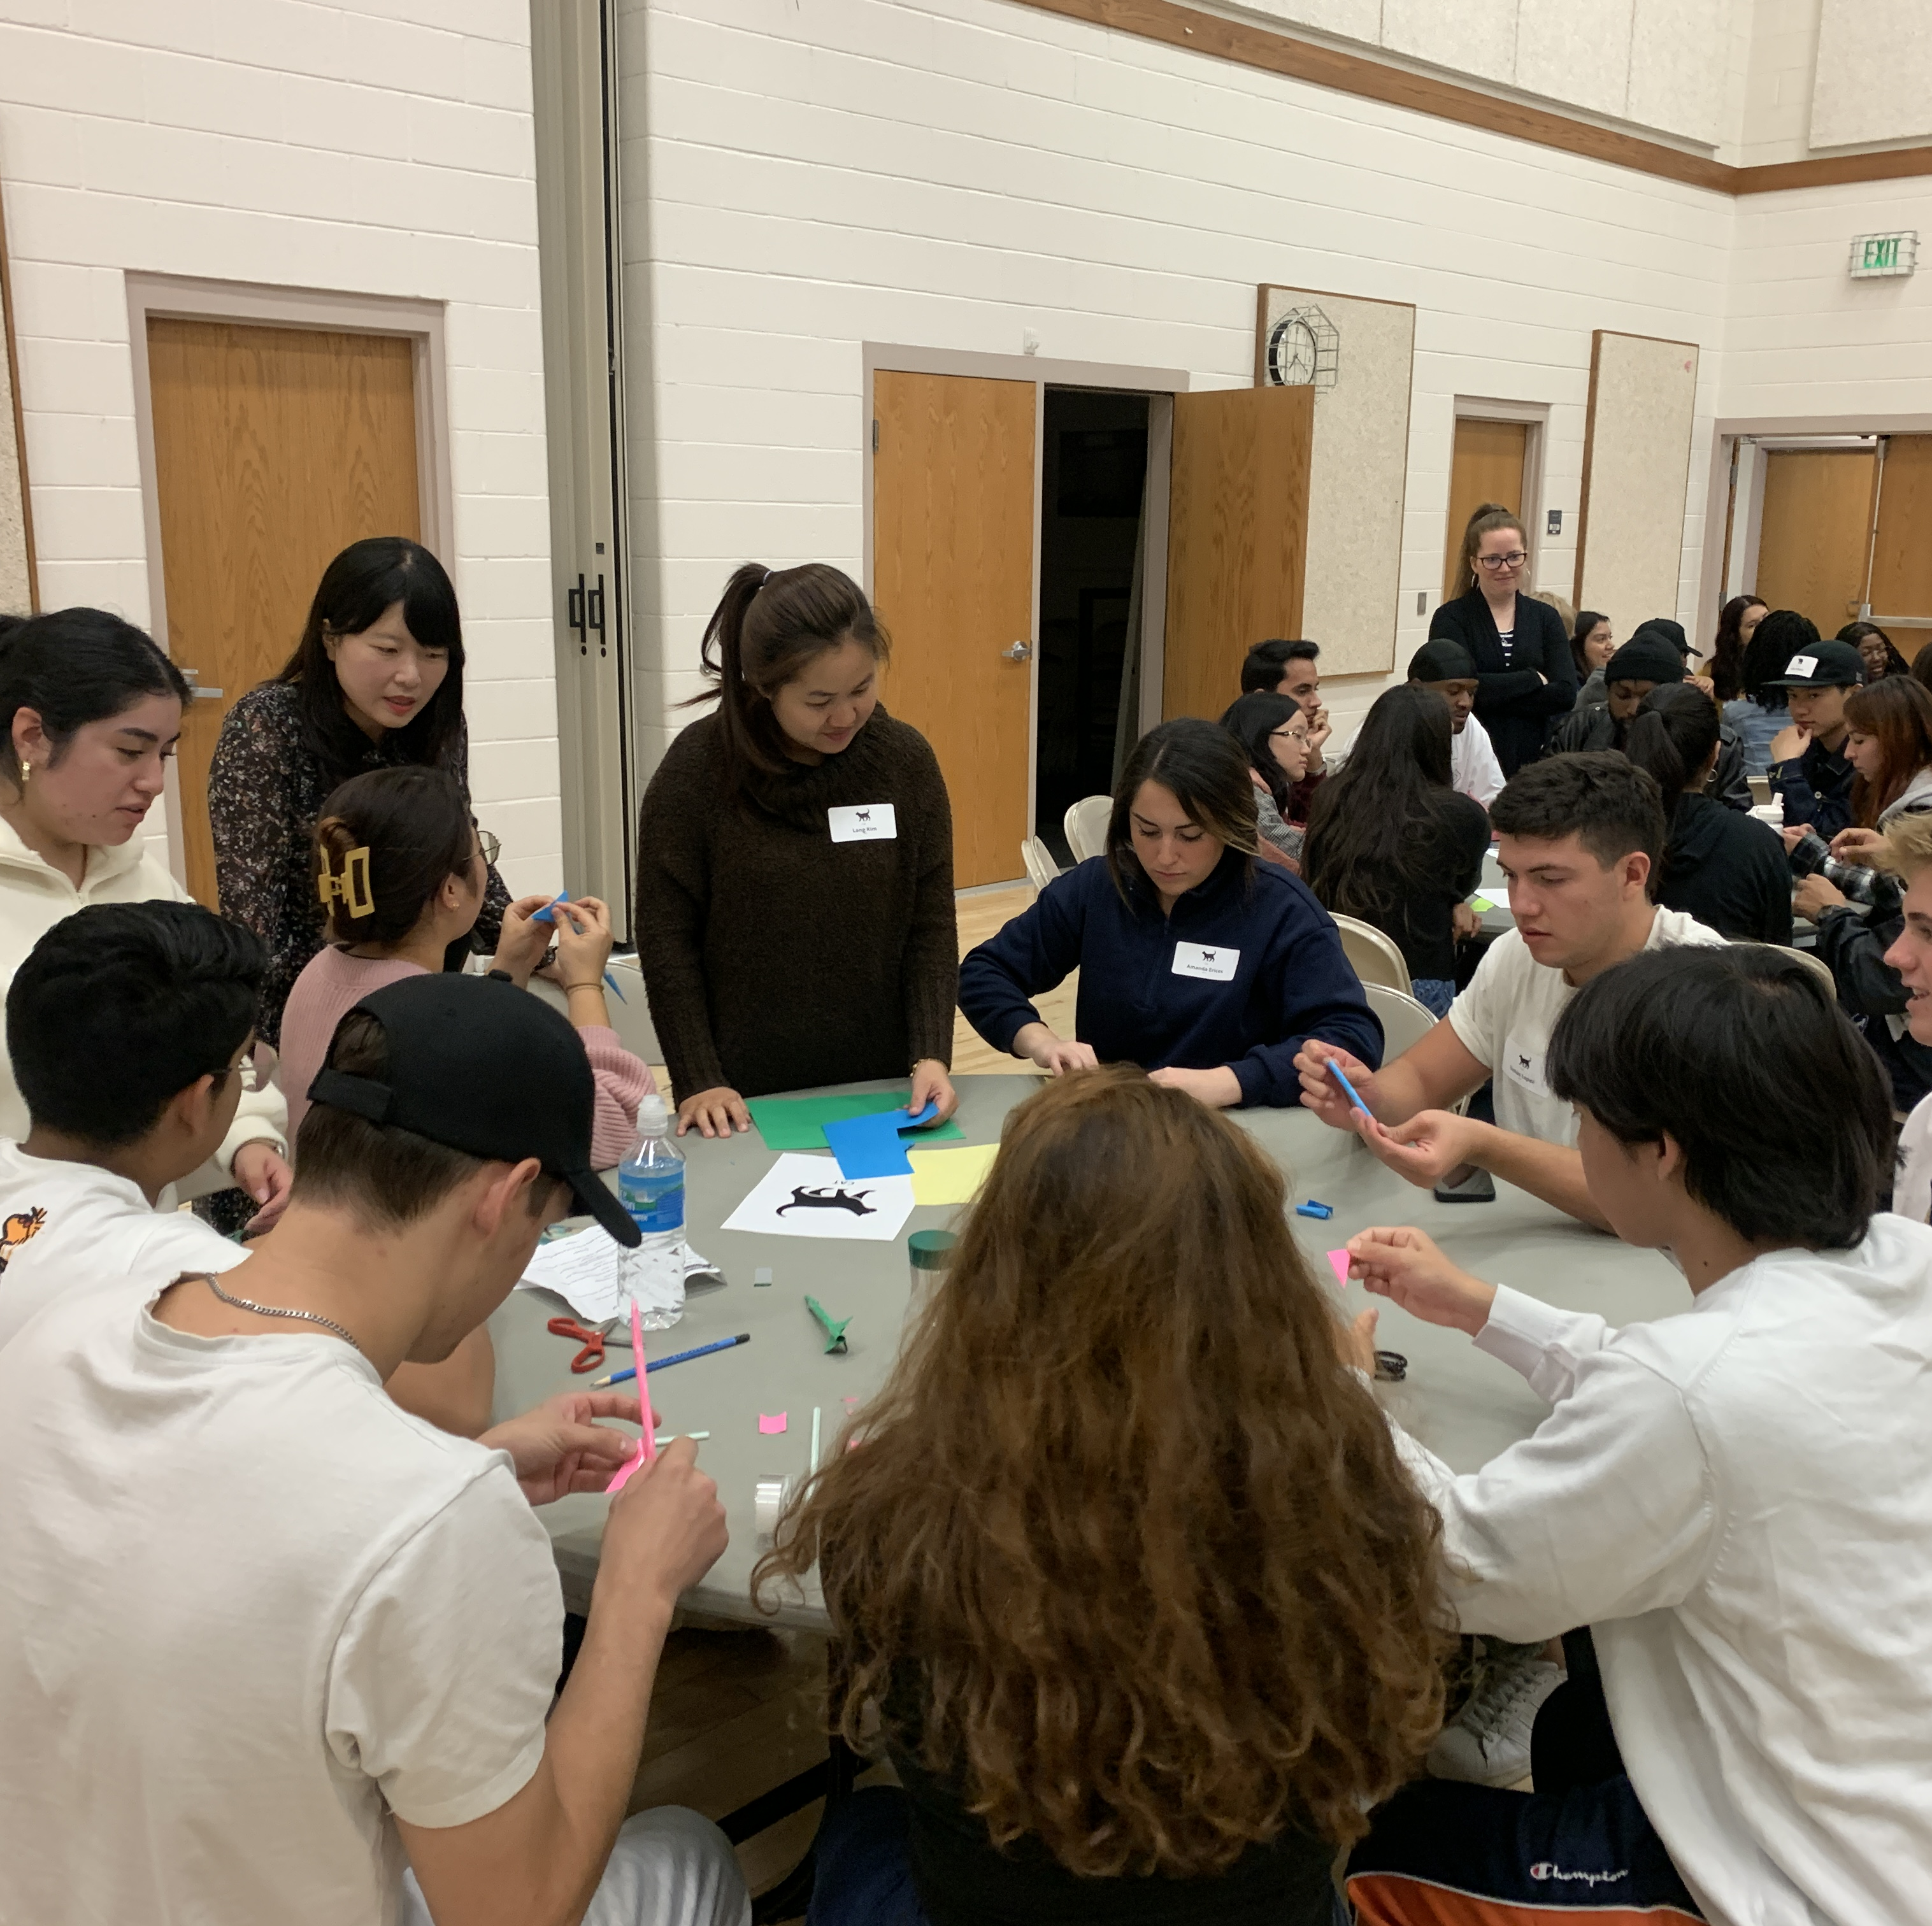
Identify vocabulary
Rockets
  Launch
  Fins
  Tip/nose
  Fold
  Roll
  Attach
  Blow
  Aim

Slide 10
Example: Straw Rockets
Materials
1 piece of paper
A pencil
Tape & Scissors
Example: https://www.jpl.nasa.gov/edu/learn/project/make-a-straw-rocket/
The Steps
Follow instructions, problem-solve, trial and error
Make a rocket that will fly
Launch, fins, tip, fold, roll, etc
If ____ then ____
A rocket that will fly, labeled parts, designed as a team before creating

Slide 11
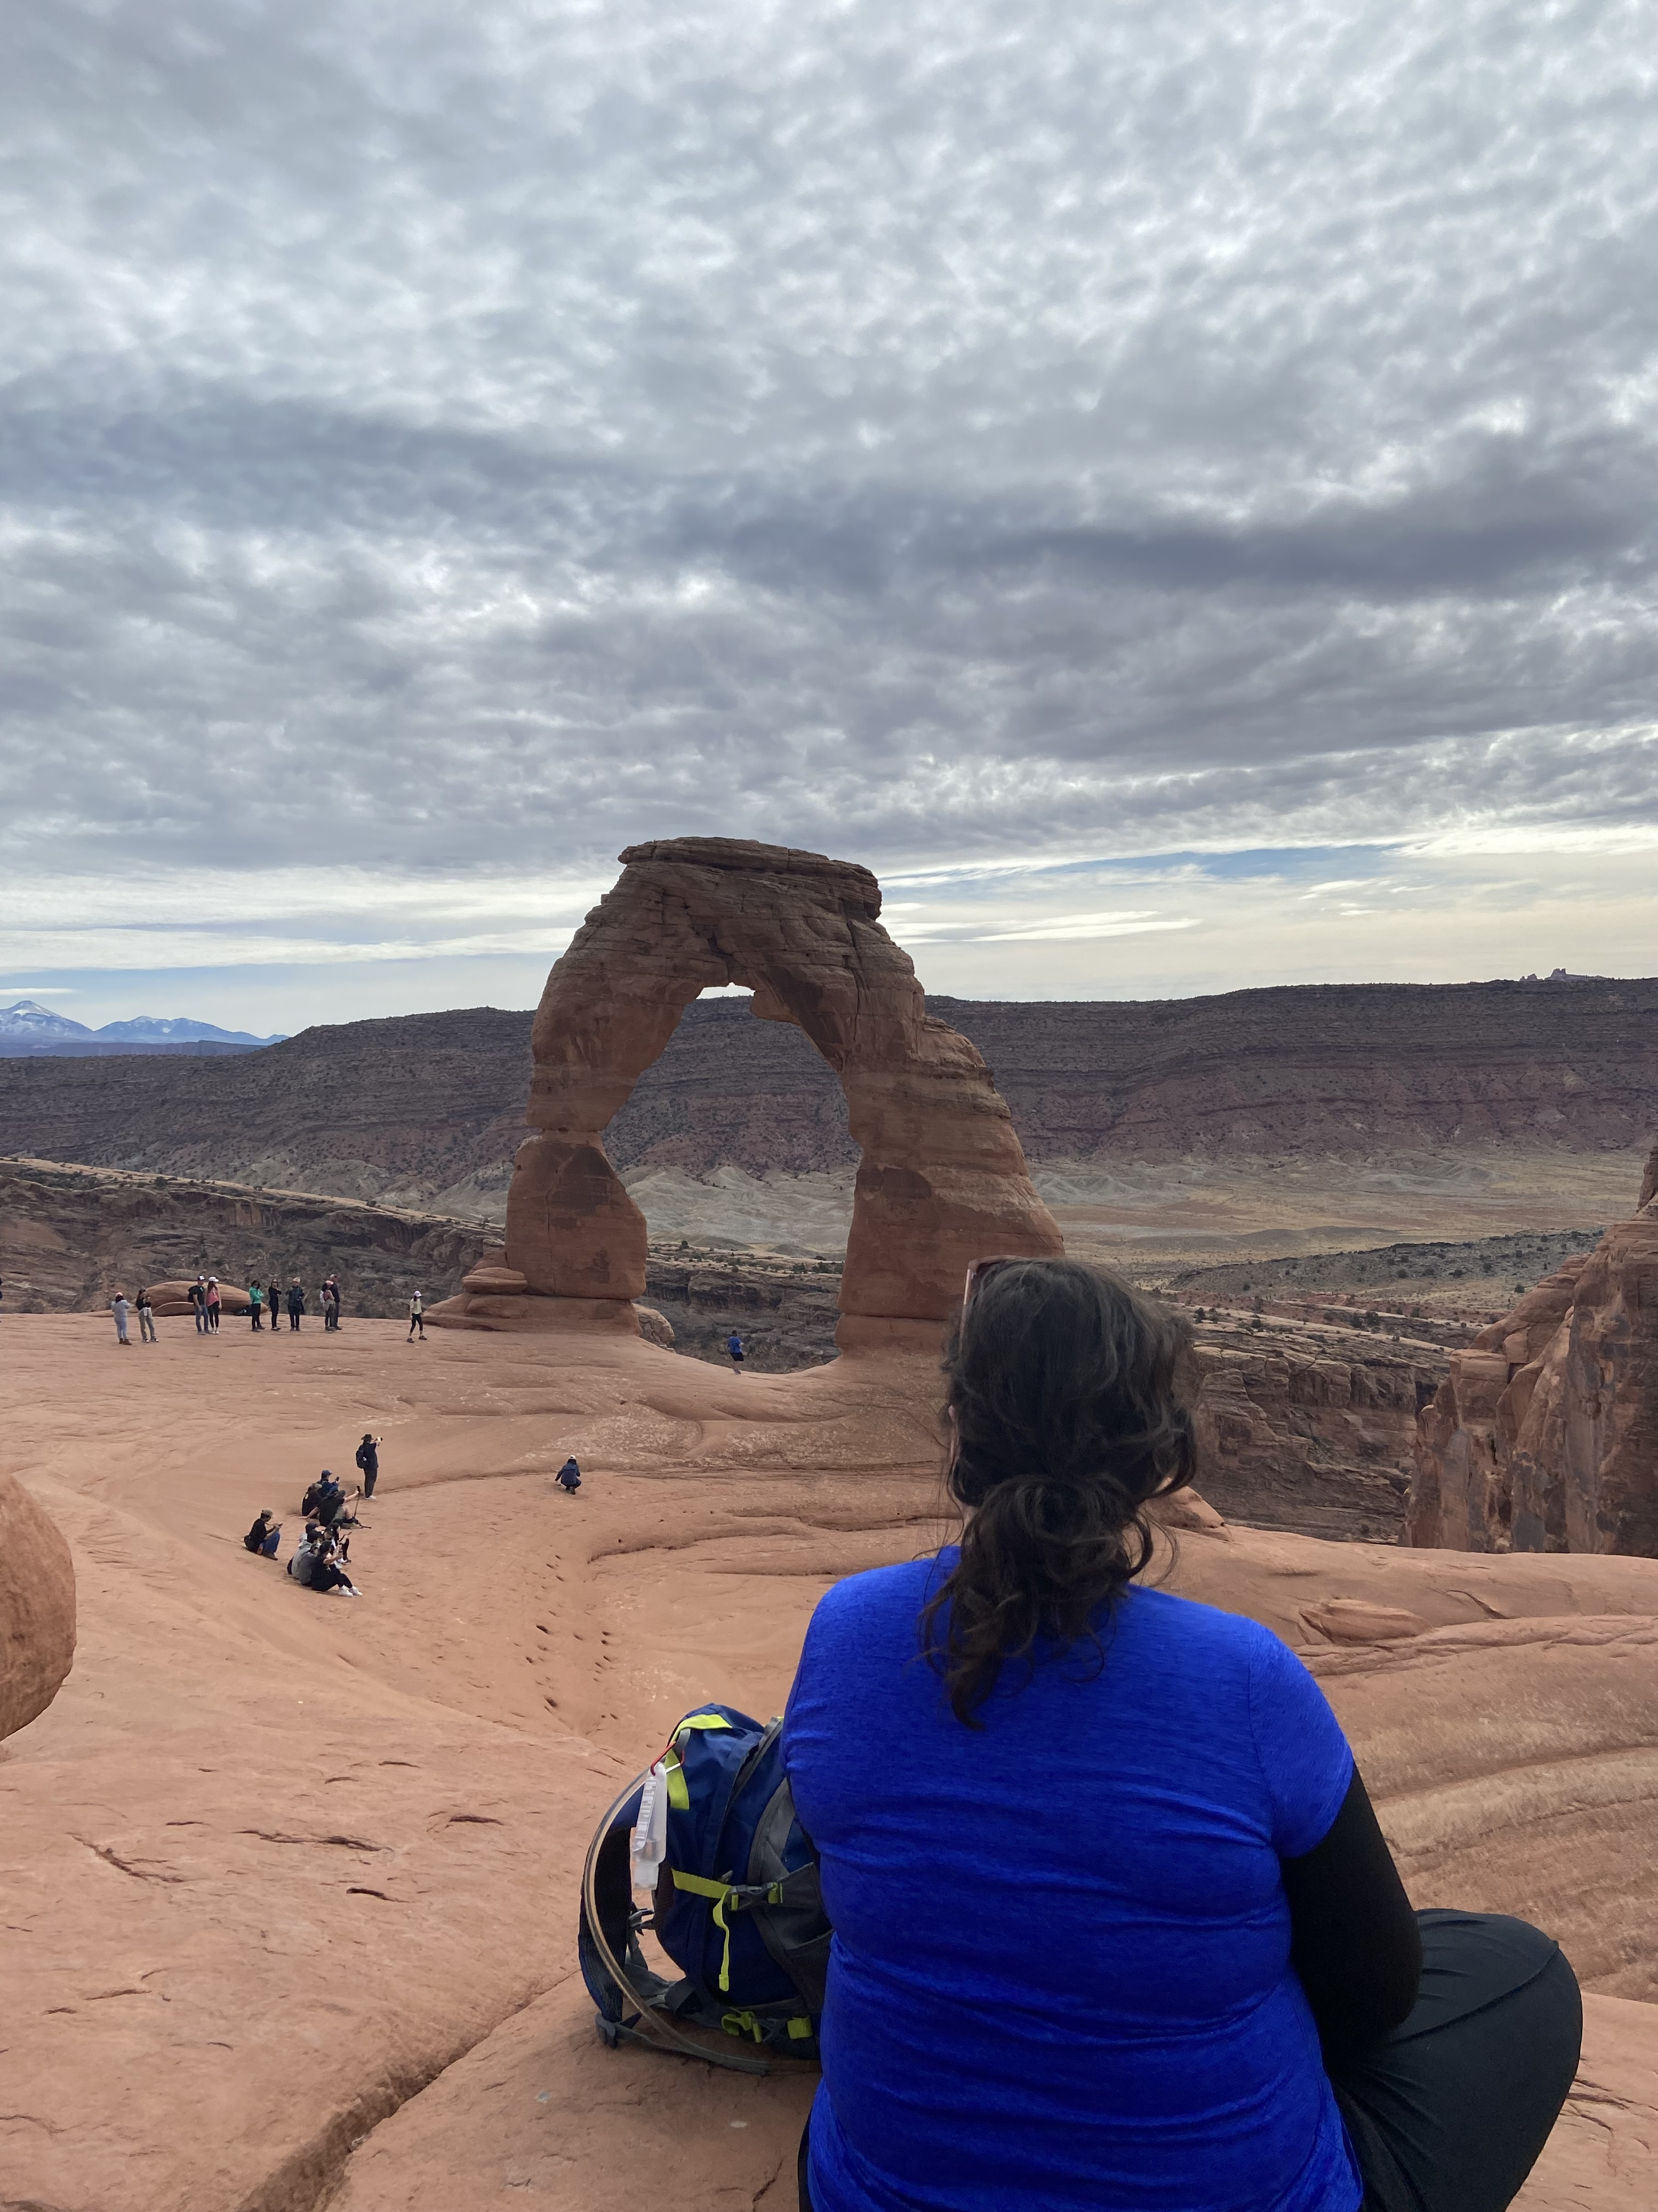
Establish language scripts for the task

Slide 12
Example: Hiking
Materials
Somewhere to hike to :)
Water/Backpacks
The Steps
Cultural awareness
Hike to the location
Trail, backpack, yield, greet, arch, marker
Excuse me. Would you ____ for us?
Arrive at the goal with the group, appropriate interactions with other people

Slide 13
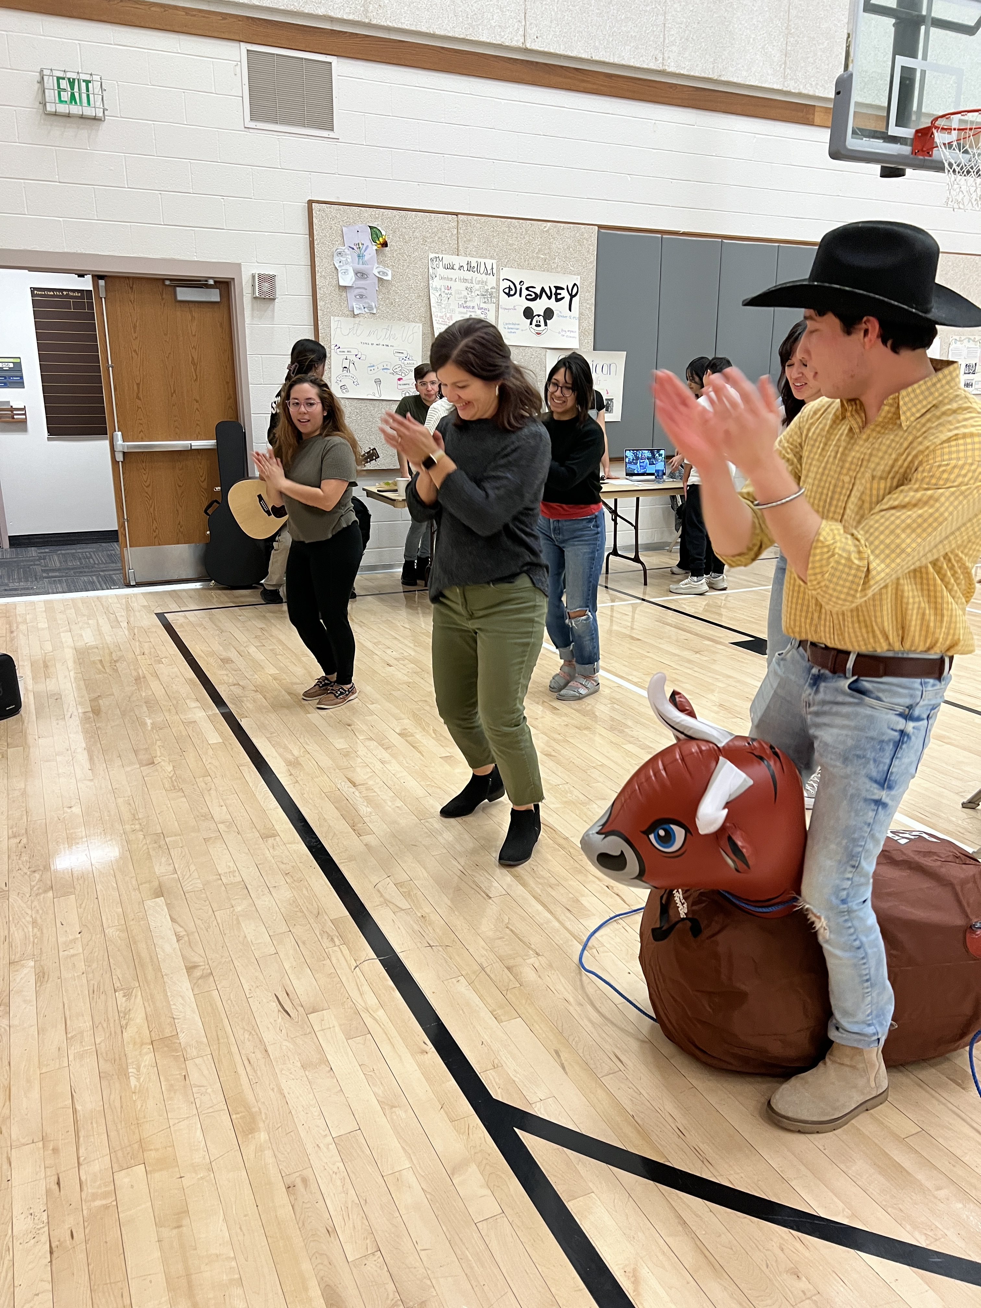
Define successful completion
What is the rubric for successful language use?
What is the rubric for a successful task?
Provide feedback on all parts of the task

Slide 14
Example: Line Dancing
Materials
A YouTube video to teach you first :)
Music
The Steps
Follow instructions, group participation
Dance
Step, cross, go back, clap, spin
No scripts :) this is about embodied learning of vocabulary and cultural experience
Correct steps, listening, following partners

Slide 15
Practice: Paper Airplanes
Materials
Paper
The Steps
Make decisions as a team
Make a paper airplane
Fold, crease, bend, nose, wings, body
First, second, third, next, steps
A paper airplane that flies, describe the steps, everyone is involved

Slide 16

Brainstorm
What activities could you try?
  Limited resources: paper, tape, scissors, soda bottles, straws

Slide 17
More Activities
The tea on slang
Song analysis
Cultural presentations
Product investment pitches
Blind artist
Paper airplanes
Podcasts
Poster sessions
Multi-media scavenger hunts
Skits

