Slide 1

Interactive Grammar Instruction
Andrea Gonzalez, BYU ELC

Slide 2
Grammar Teaching
How many of you like English grammar?
How many of you like teaching English grammar?
How do students usually feel about grammar?
Can grammar really be interesting and fun?

Slide 3
The BEST thing about grammar
It can (and should!) be used in all other skill areas
  Listening
  Speaking
  Writing
  Reading

Slide 4
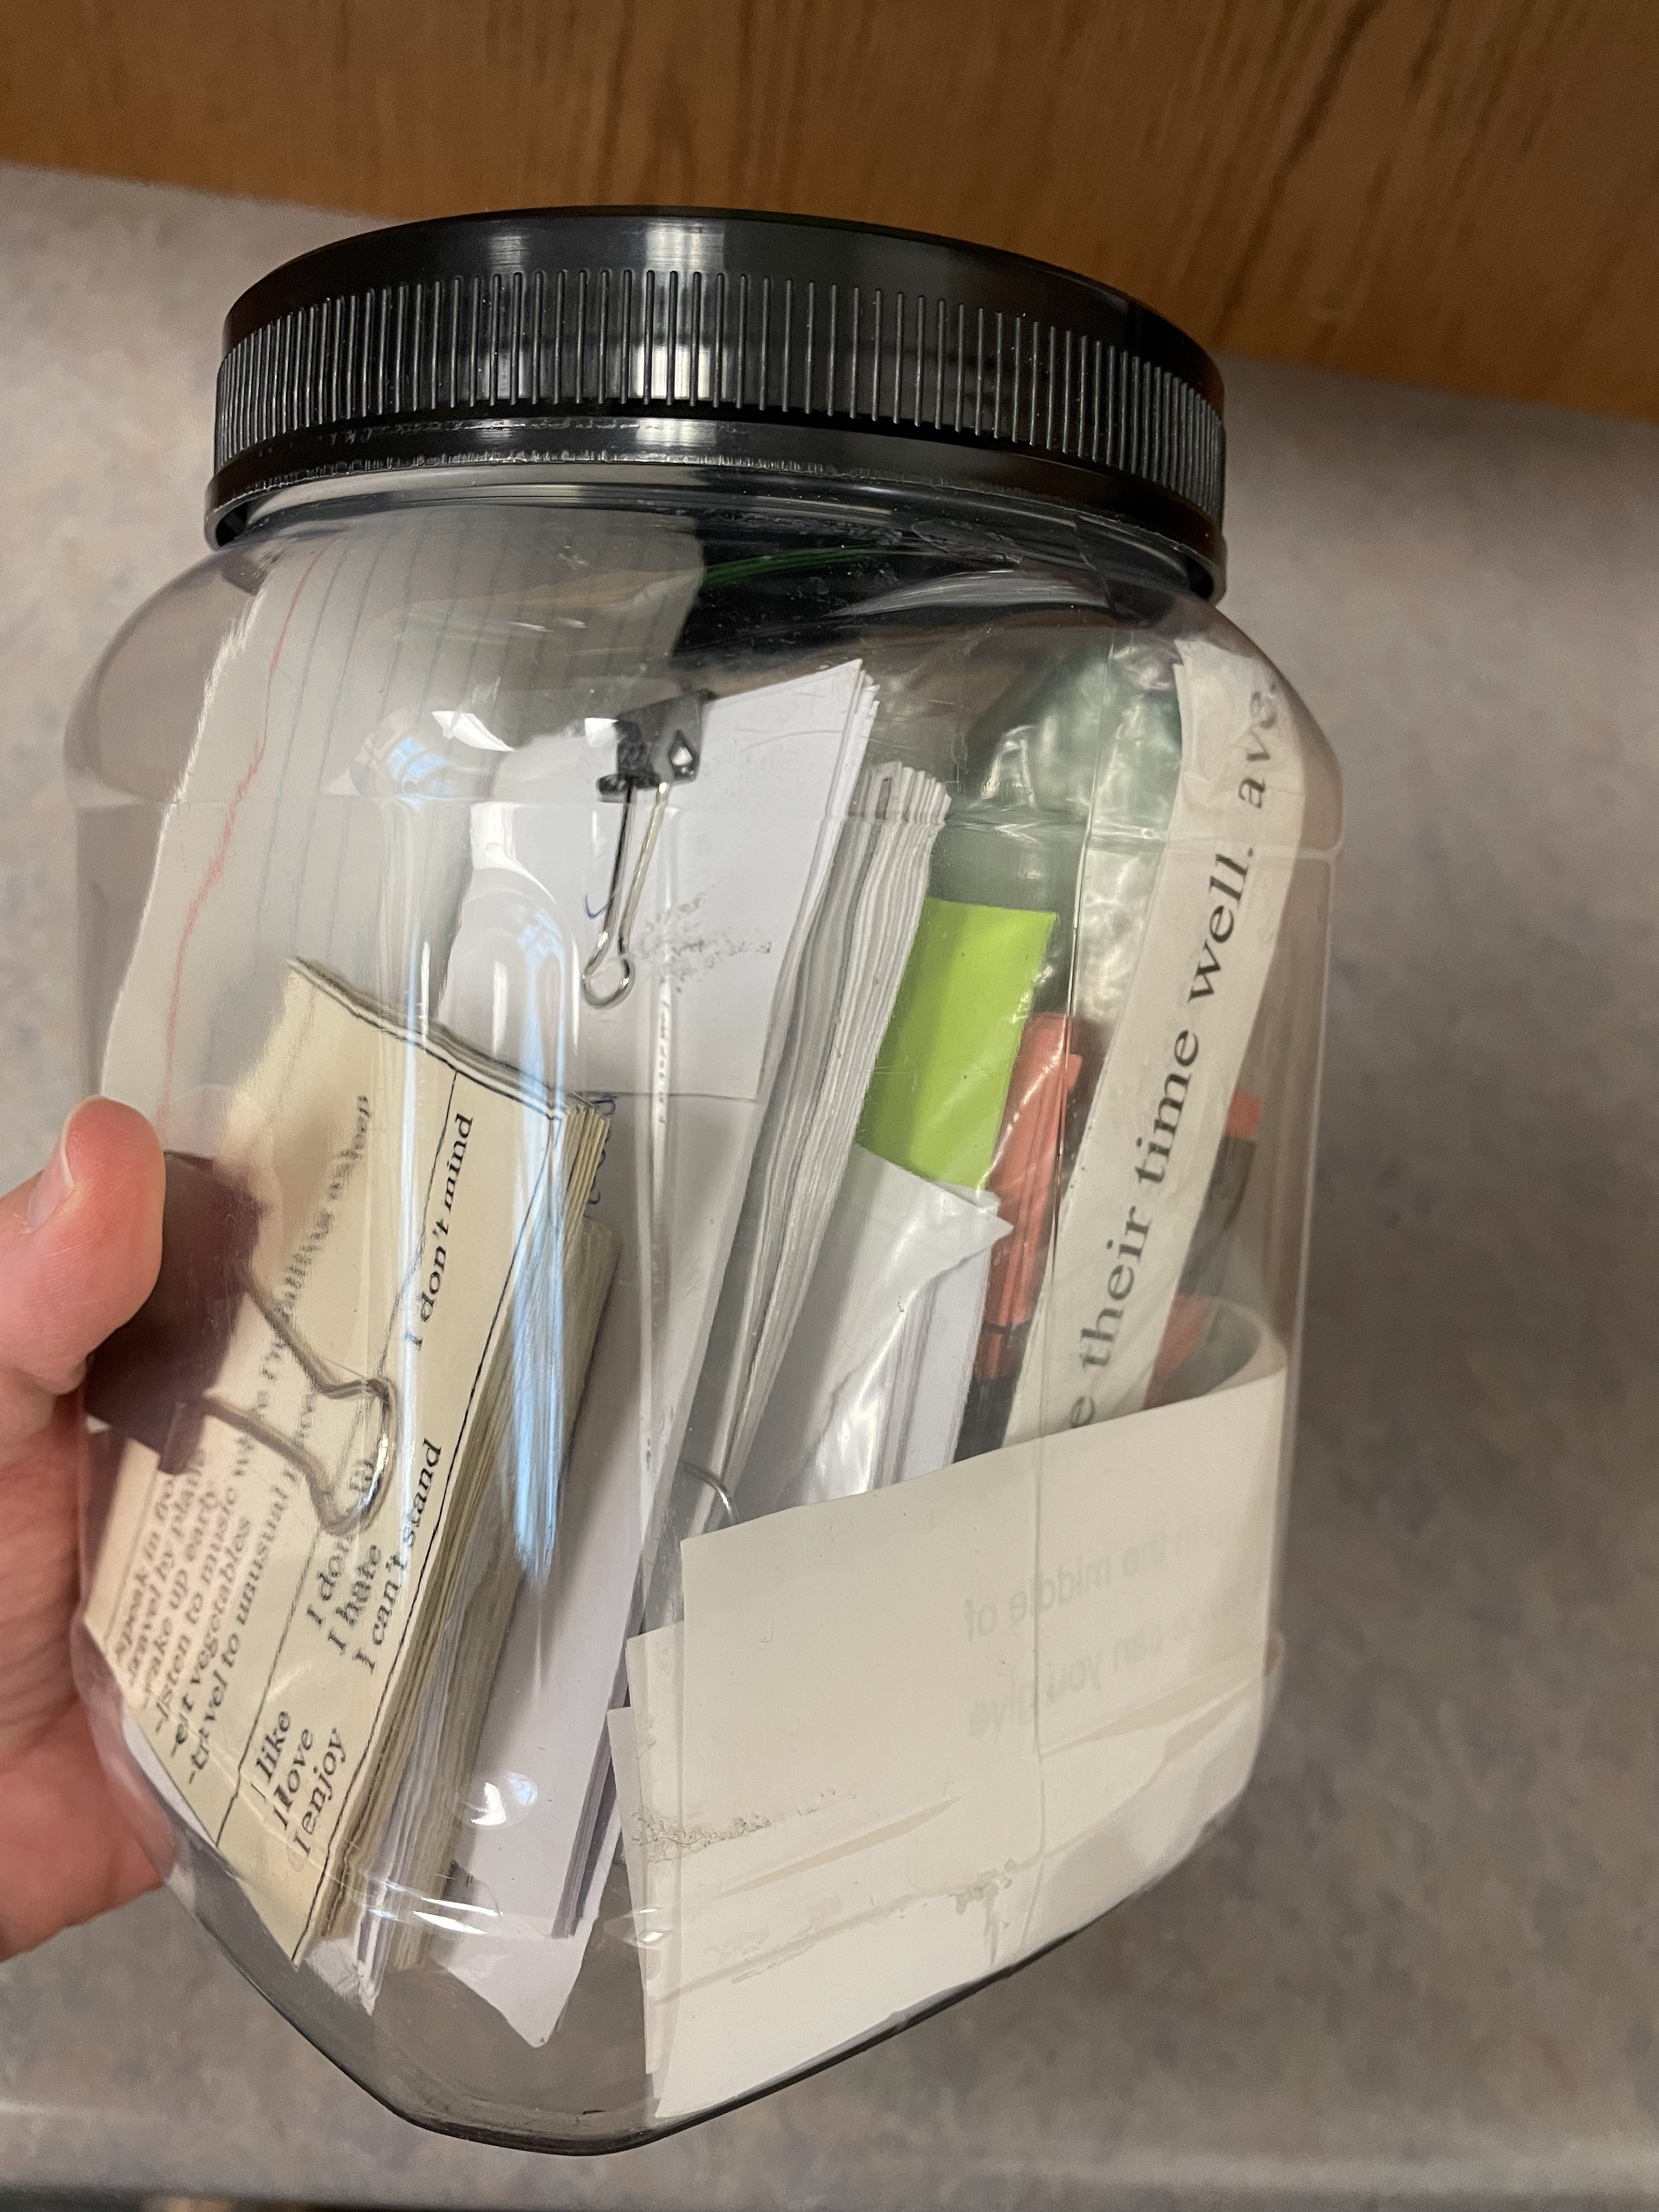
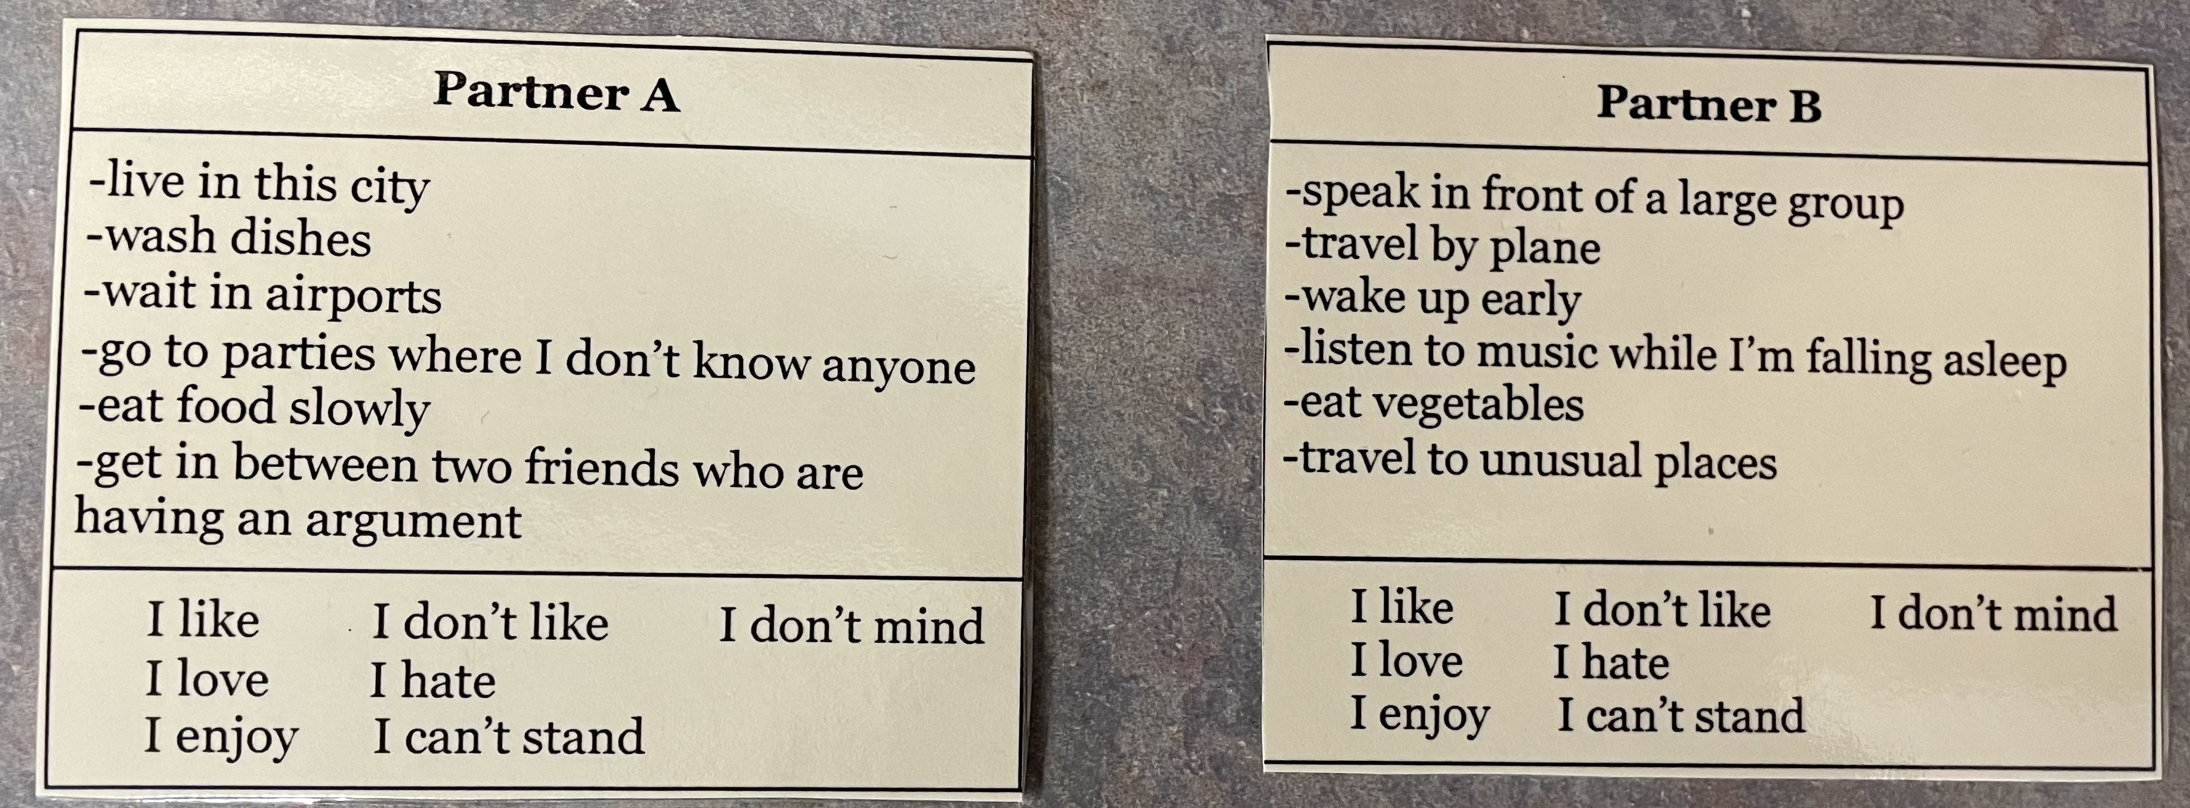
Helpful Tips
Make it your own – be creative!
Share ideas with other teachers
Use curriculum materials in different ways

Slide 5
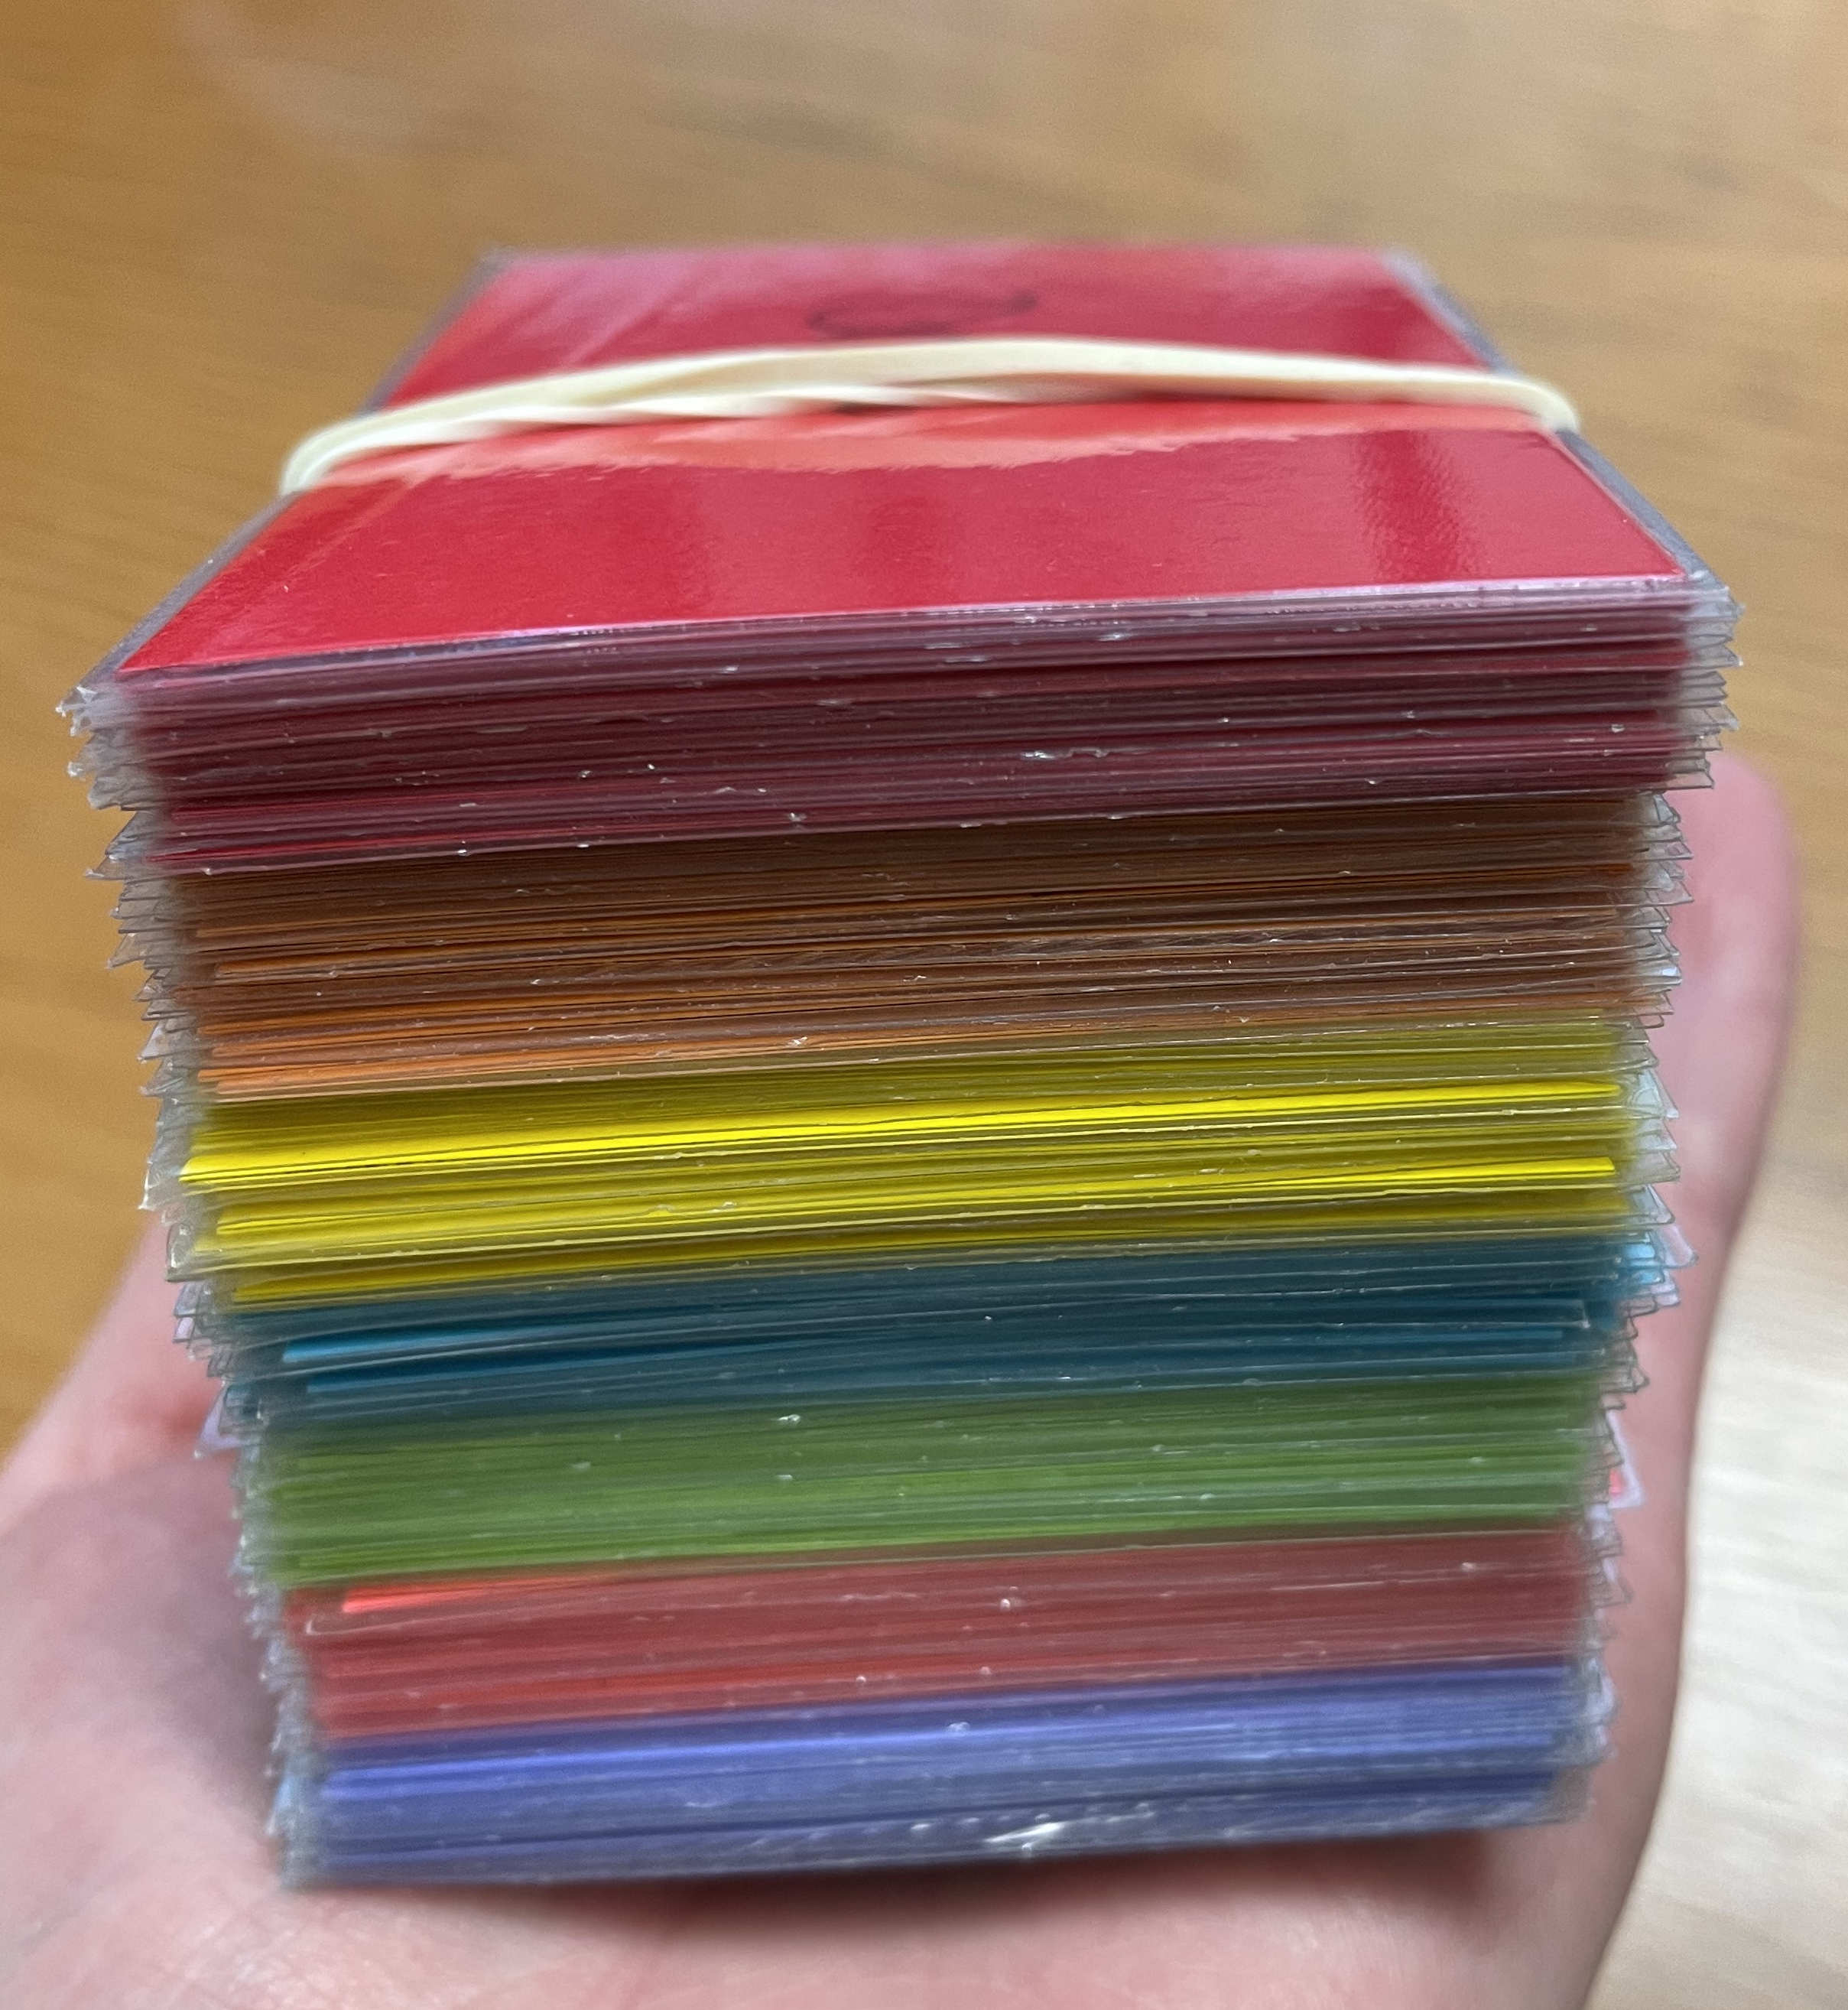
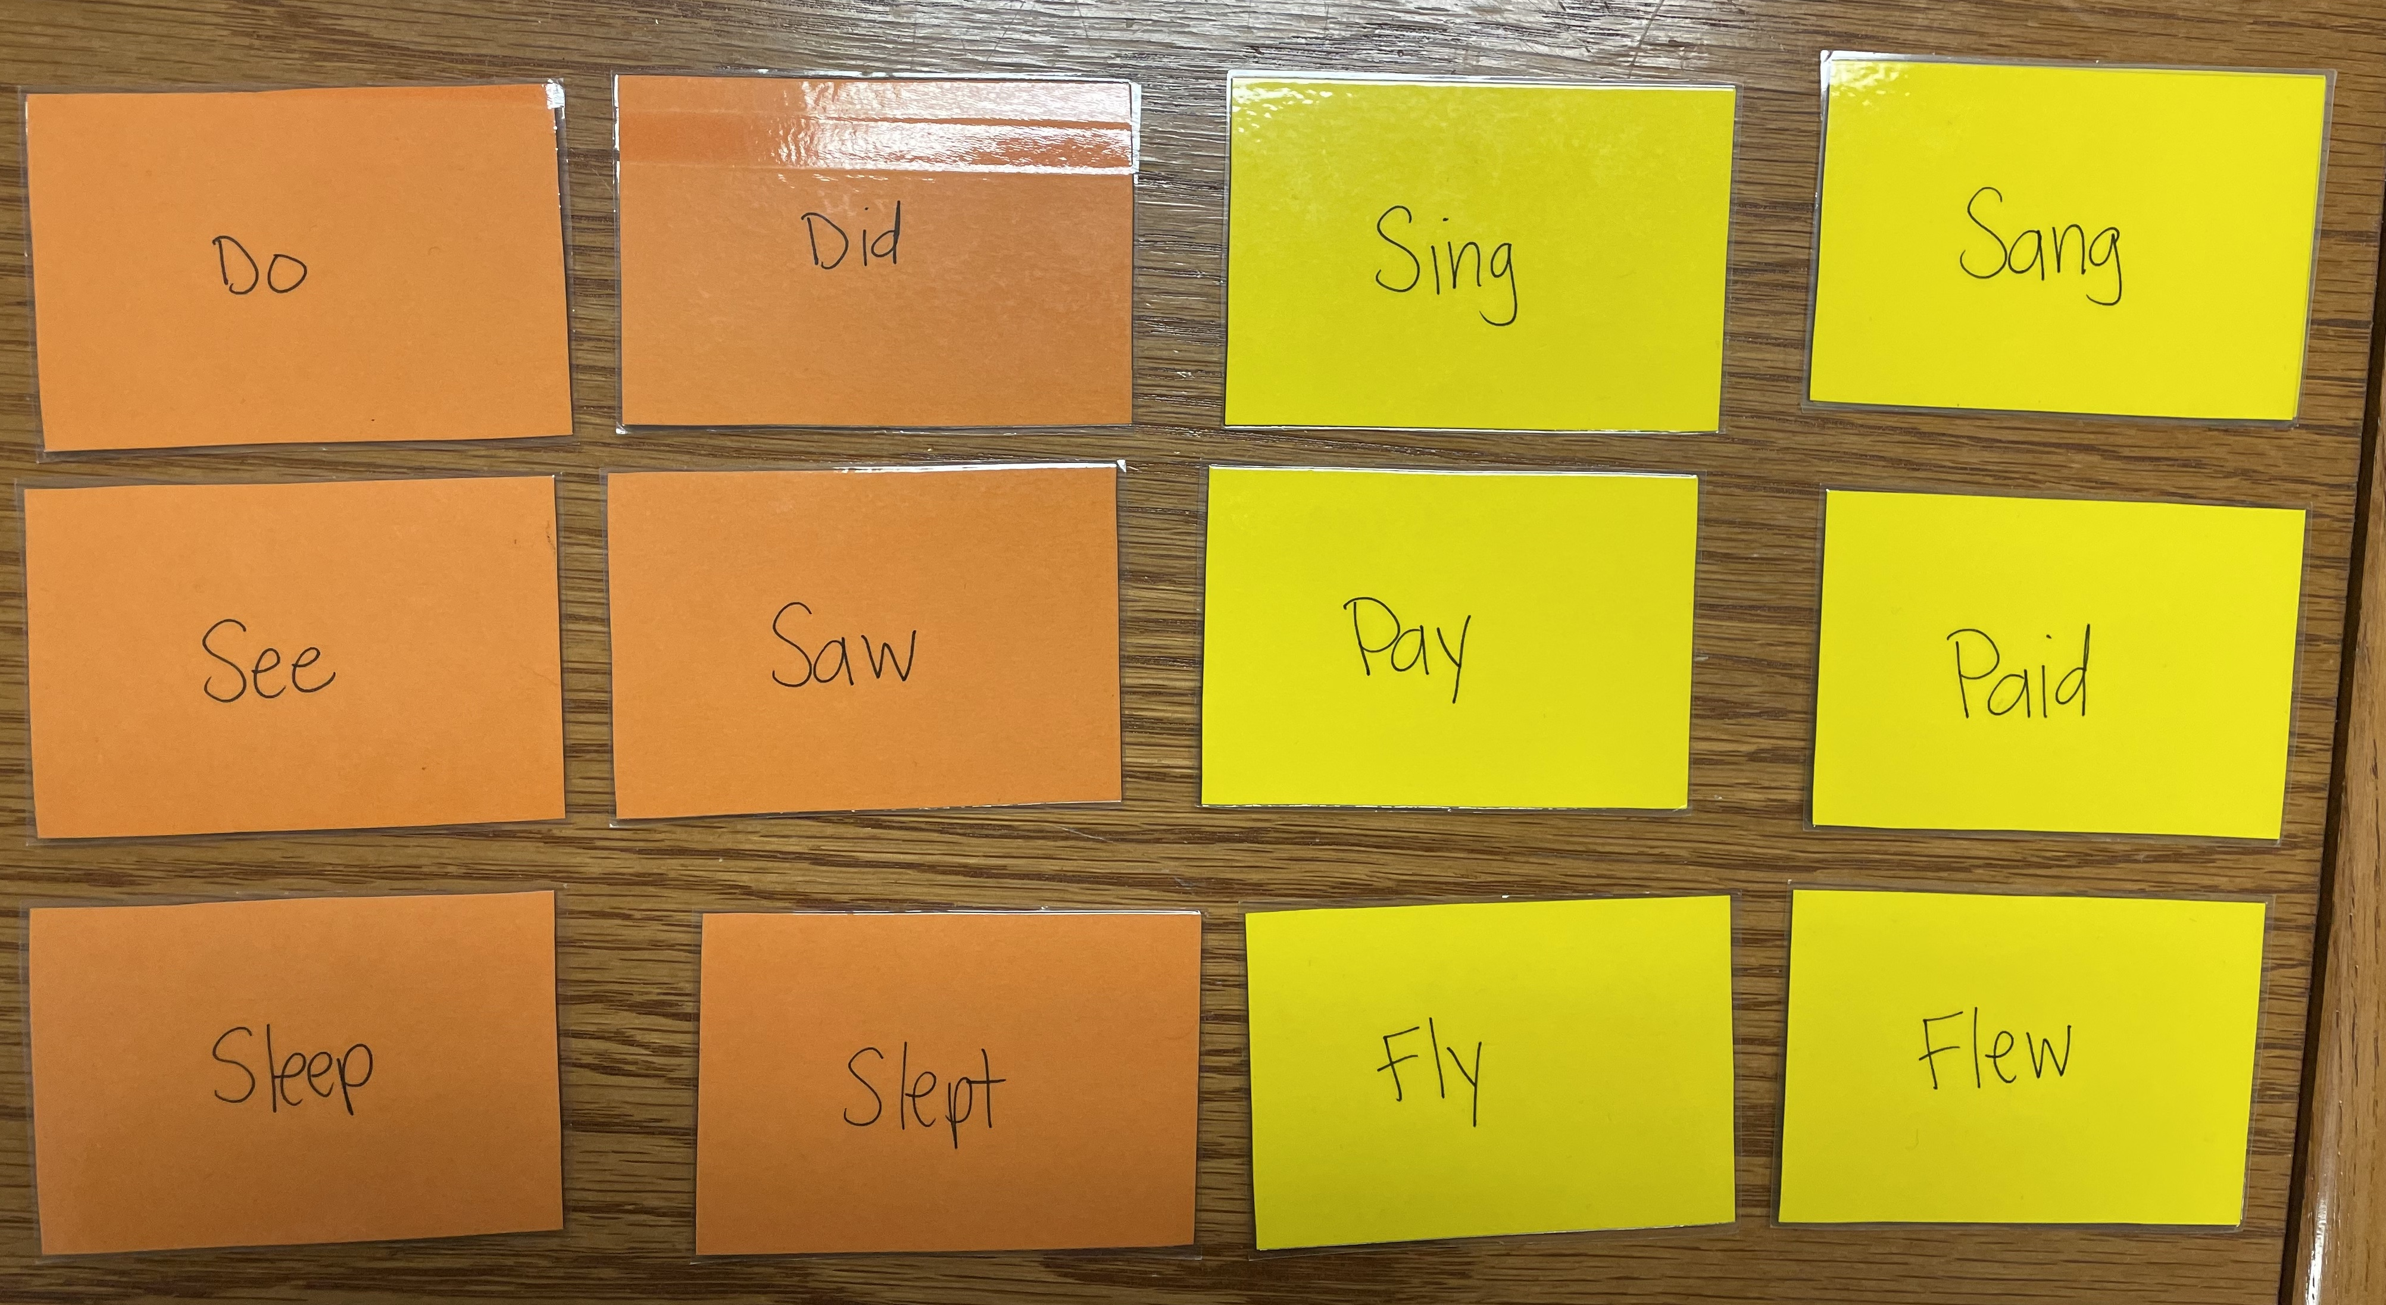
Irregular Verbs
Memory cards
  Irregular past
  Past participles
How I use them
  Review activity
  Introduction activity
  Practice
Let's do it!

Slide 6


Conditionals
If I (simple past) _____, I would _____.
Trip to Paris
One million dollars

Slide 7
Present Perfect
Game: Never Have I Ever
Rules: The person in the middle says something they have never done. If the people sitting have done it, they move seats while the middle person tries to sit down. The last person standing goes next.
Tip: I have never ______.
Uses present perfect (have + past participle) and adverb

Slide 8

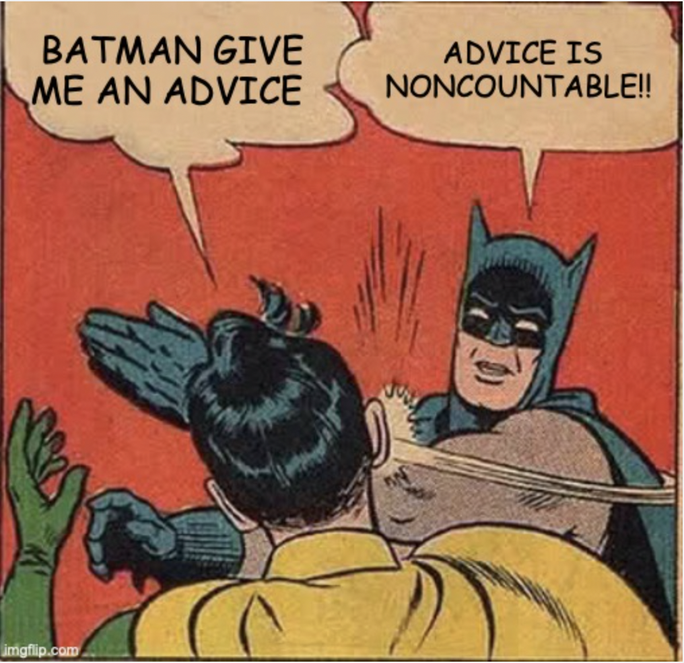
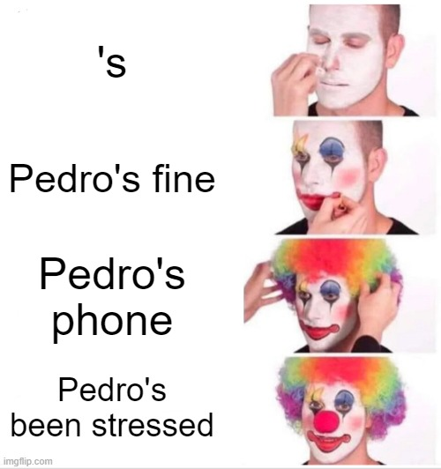
Memes
Meme generator https://imgflip.com/memegenerator
Give students specific grammar to use

Slide 9
Fun with Grammar

Slide 10
Reflection
Think about your classes now. What is something we talked about that you could use?
How will you adapt one of these activities for your class?
What is your plan to make grammar more interactive?

