Slide 1

Interactive Vocabulary and Reading Activities

Slide 2
Interactive Vocabulary Activites

Slide 3

Hit the board (or screen)
Present or Review Vocabulary
Divide into teams
Form two lines
Three options
Say the word
Show the word (before or during)
Show the picture

Slide 4
Vocabulary Words
Apartment Building
Restaurant
Hospital
Library
School
Bus stop
Park
Museum

Slide 5
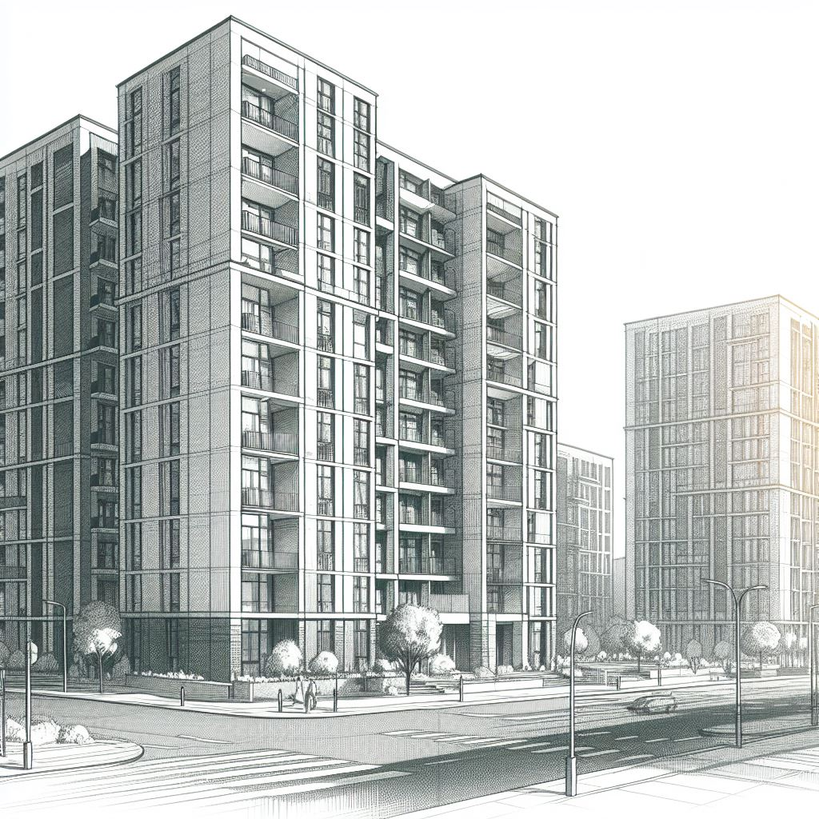
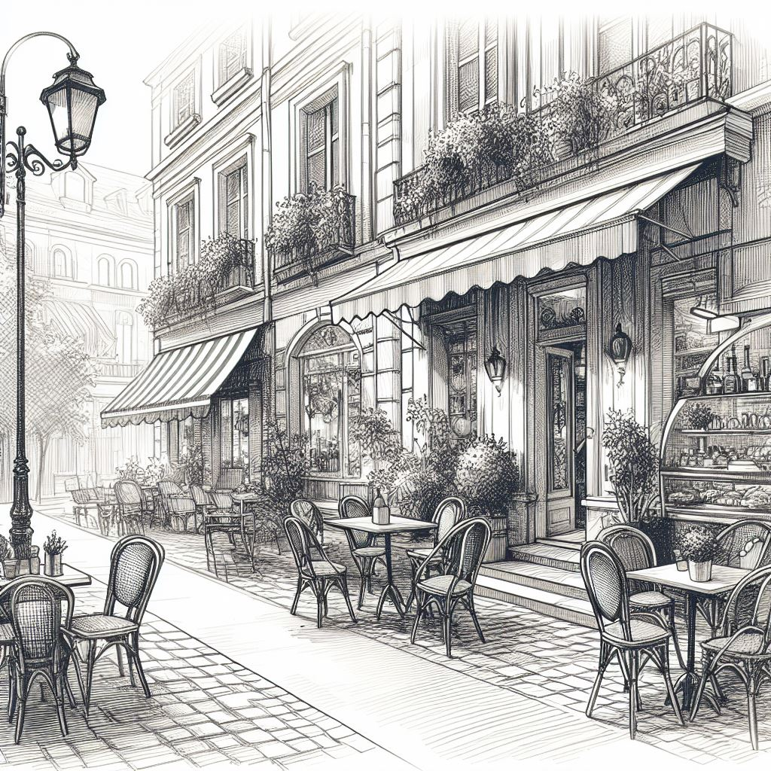
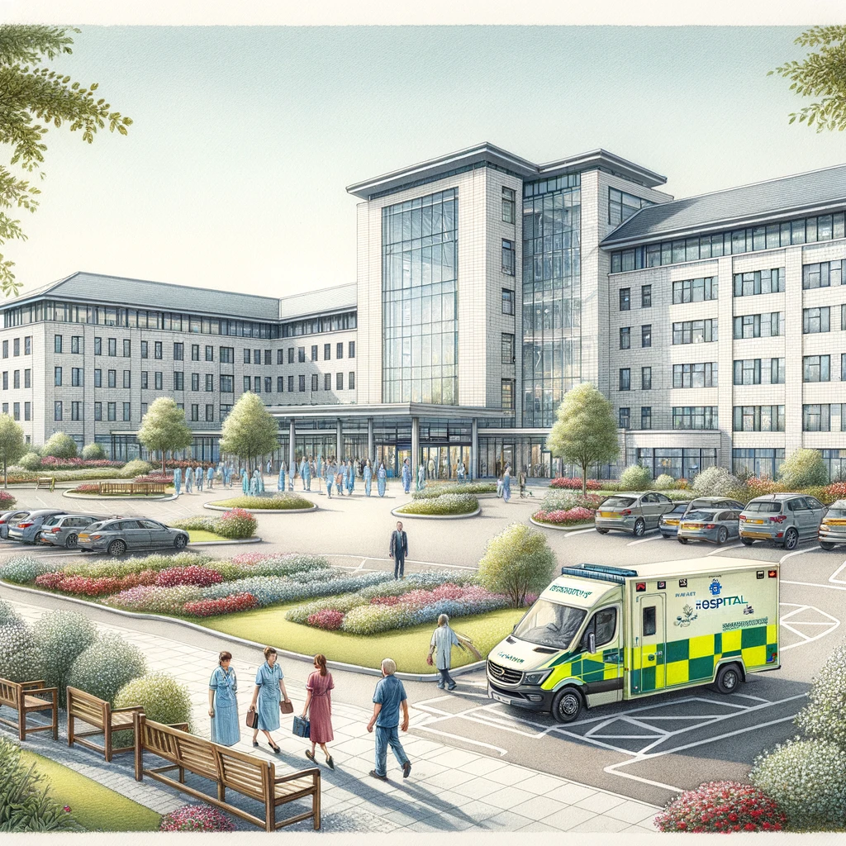
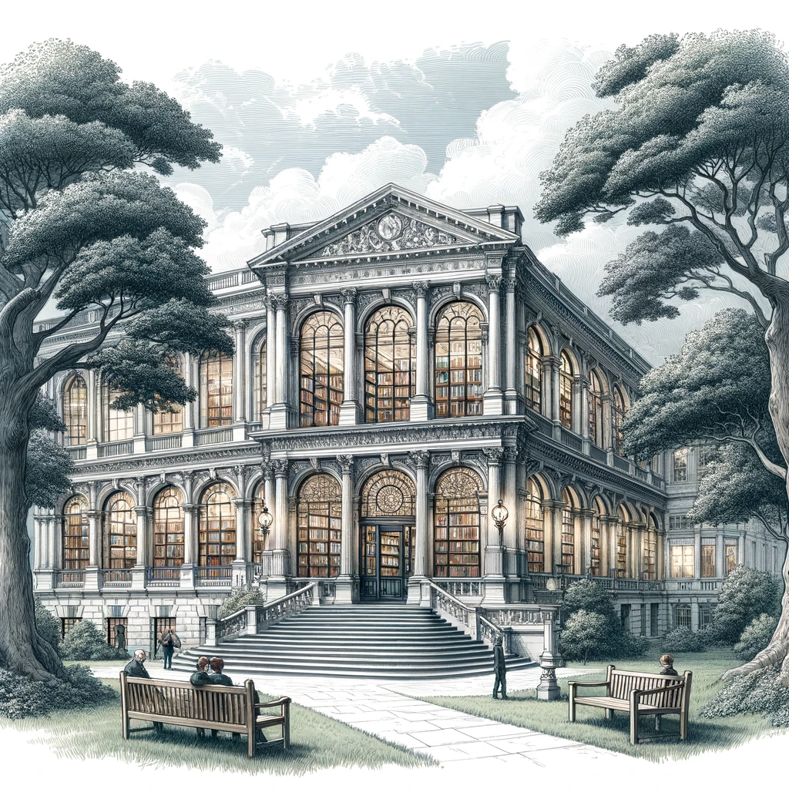
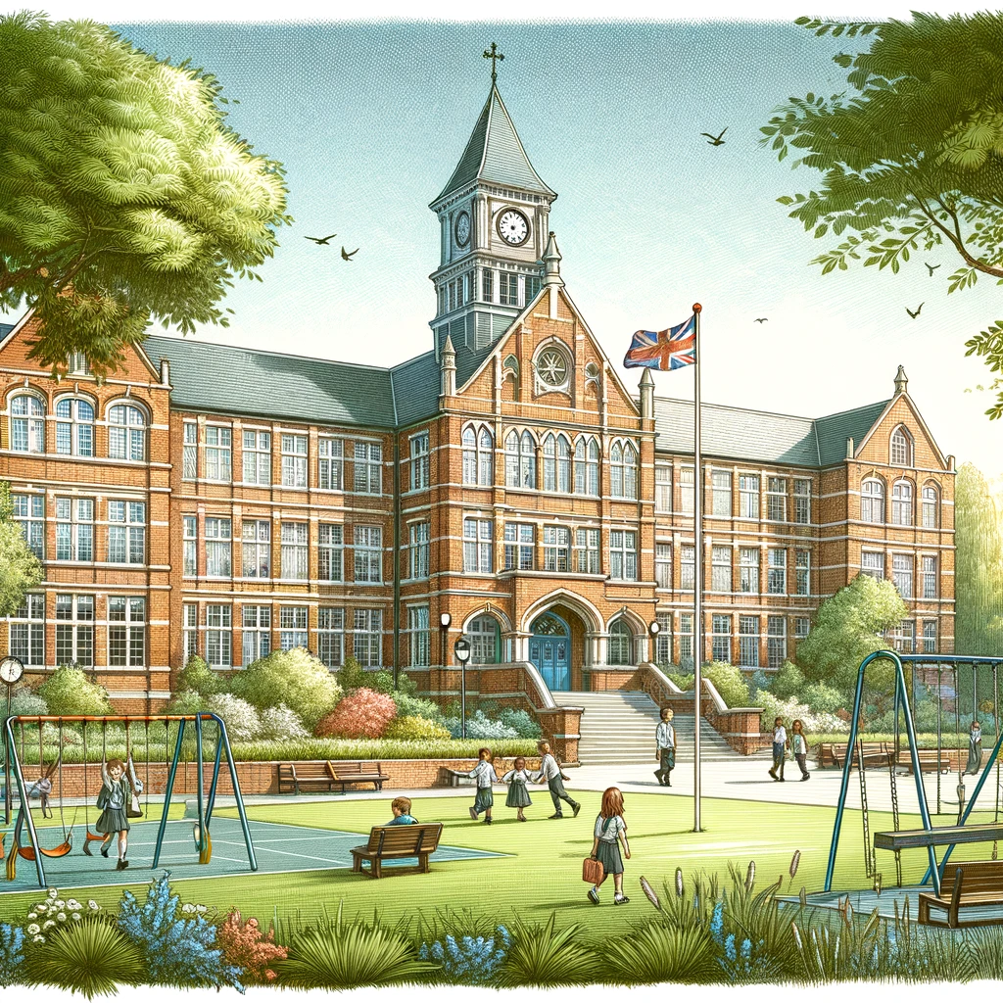
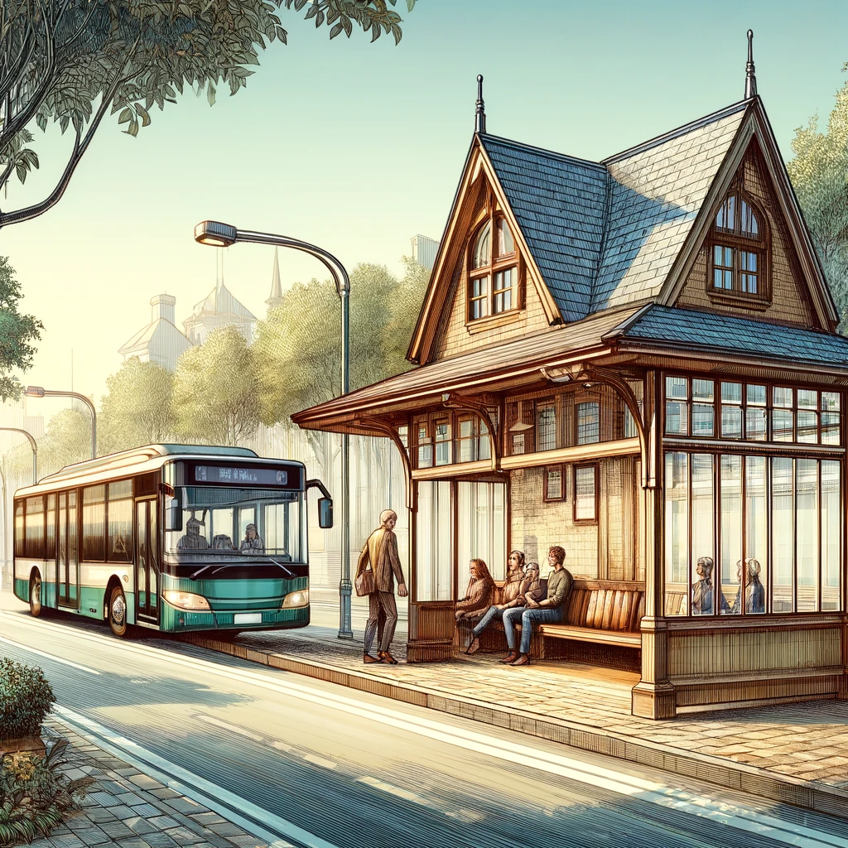
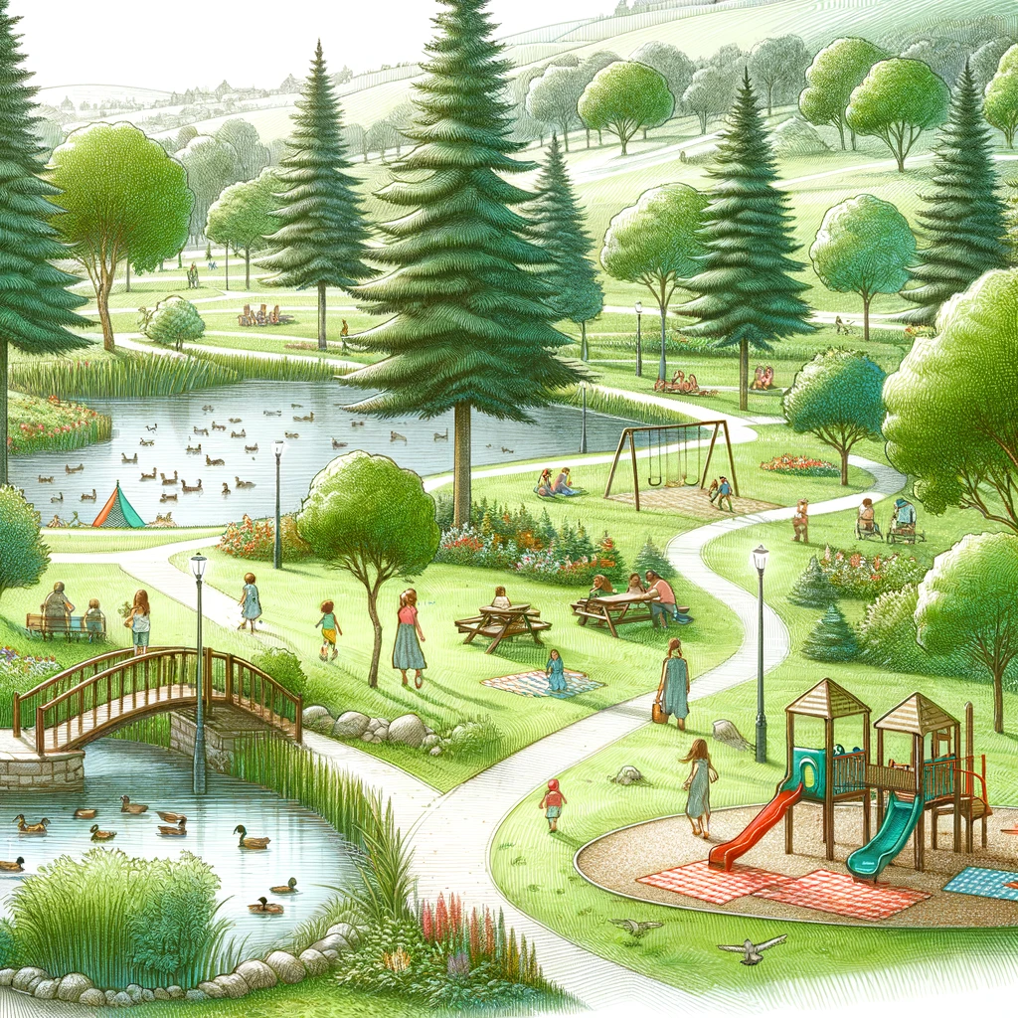
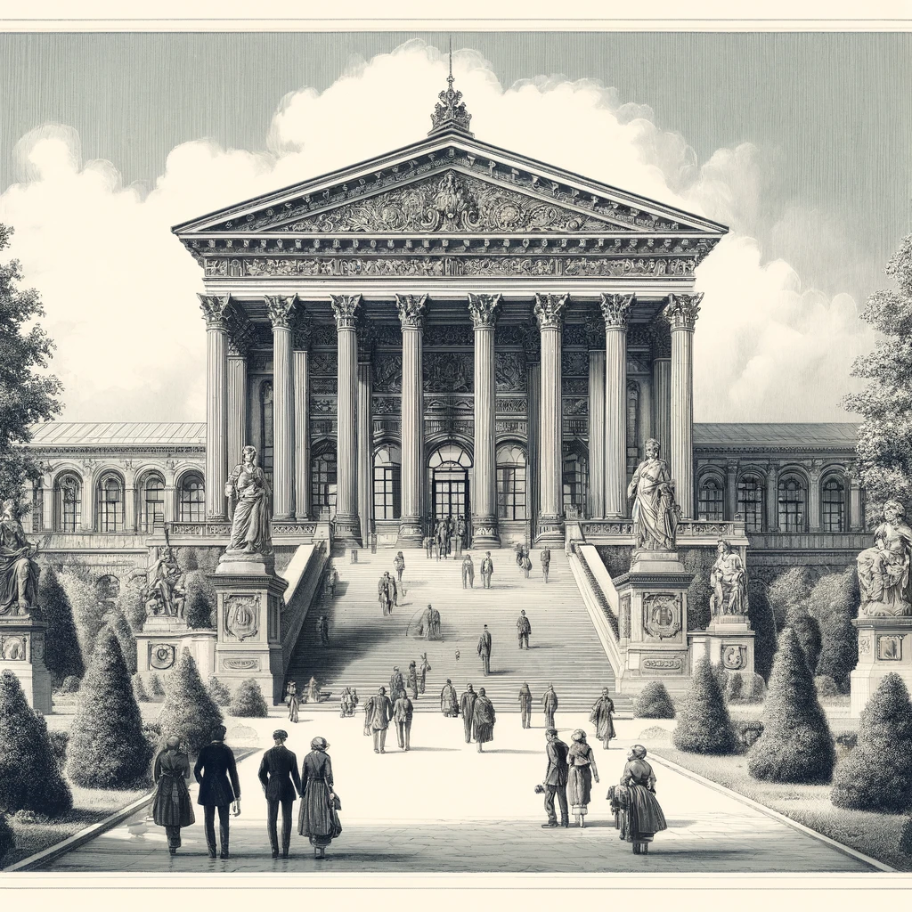
Apartment Building
Restaurant
Hospital
Library
School
Bus stop
Park
Museum

Slide 6
Let’s practice – Say the word

Slide 11
Let’s practice – See the word

Slide 12
Vocabulary Words
Pizza
Burger
Sushi
Taco
Pasta
Curry
Sandwich
salad

Slide 13



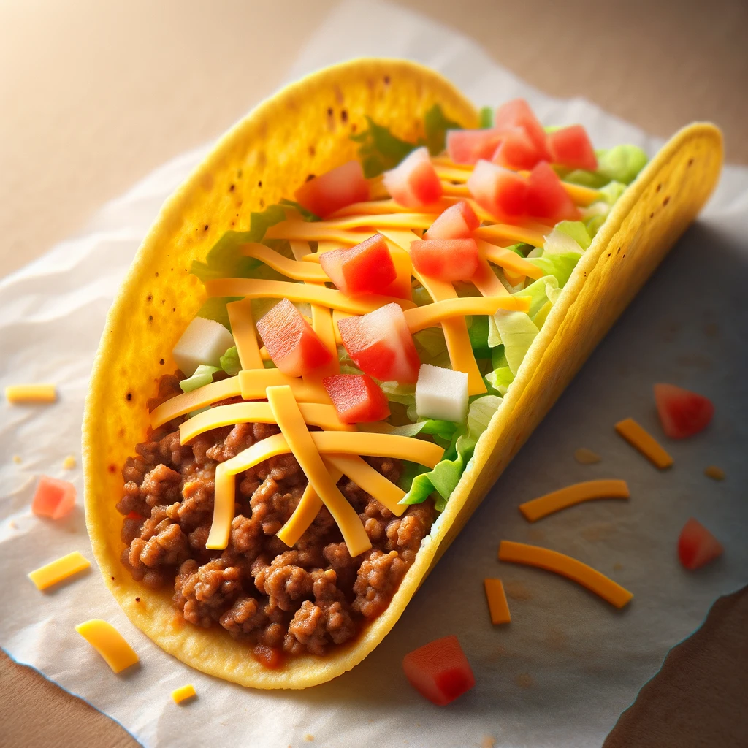
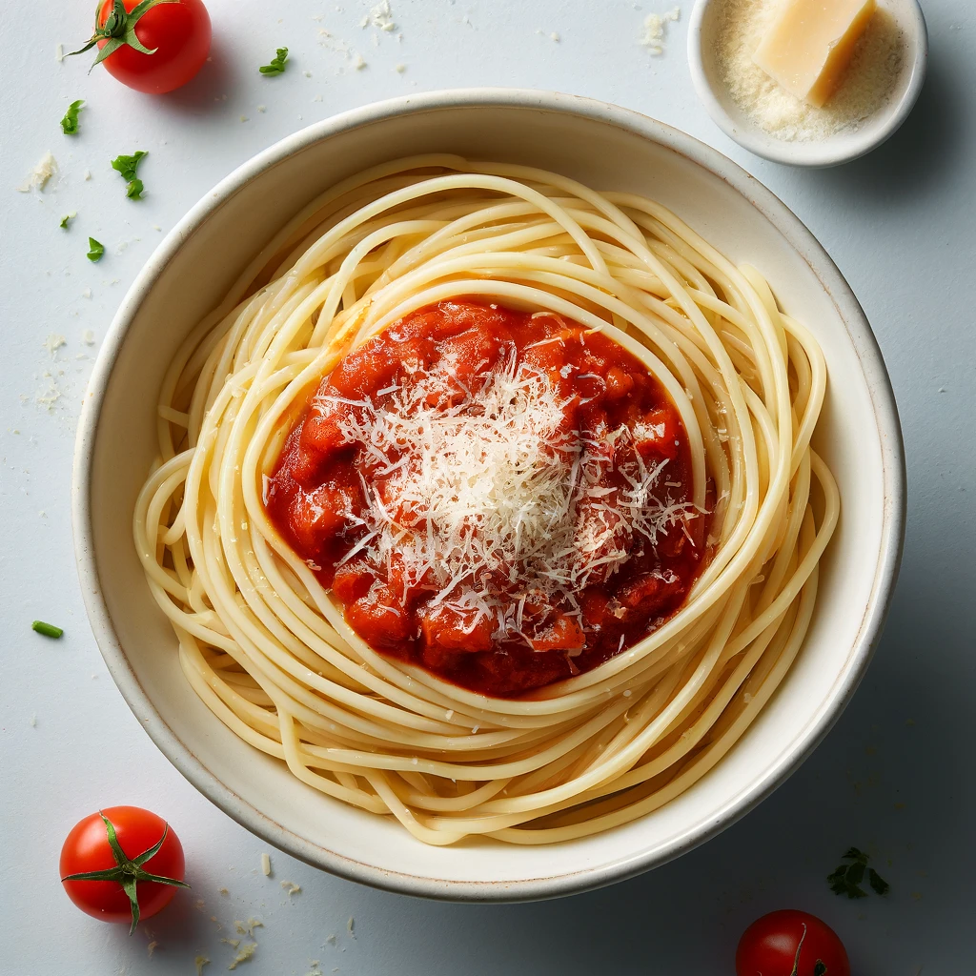

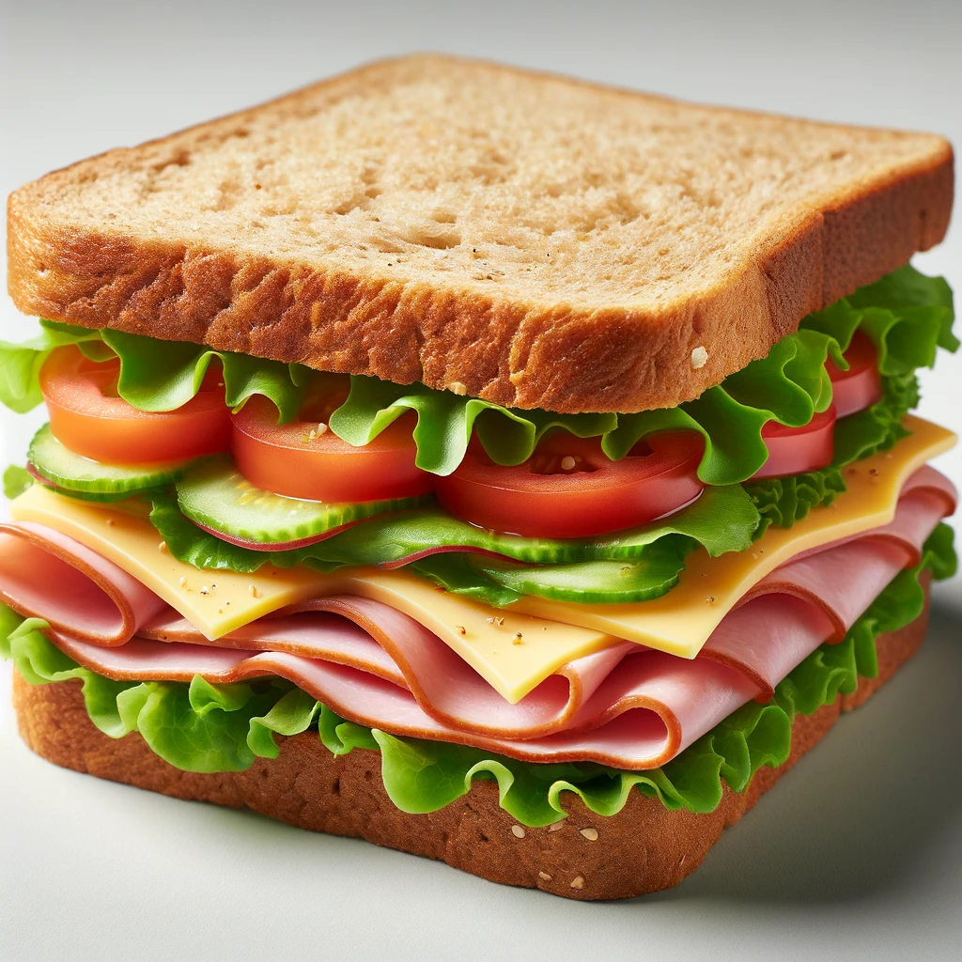
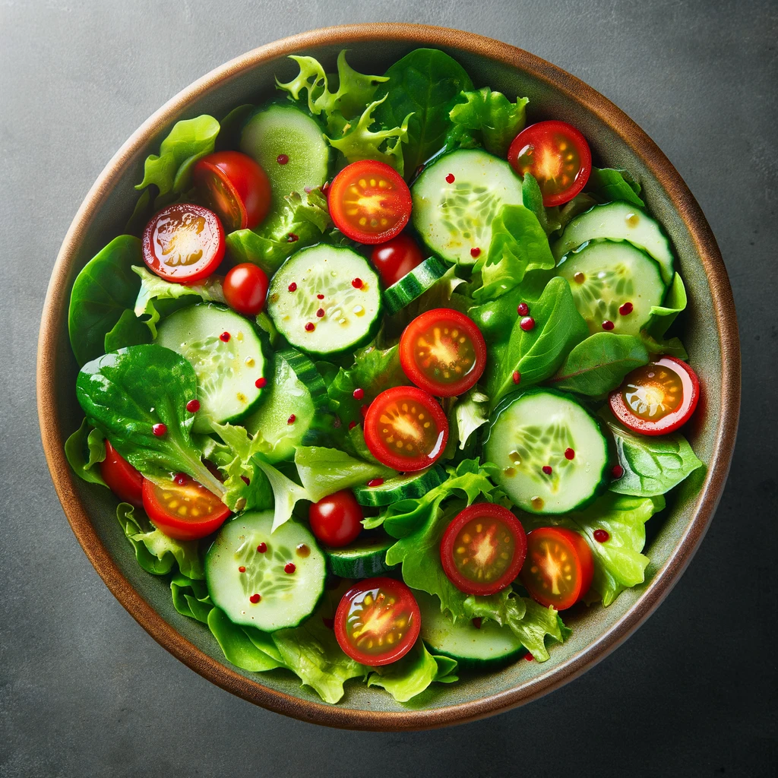
Pizza
Burger
Sushi
Taco
Pasta
Curry
Sandwich
salad

Slide 19
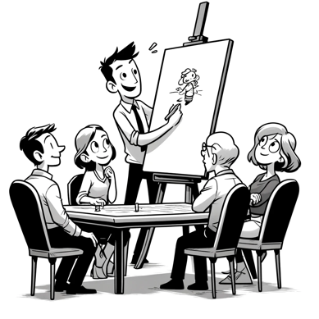
Pictionary
Present or Review Vocabulary
Divide into teams
Show the designated drawer the word
Start the timer and see which team guesses first.

Slide 20
Vocabulary Words
Table
Chair
Sofa
Bed
Cabinet
Dresser
Desk
Bookshelf

Slide 21
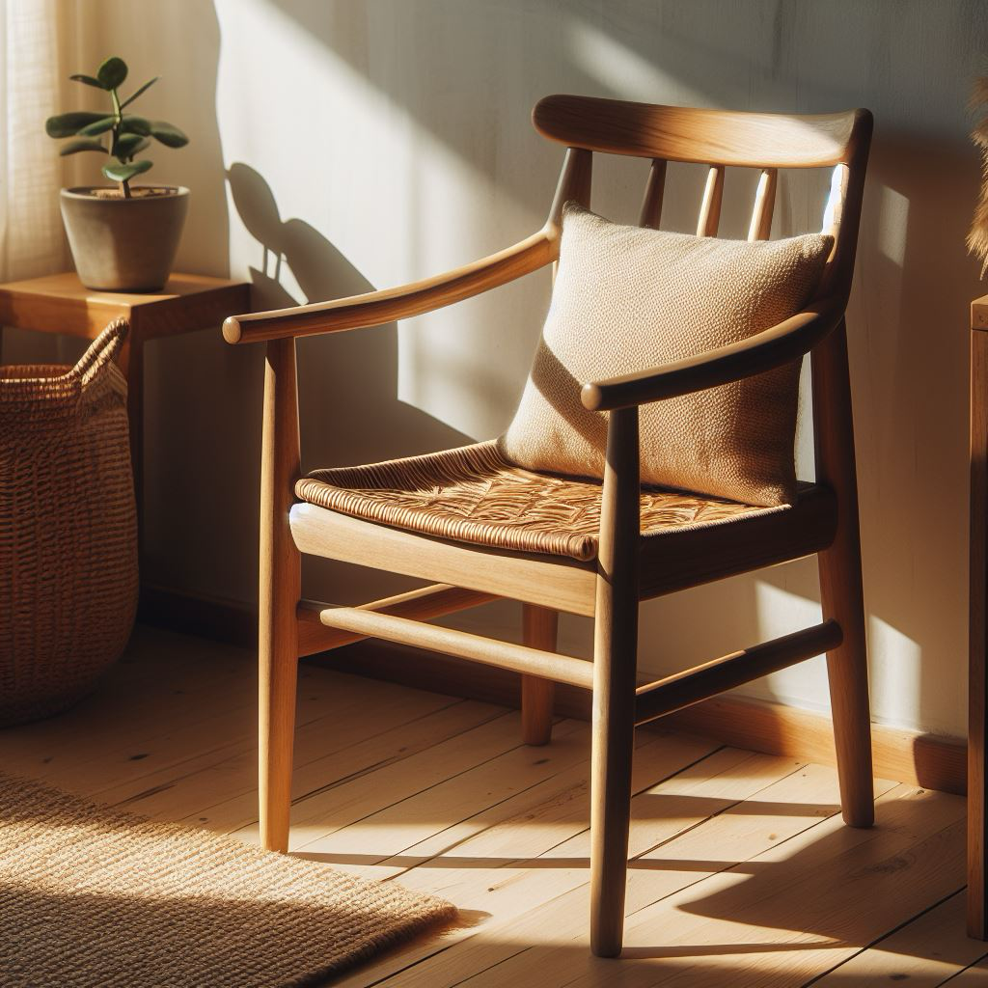


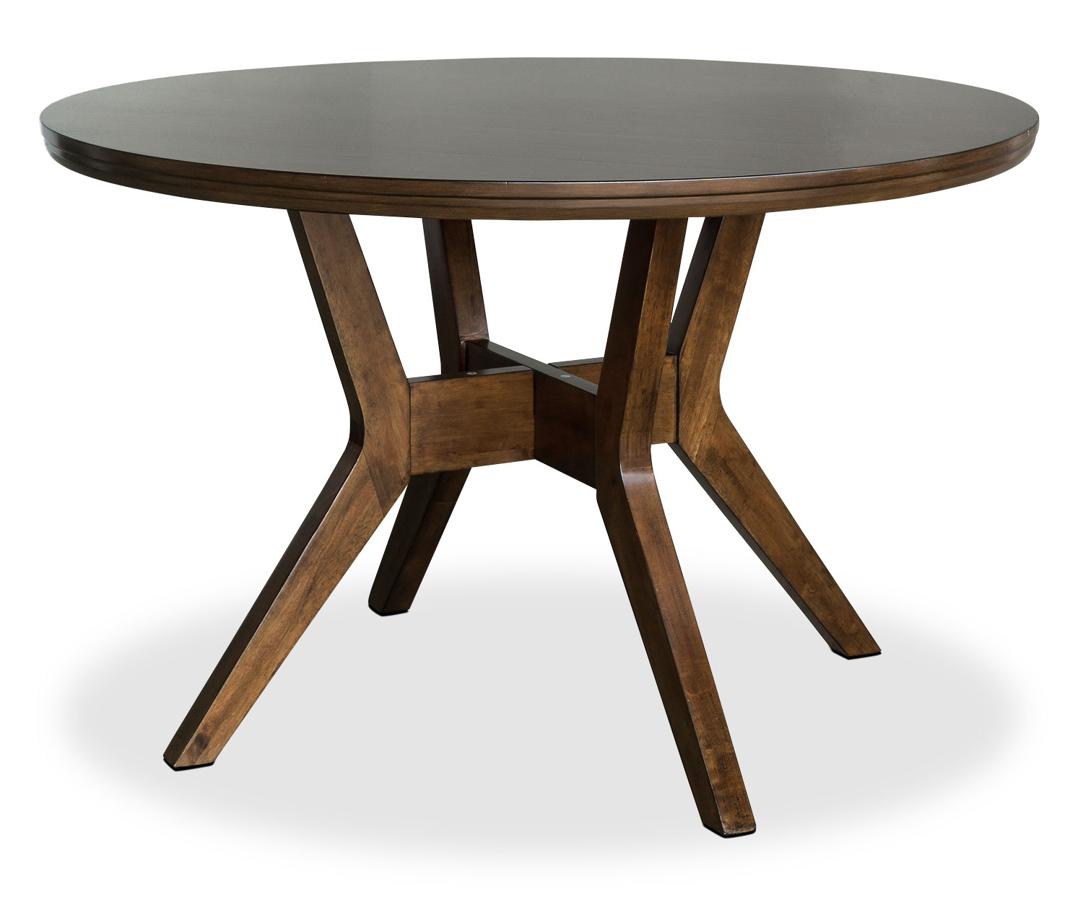
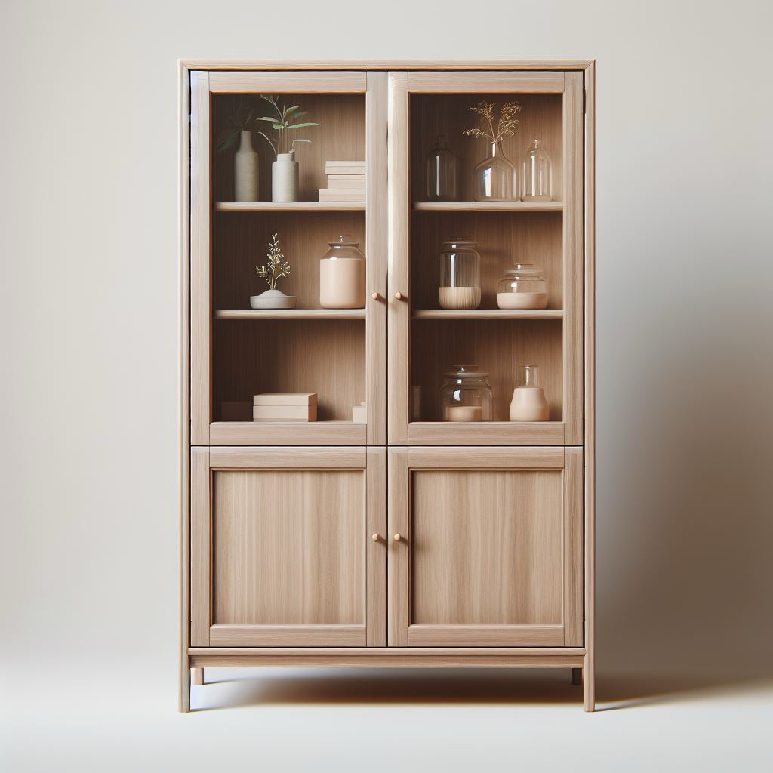
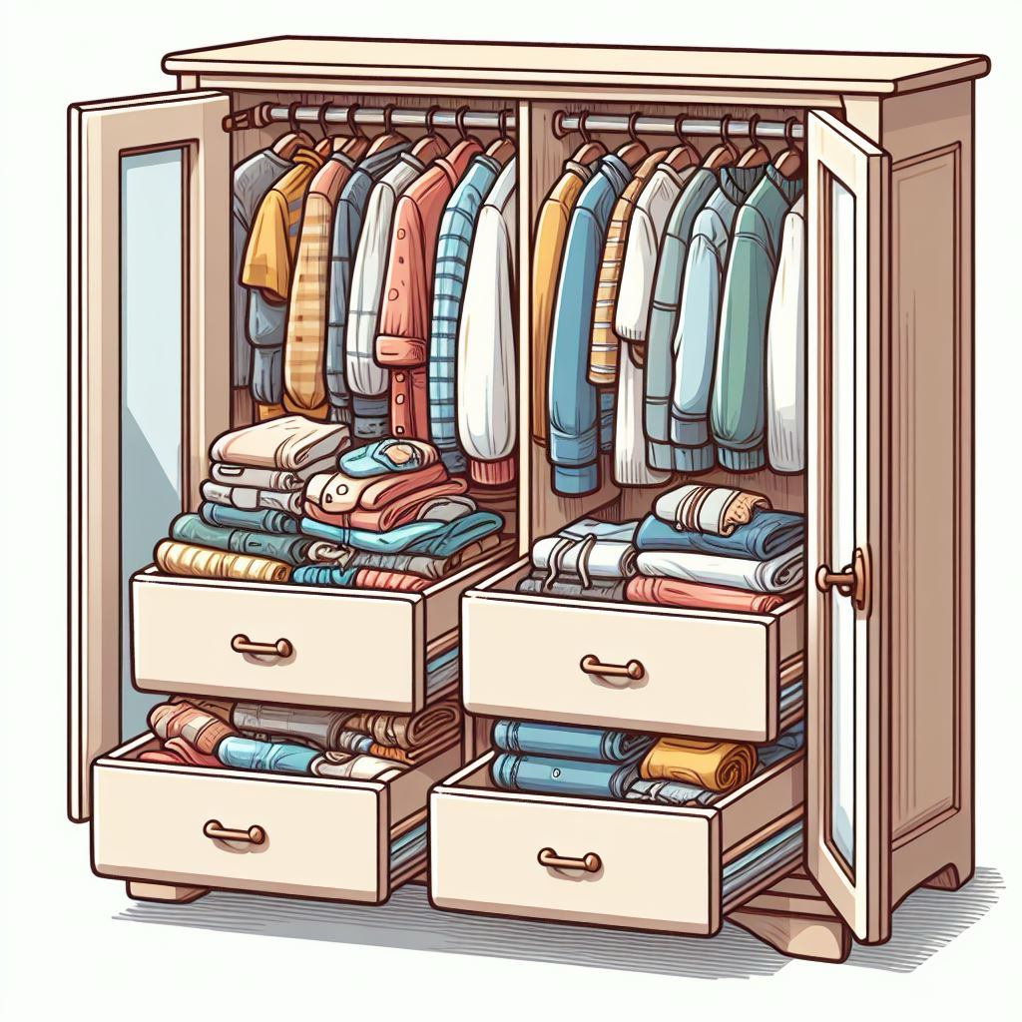


chair
table
sofa
bed
cabinet
dresser
desk
bookshelf

Slide 22
Demonstration/Practice

Slide 23
Variation – 1 drawer/times

Slide 24
Vocabulary Words
Table
Chair
Sofa
Bed
Cabinet
Dresser
Desk
Bookshelf

Slide 25
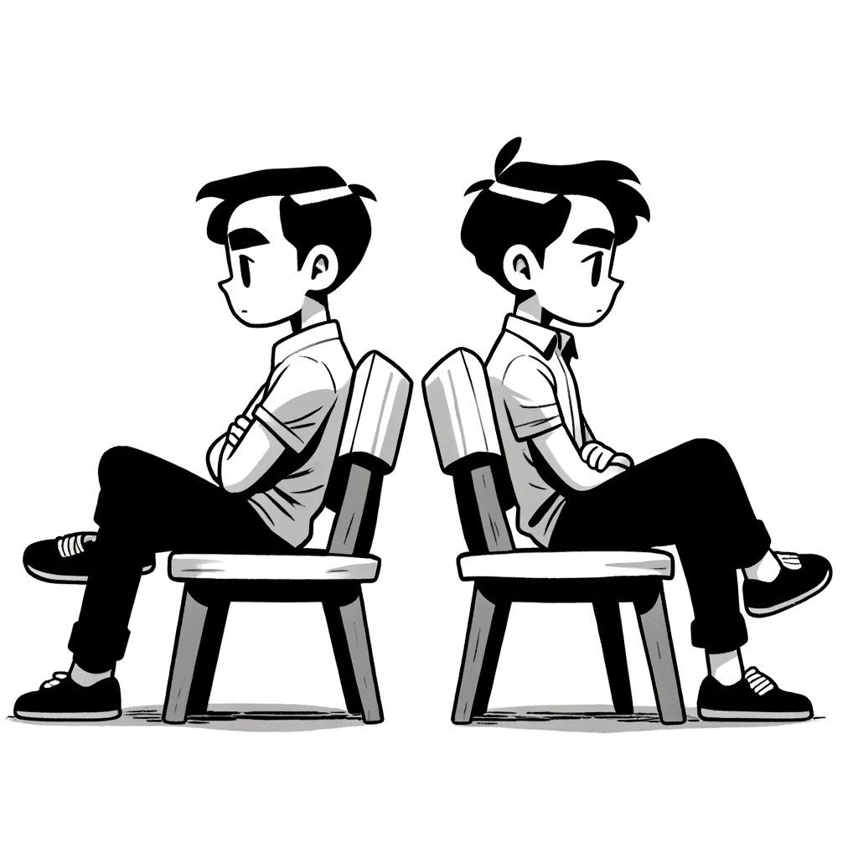
Explanation Relay
Present or Review Vocabulary
Divide into pairs
Pairs sit back to back. One person faces the board.
The person facing the board tries to get he person to guess the word without saying it.

Slide 26
Vocabulary Words
car
truck
scooter
bicycle
motorcycle
bus
Van
Sport Utility Vehicle (SUV)

Slide 27


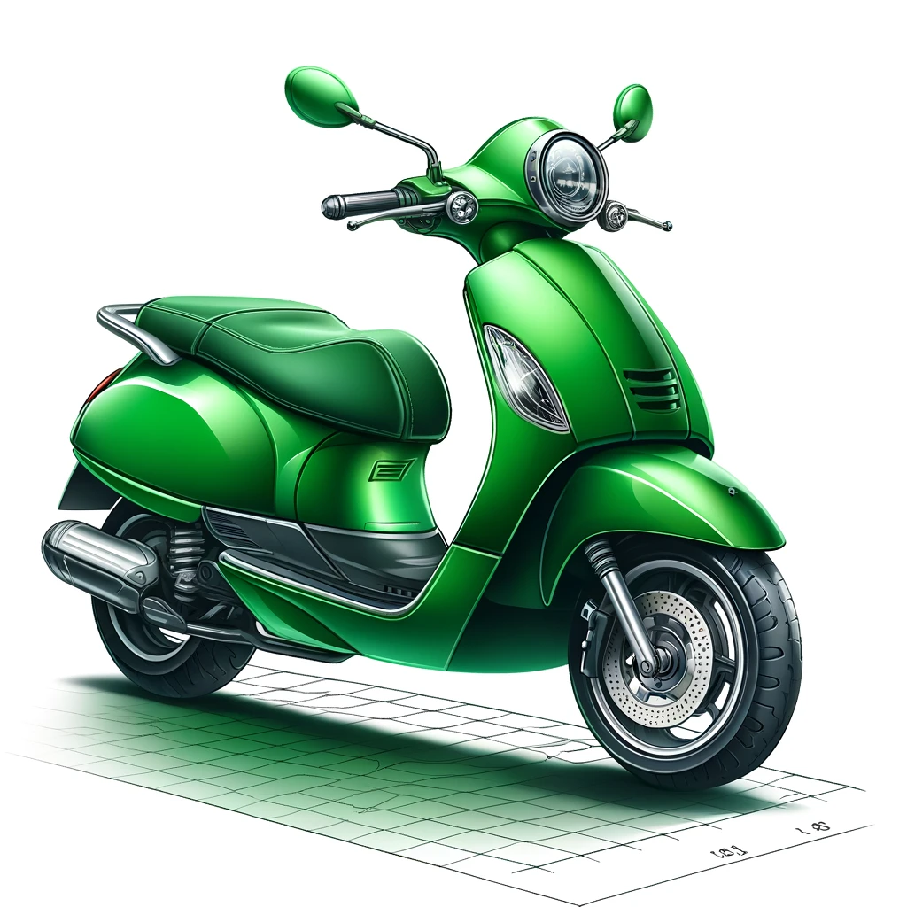
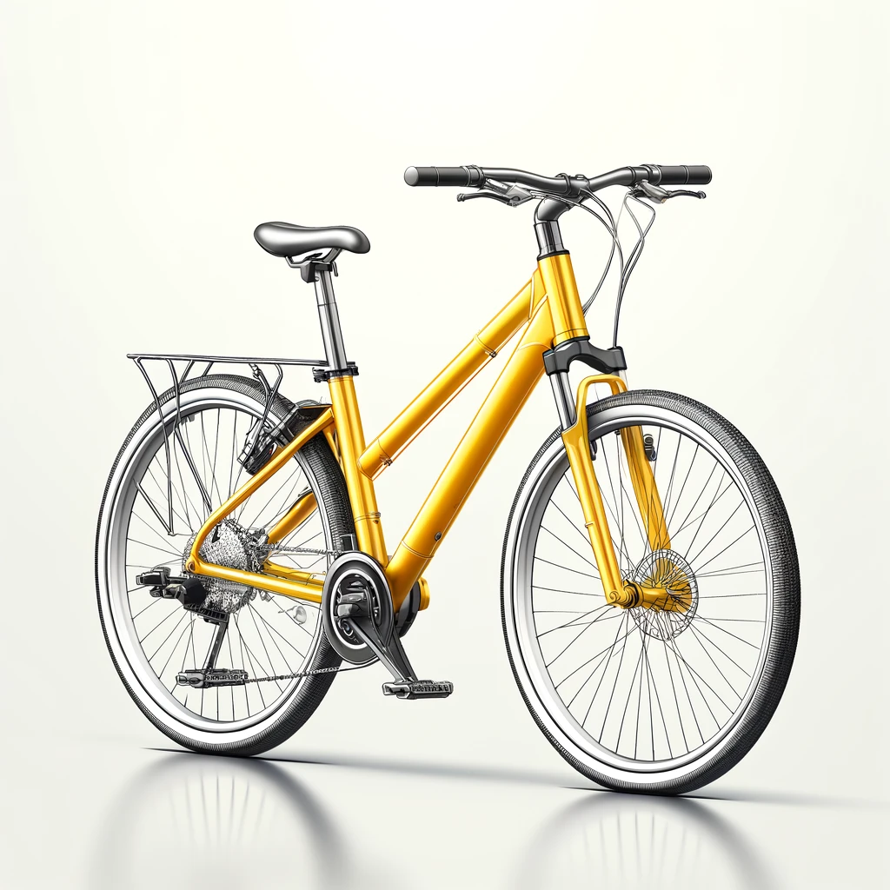

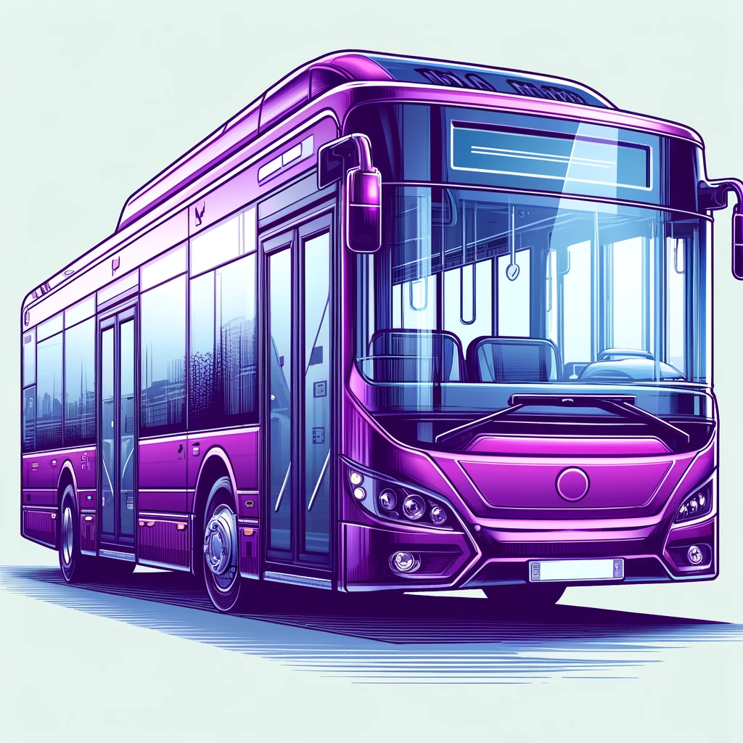
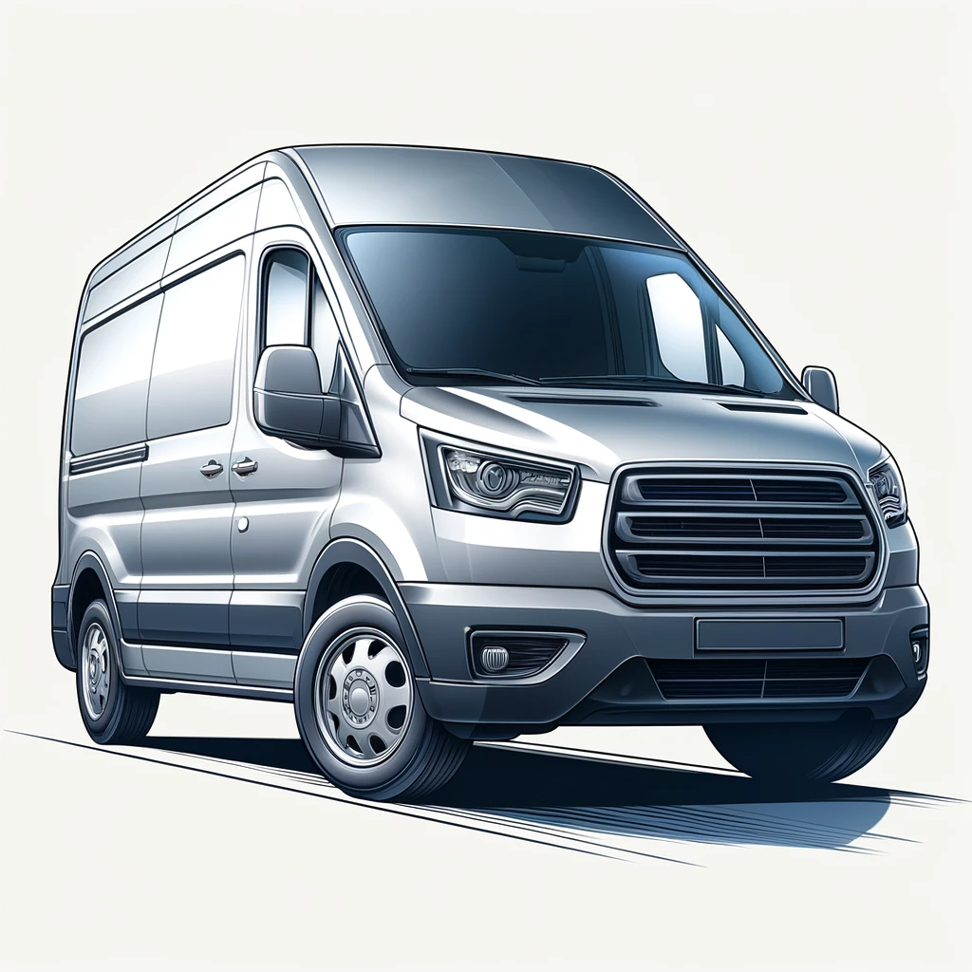

car
truck
scooter
bicycle
motorcycle
bus
van
Sport utility vehicle (SUV)

Slide 28
bus

Slide 29
Sport utility vehicle (SUV)

Slide 30
car

Slide 31
motorcycle

Slide 32
van

Slide 33

Timed Variation

Slide 34
Vocabulary Words
Van
motorcycle
truck
car
bus
Sport Utility Vehicle (SUV)
scooter
bicycle

Slide 35

Reading Activity Level 1 – Put the Puzzle together
Give the students a list of sentences that they need to put in the correct order.

Slide 36
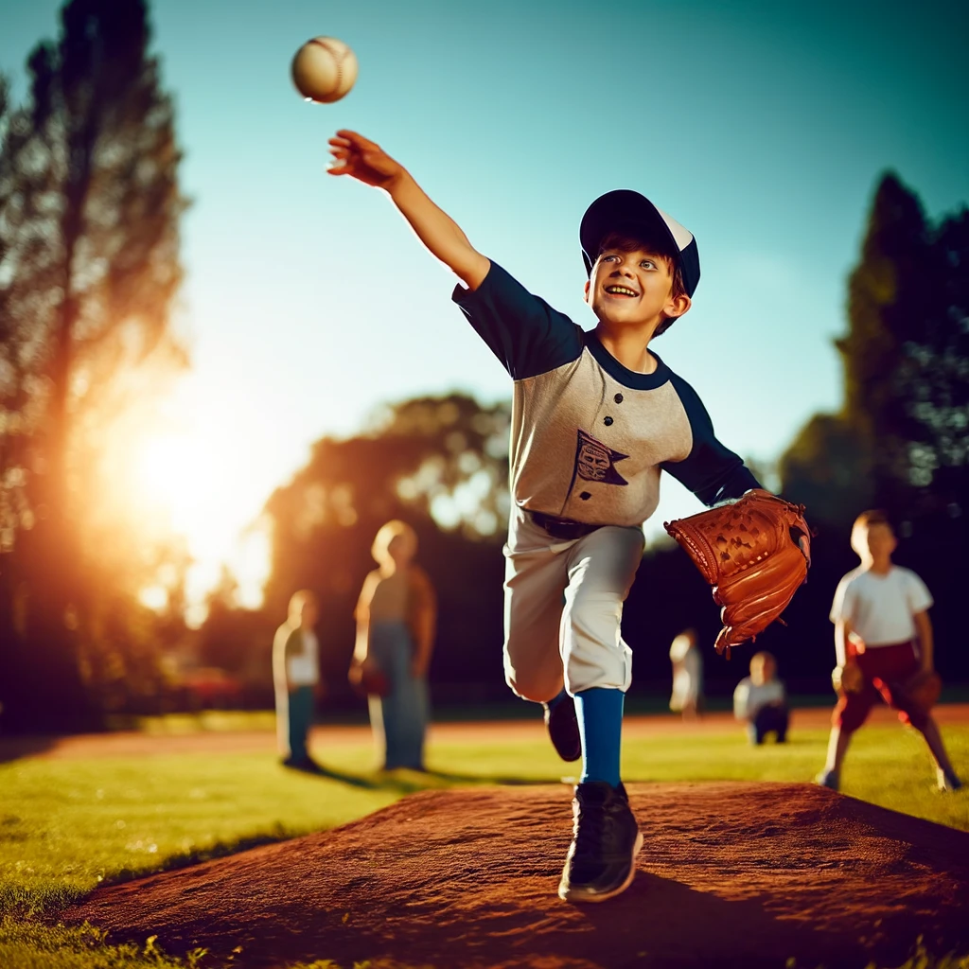
Example 1
One sunny afternoon, Tommy grabbed his baseball glove and dashed to the park.
After the game, all dusty and happy, Tommy couldn't wait to play again tomorrow.
He kept throwing great pitches, feeling awesome as the batters missed.
He joined a bunch of kids setting up for a game and quickly signed up to pitch.
With a big smile, Tommy threw his first pitch—it zipped right over the plate as a strike, and everyone cheered.

Slide 37
Example 1 - Answers
1. One sunny afternoon, Tommy grabbed his baseball glove and dashed to the park.
4. He joined a bunch of kids setting up for a game and quickly signed up to pitch.
5. With a big smile, Tommy threw his first pitch—it zipped right over the plate as a strike, and everyone cheered.
3. He kept throwing great pitches, feeling awesome as the batters missed.
2. After the game, all dusty and happy, Tommy couldn't wait to play again tomorrow.

Slide 38
Reading Activity Level 2 – Retelling the story.
Students are put into pairs.
Each student is given a story to read.
They retell the story to their partner

Slide 39
Example 1 - A
In a small village nestled among rolling hills, there lived a young girl named Maya. She had recently moved to the United States with her parents and younger brother. Adjusting to a new country was challenging, but Maya’s family supported each other. Her father worked at a local factory, while her mother helped out at the school cafeteria. Every evening, they gathered around the dinner table, sharing stories of their day. Despite the language barrier, their love and laughter transcended words. Maya’s little brother, Sam, was excited about starting school. He would join the first grade, and Maya promised to help him learn English. Their family bond grew stronger as they navigated this new chapter together.

Slide 40
Example 1 - B
On the first day of school, Maya held Sam’s hand as they entered the hallway. The unfamiliar faces and rapid conversations overwhelmed them. Mrs. Johnson, their teacher, welcomed them. She understood their limited English and encouraged them to participate. In class, Maya sat next to a girl named Emily, who explained the math problems. During recess, they played tag with other kids. Maya discovered that school was more than just learning; it was about making friends and embracing differences. As weeks passed, Maya’s English improved, and she even volunteered to read aloud in class. Sam made friends and showed off his crayon drawings. Together, they discovered that family and school were a support system that helped them thrive in their new home.

Slide 41
Example 2 - A
As I pedaled my bike faster, the wind felt cool on my face, and I could hear Emma laughing next to me. Her hair flew behind her like a golden ribbon as we zoomed down the big hill near where we live. I looked at her and saw her eyes shining with excitement. We weren’t racing to see who was faster; we were just having fun riding together. Everything else seemed to disappear, and all I could hear was our laughter and the whirr of our bike wheels as we shared this awesome adventure.

Slide 42
Example 2 - B
Riding beside Jake, I felt like we were on top of the world, our bikes speeding down the hill with the breeze cheering us on. I heard Jake's joyful shout mix with my giggles as we dodged the sun-dappled shadows on the path. Every time we rode together, it felt like a new adventure, and today was no exception. I glanced at Jake, his face lit up with excitement, and it made me pedal even faster. It wasn't about winning; it was about enjoying this moment of pure fun and feeling the freedom that came with every turn and every laugh we shared.

Slide 43
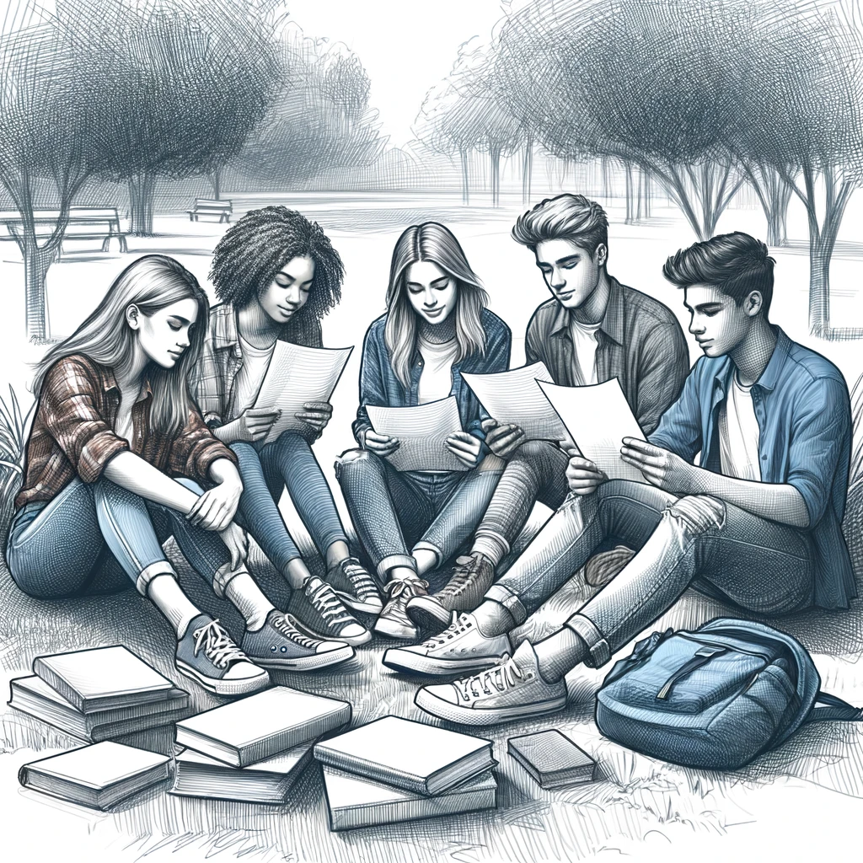
Reading Activity Level 3 – Readers’ Theater
Students are put into pairs.
Each student is given a story to read.
They retell the story to their partner

Slide 44
Example 1: Café Catch-Up
Characters:
Alex: Optimistic and always looking for the bright side.
Casey: Practical, a bit sarcastic.
Jamie: The peacemaker, always trying to keep things light.
Drew: Curious and loves to ask questions.

Slide 45
[Scene: Inside a cozy local café, afternoon.]
Alex: (excitedly) Hey everyone! It's been ages. I missed these little get-togethers.
Casey: (smiling) Definitely! It's great to see all of you. How’s everyone been?
Jamie: Just the usual for me, but I’ve started a yoga class lately. It’s actually really relaxing.
Drew: That sounds cool, Jamie. How about you, Alex? What’s new on the sunny side?
Alex: Oh, you know me, always a new project. I’m helping organize a community garden now. It’s tiny but so rewarding!
Casey: (teasingly) A garden, huh? Hope it survives your legendary lack of a green thumb!
Alex: (laughs) I know, right? But I’m learning a lot. What about you, Casey? Still at the tech startup?
Casey: Yeah, it’s hectic but exciting. We’re gearing up for a big update release next month.
Drew: Sounds intense. Make sure you don’t burn out. We need our tech guru in one piece.
Jamie: Speaking of staying in one piece, how’s your new kitten, Drew? Still wreaking havoc?
Drew: More like she owns the place now. But she’s adorable. You all should come over and meet her sometime.
Alex: I’d love that! It’s been too long since we all hung out like that. Maybe next weekend?
Casey: I’m in. It’ll be like old times!
Jamie: Perfect. It’s a date then!
Drew: Looking forward to it! Let’s make sure it doesn’t take another year for us to meet up again.
Alex: Agreed! Here’s to making time for friends and café chats!
[All laugh and raise their coffee cups in a toast.]
END

Slide 46
Example 2 - Project Planning Session
Characters:
Jordan: The organizer, likes to keep things on track.
Riley: The creative thinker, always has unique ideas.
Taylor: The realist, practical and straightforward.

Slide 47
[Scene: Library study room, late afternoon.]
Jordan: (checking notes) Okay, team, we need a solid plan for our science project. How about we start with everyone’s ideas?
Riley: I was thinking we could do something with renewable energy. Maybe a model that demonstrates solar power?
Taylor: That’s cool, but we need to make sure it’s doable. We only have two weeks, remember?
Jordan: Good point, Taylor. We should outline each step and assign tasks. Riley, you handle the creative design?
Riley: (enthusiastic) Absolutely! I can sketch out some ideas tonight and bring them tomorrow.
Taylor: I’ll look into the materials we need then. We should keep the budget in mind too.
Jordan: Perfect! I’ll create a timeline for us and check in daily to make sure we’re on track. How does meeting here after class sound?
Riley: Works for me. It’s quieter than the cafeteria.
Taylor: Agreed. Let’s make this project awesome and not just another assignment!
Jordan: We've got this, team. Let’s meet here tomorrow with your updates. We're going to ace this!
[They nod in agreement, motivated and ready to tackle the project.]
END

