Slide 1


It’s Time to Maximize Interaction in the Classroom
Dr. Ben McMurry

Slide 2
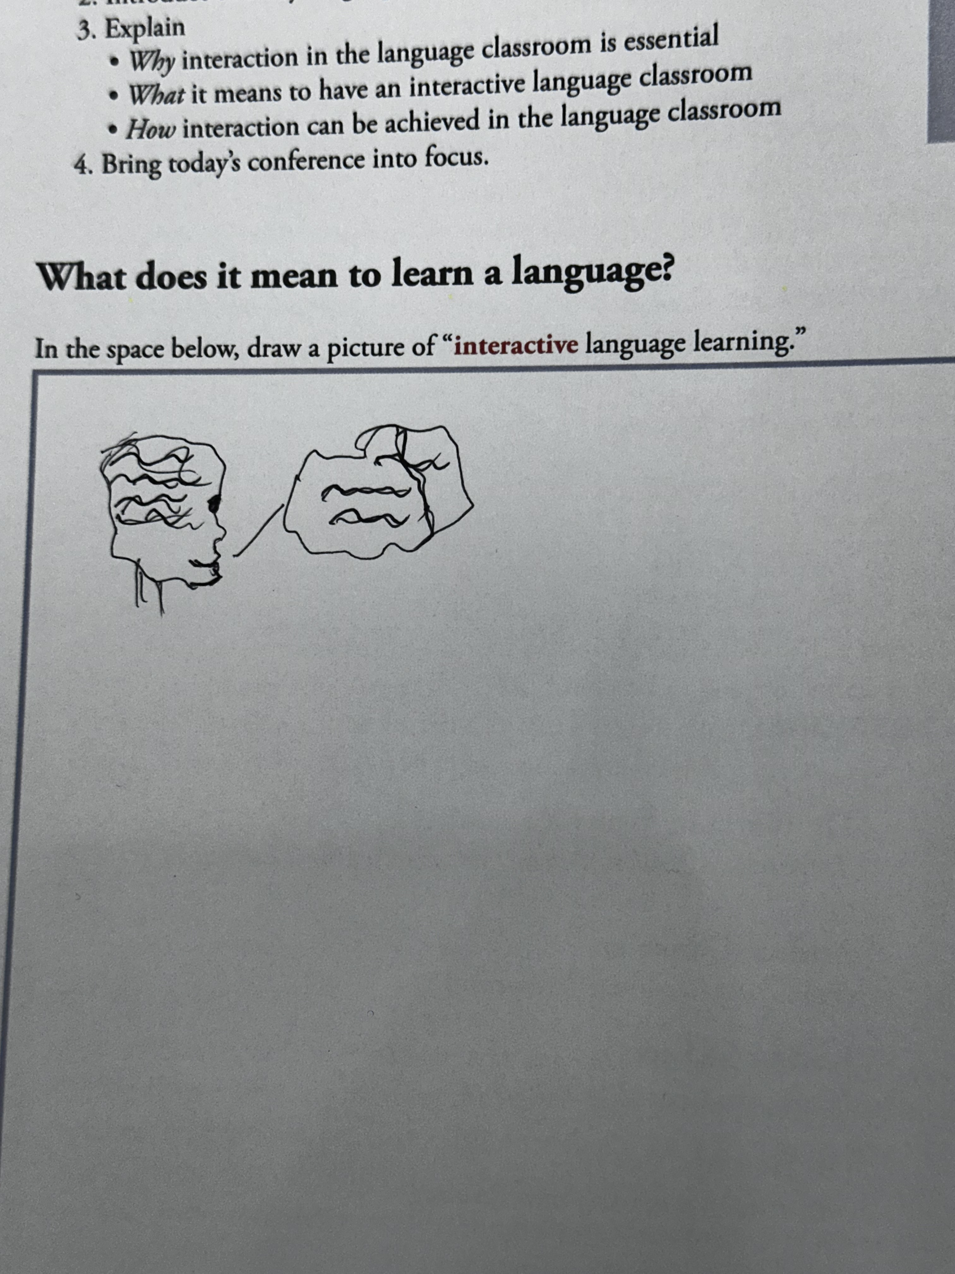
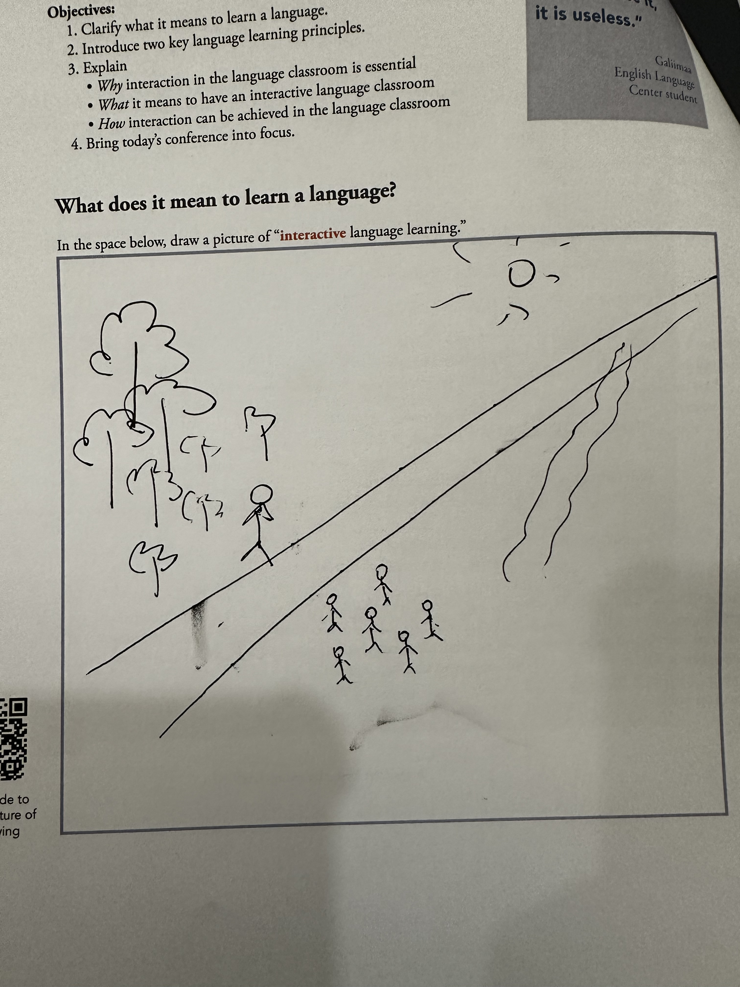
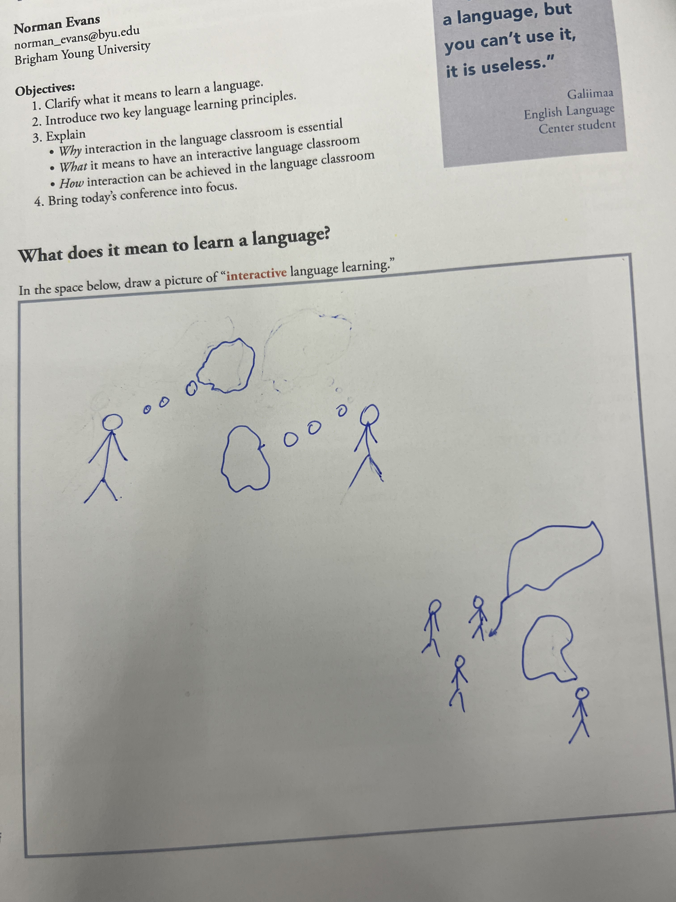
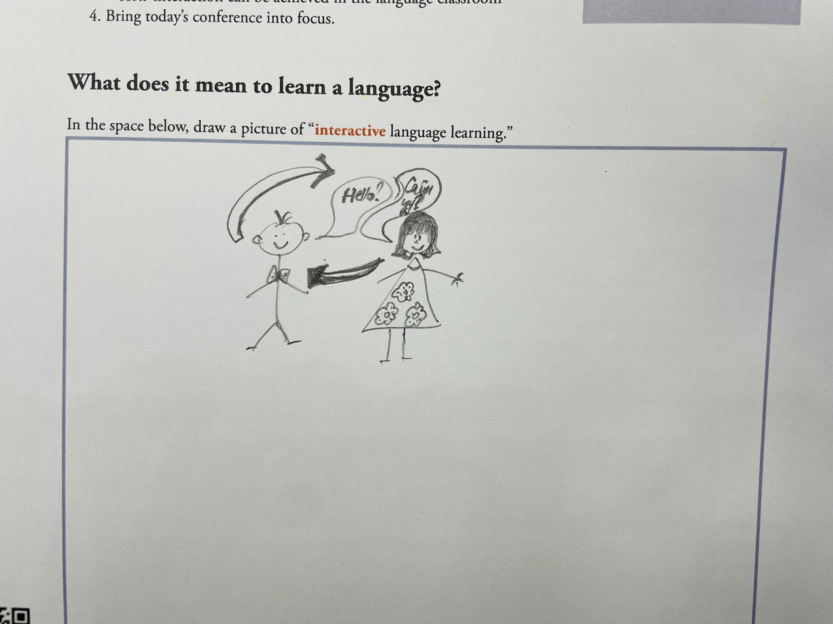

Slide 3
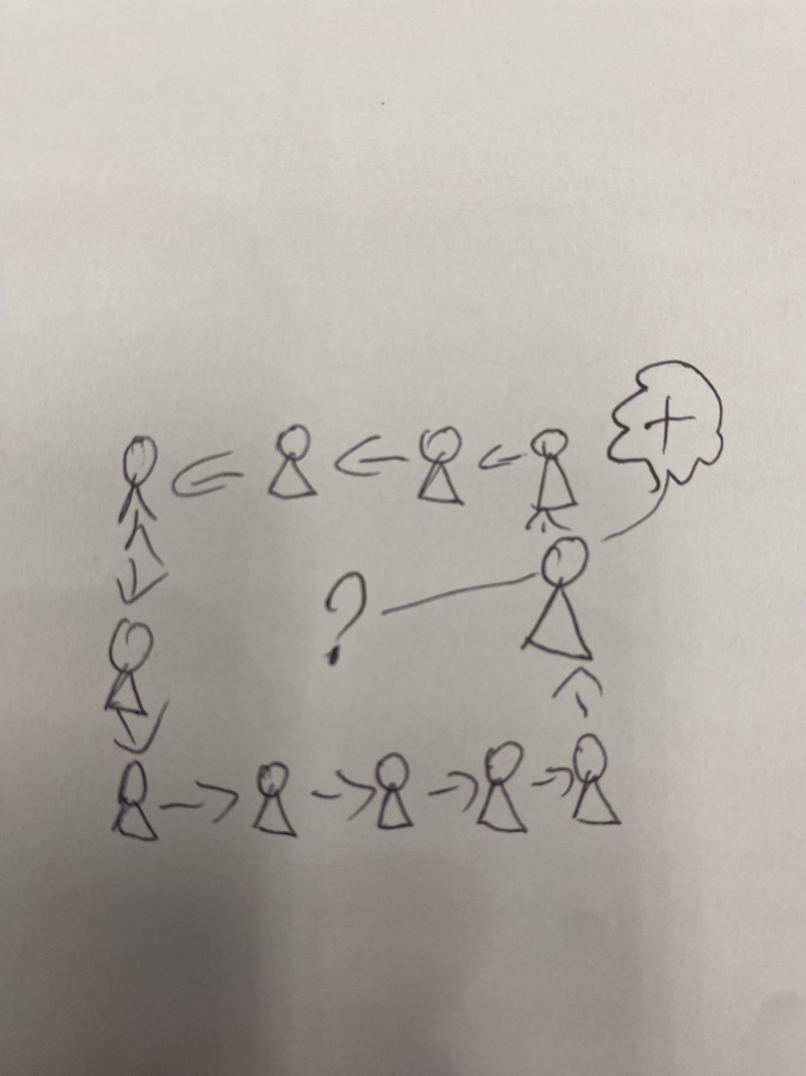
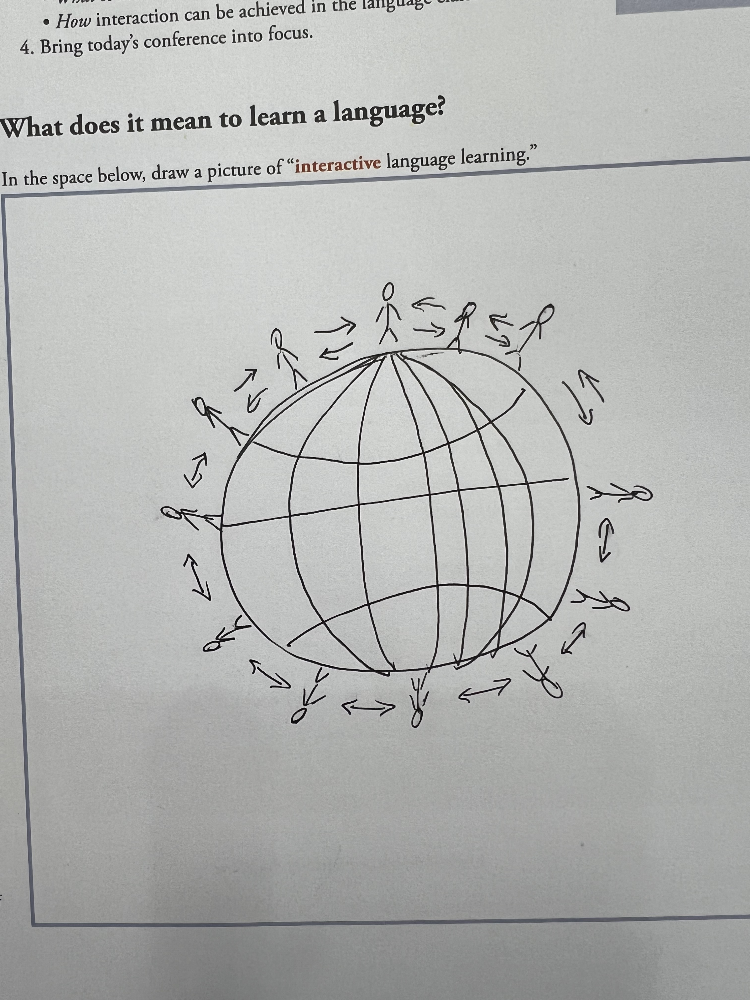

Slide 4
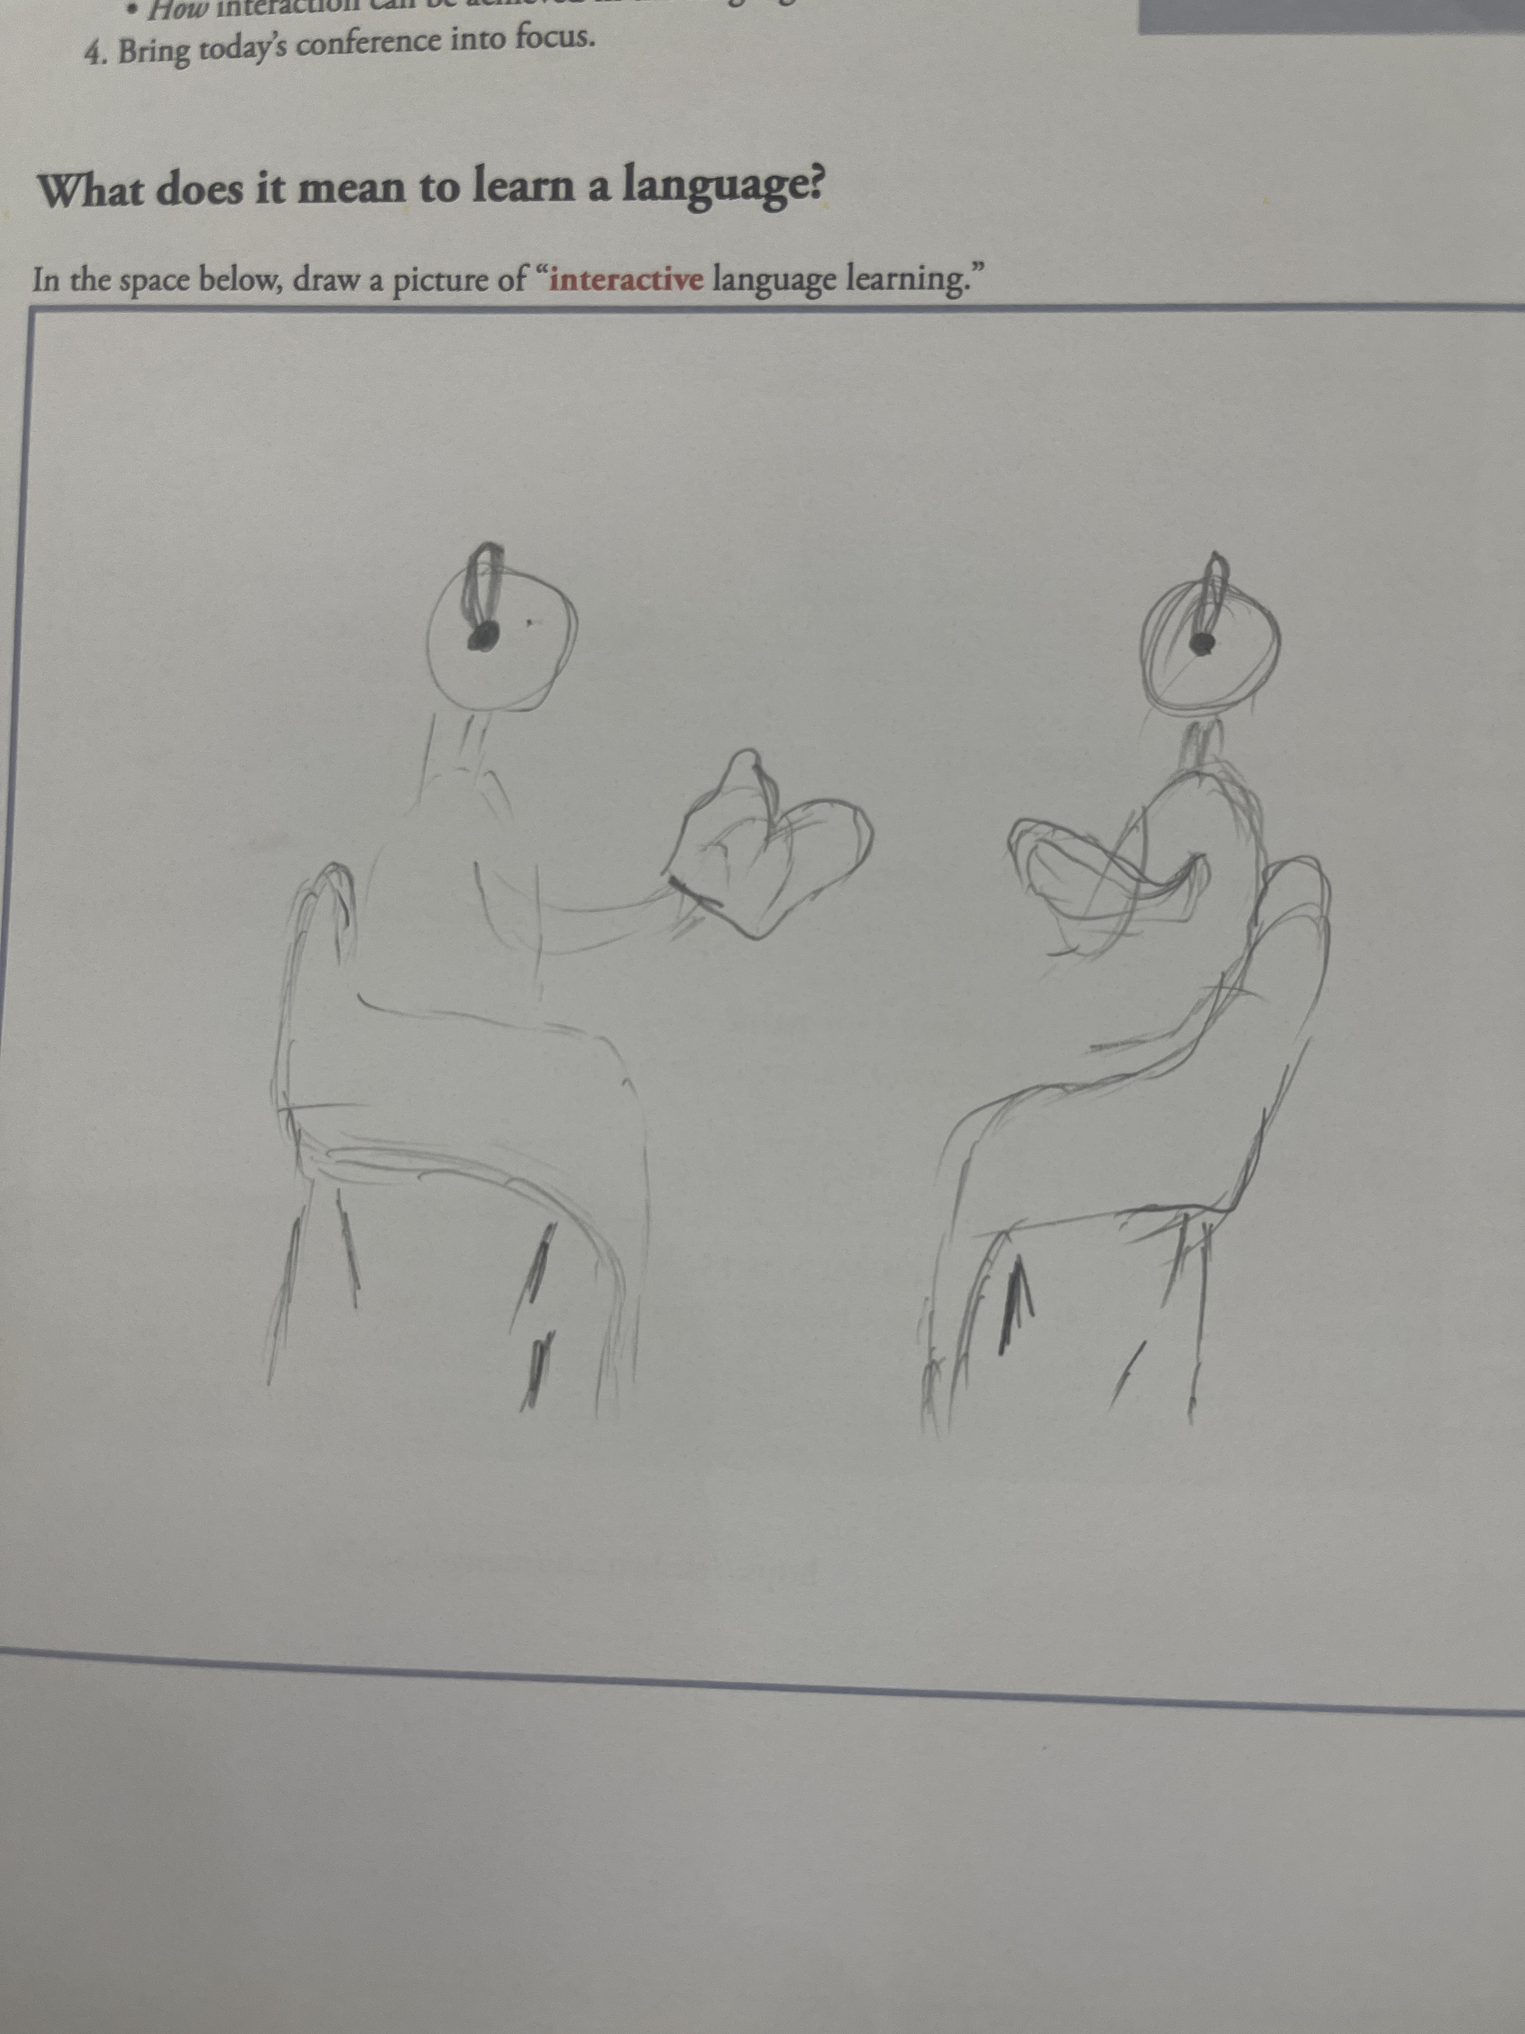
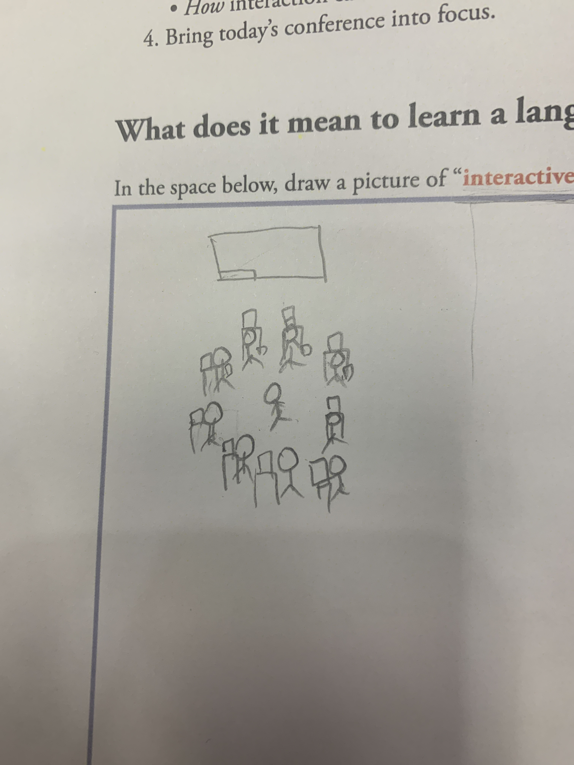
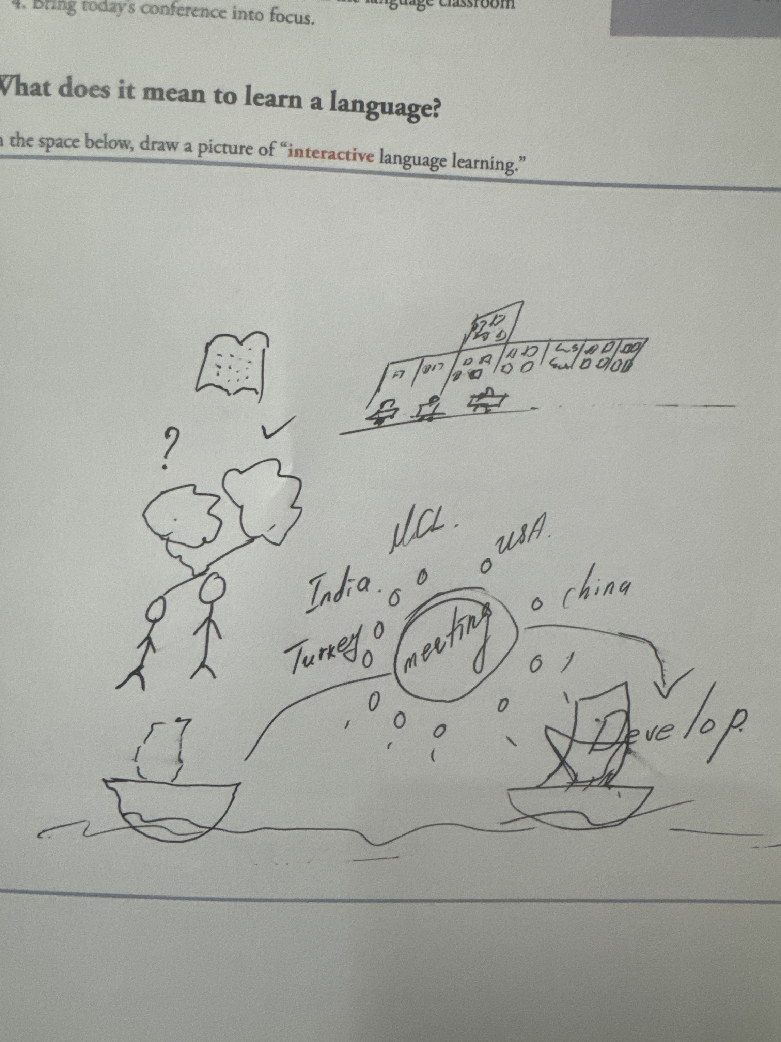

Slide 5
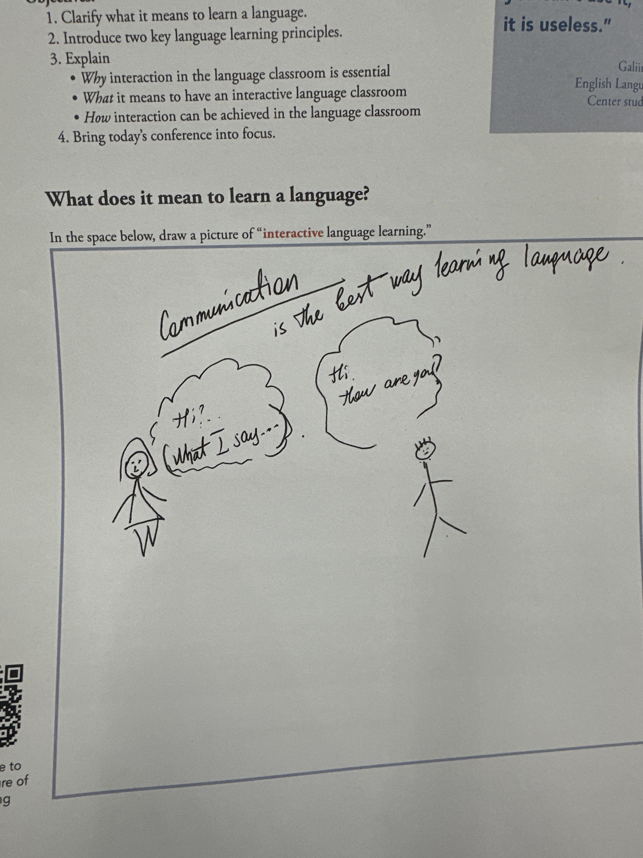
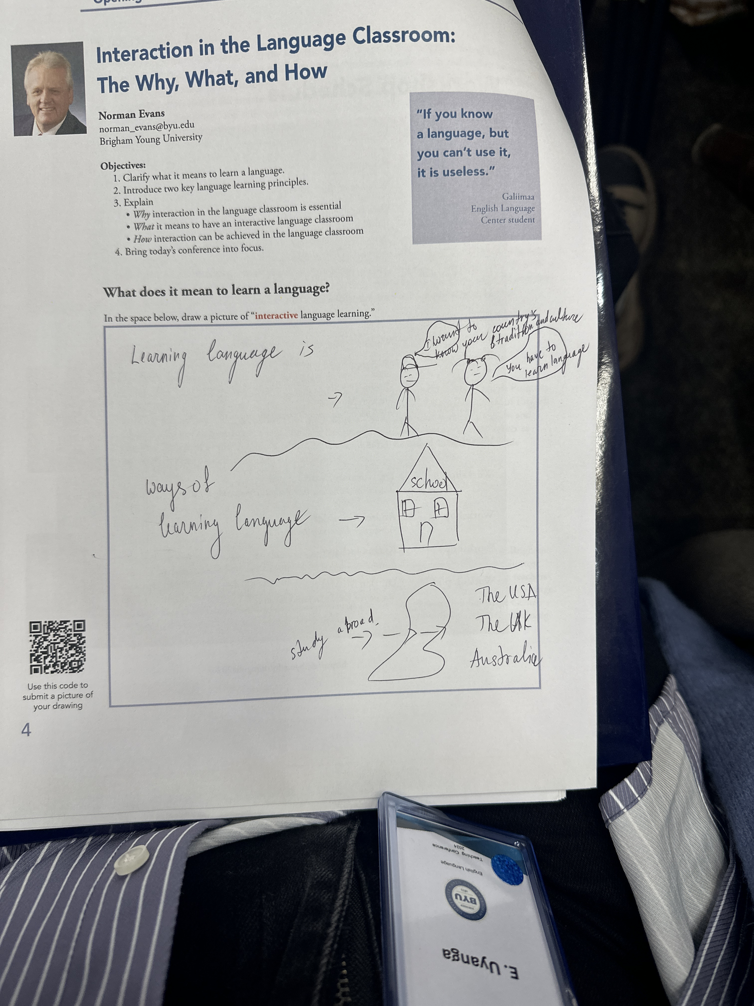
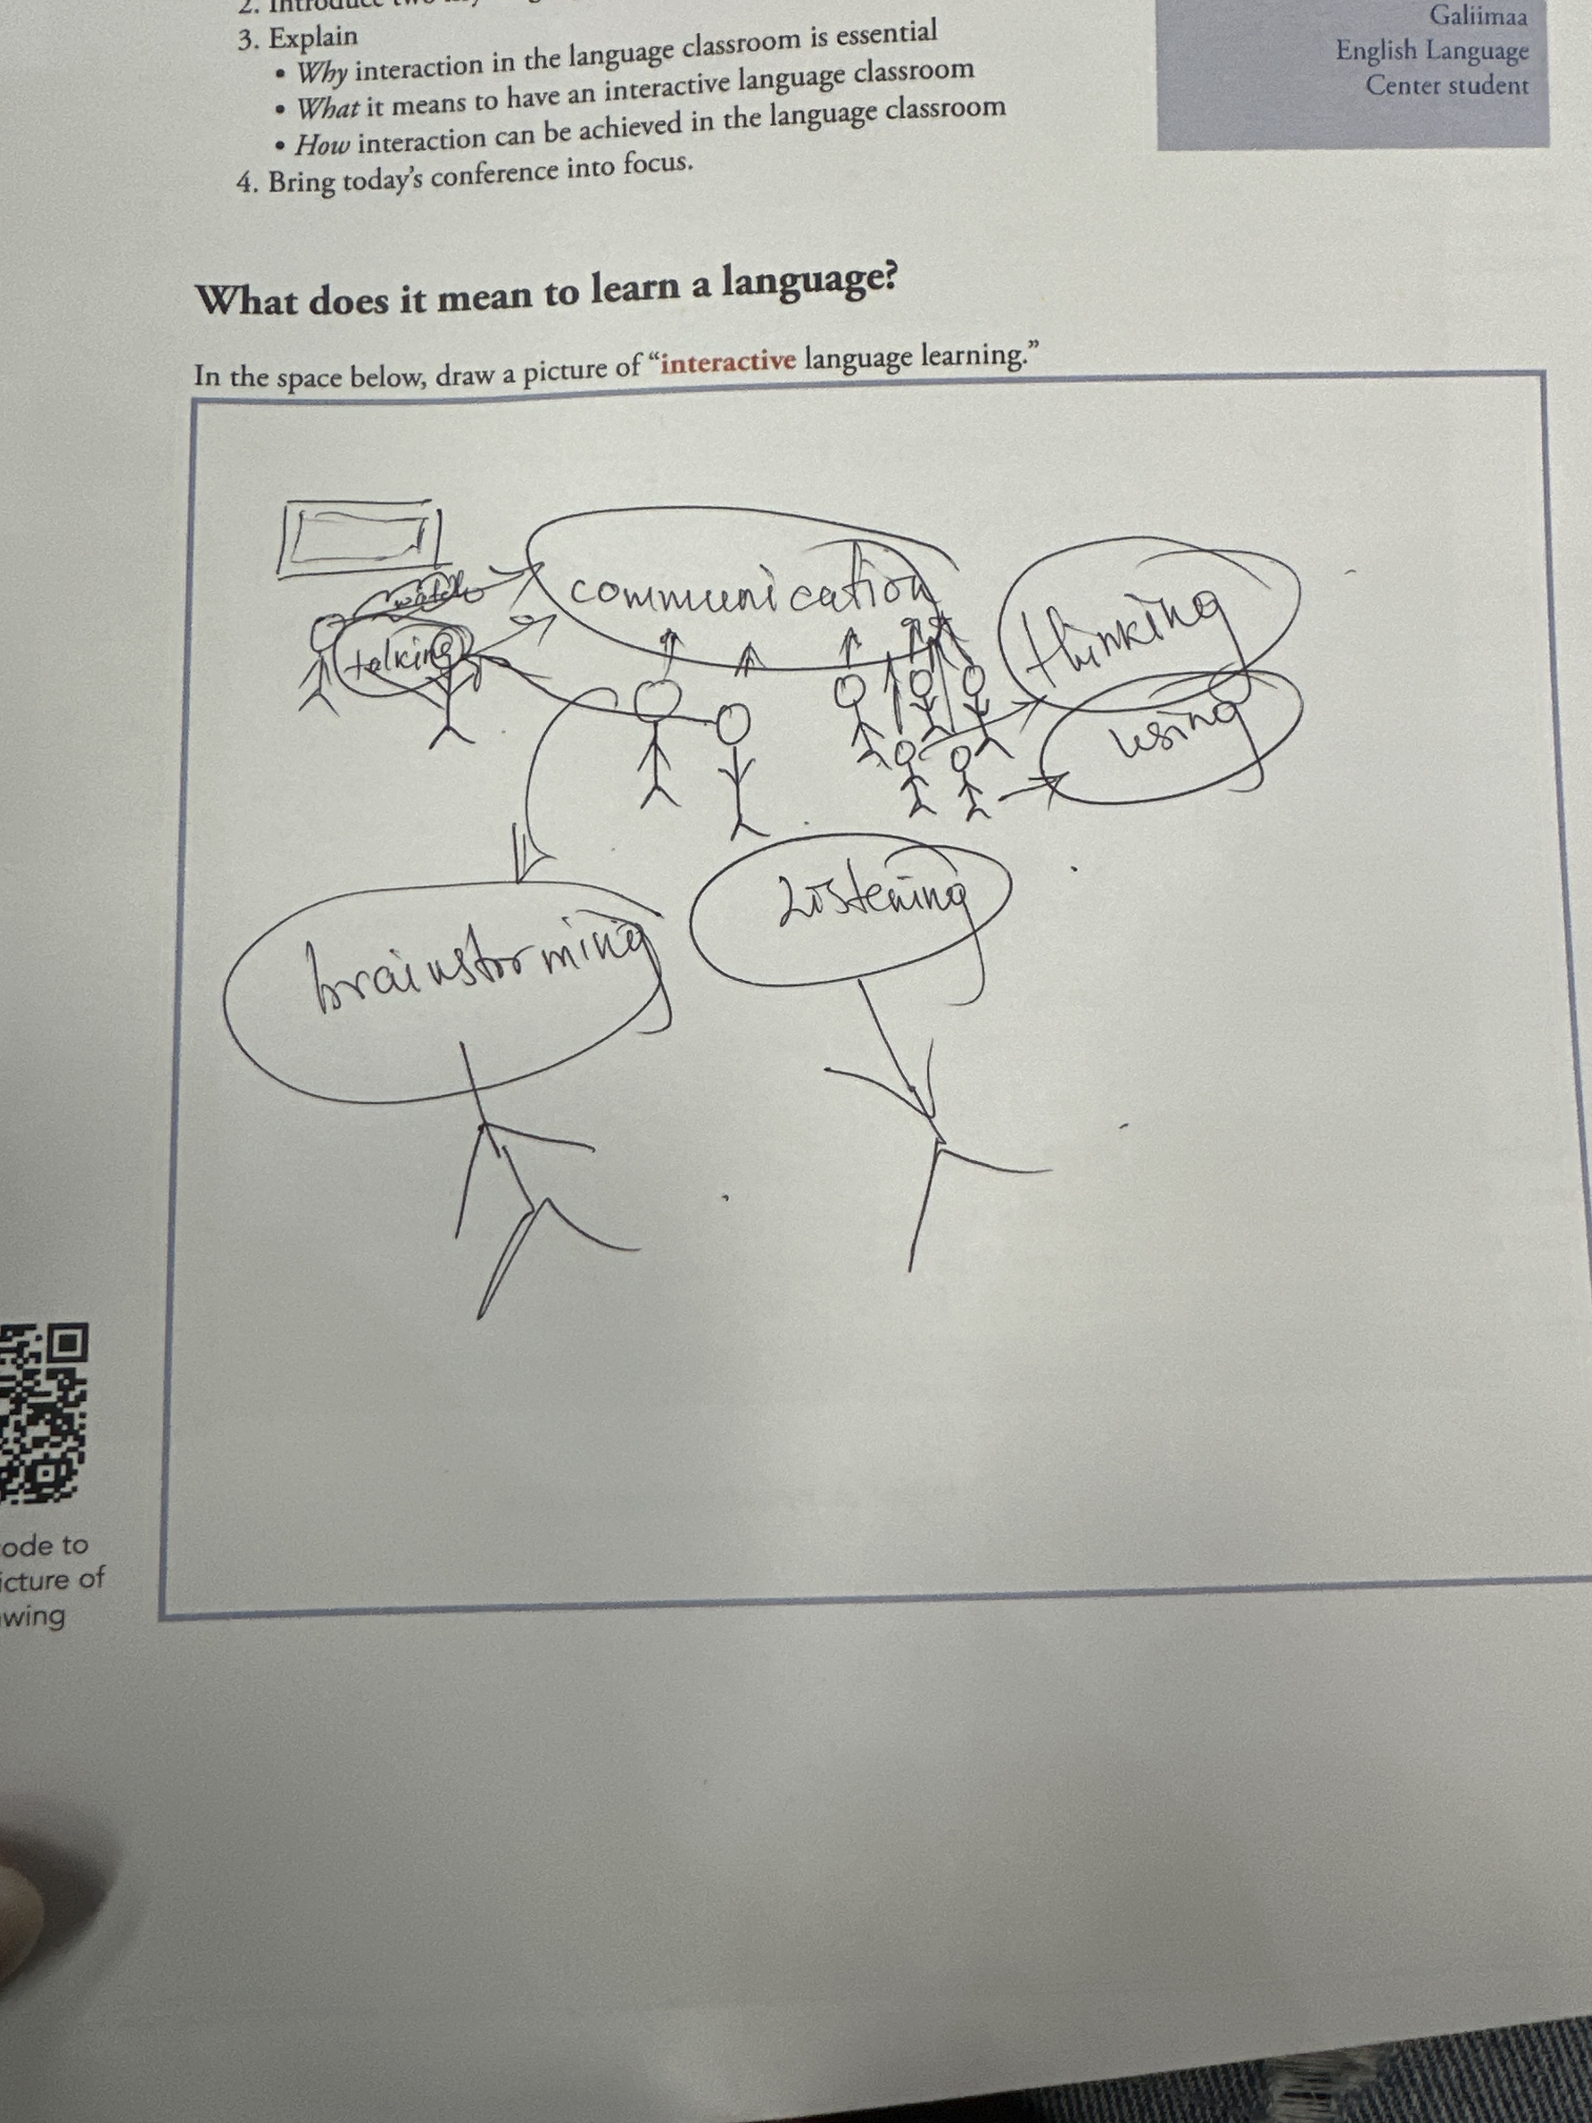

Slide 6
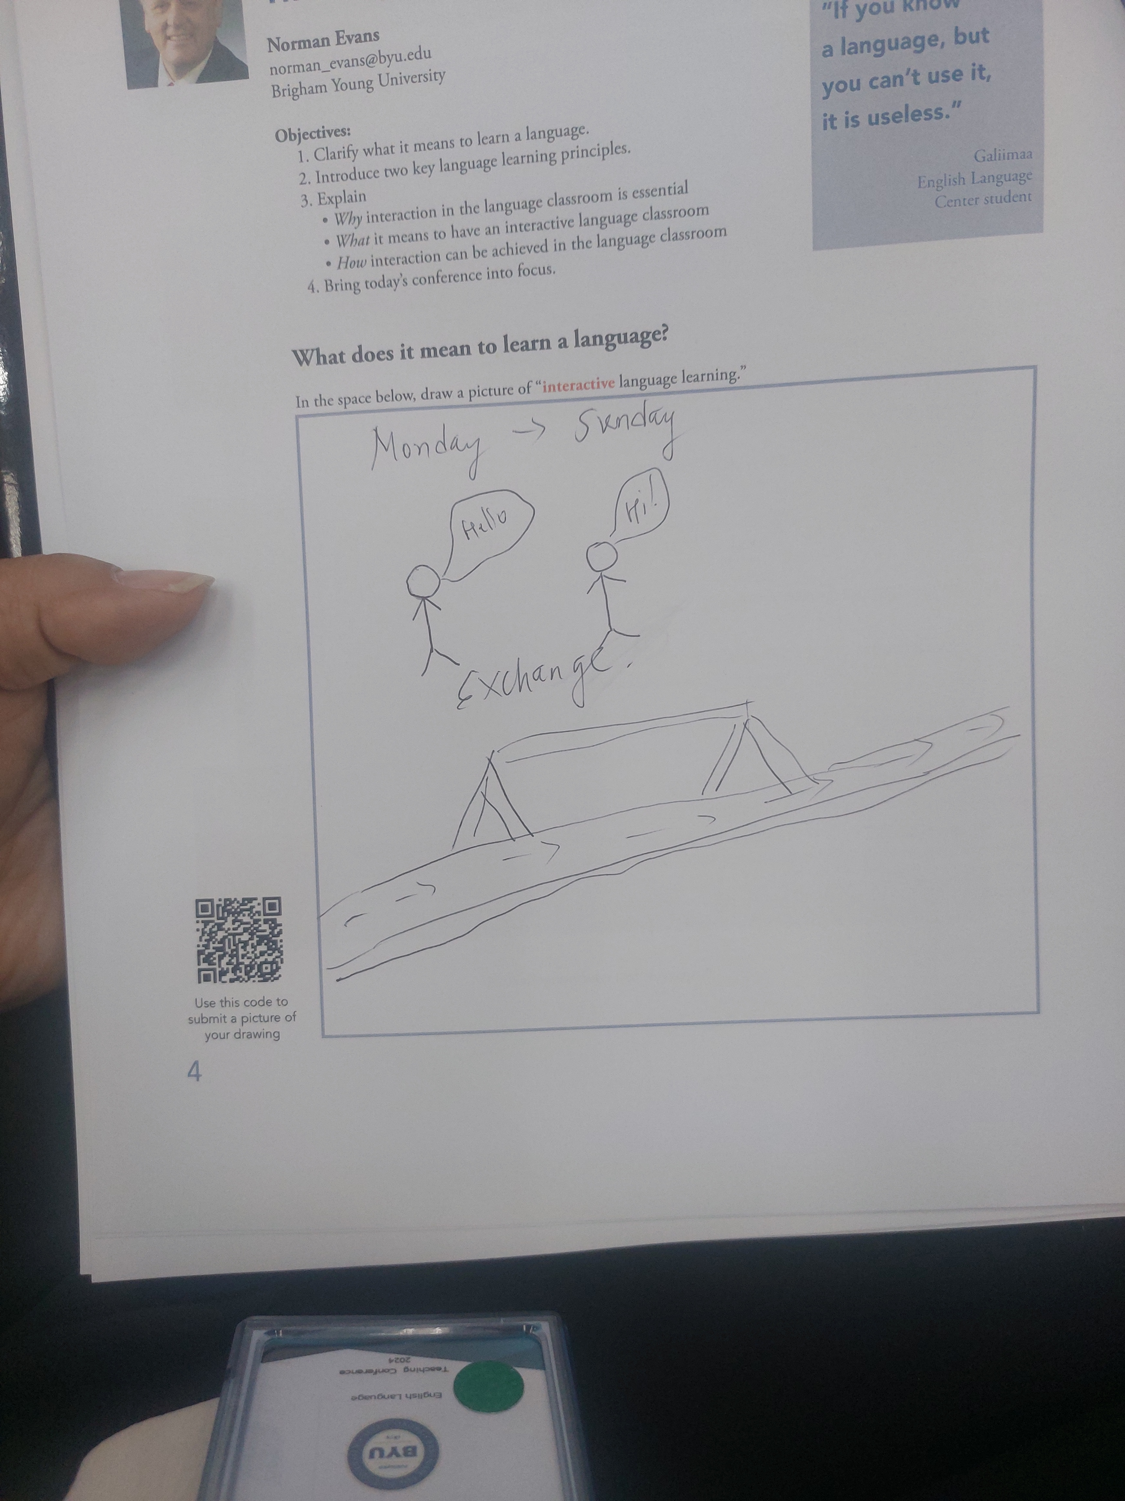
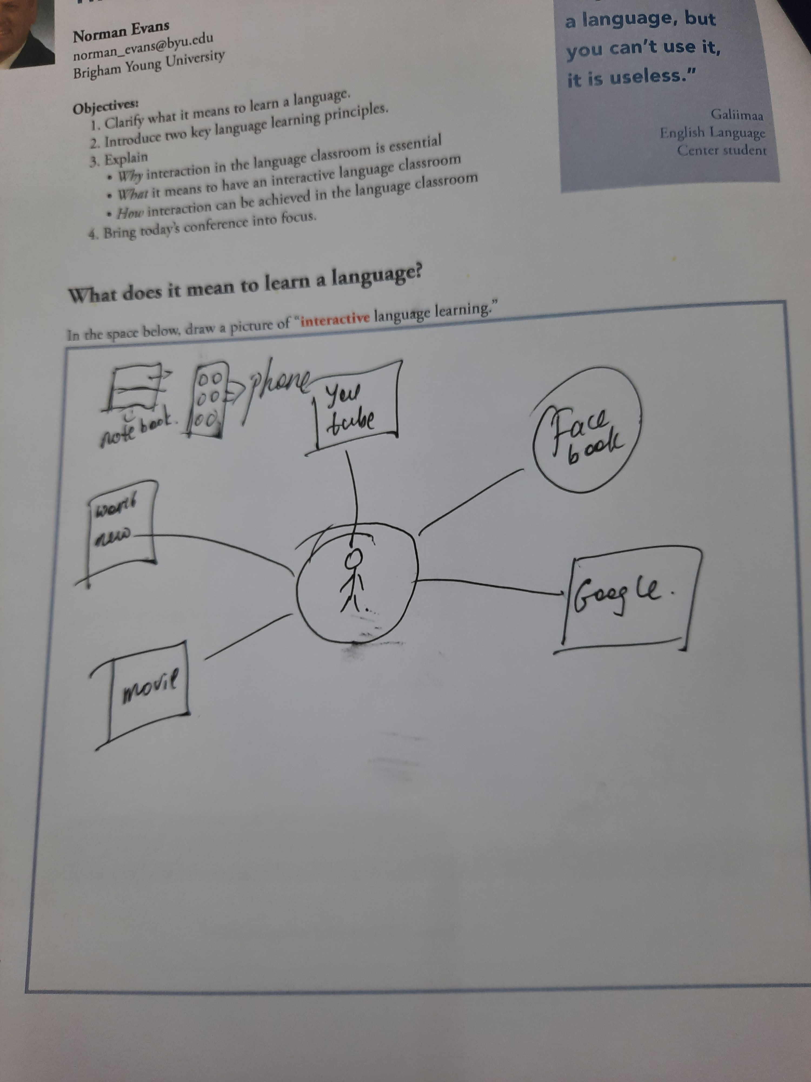
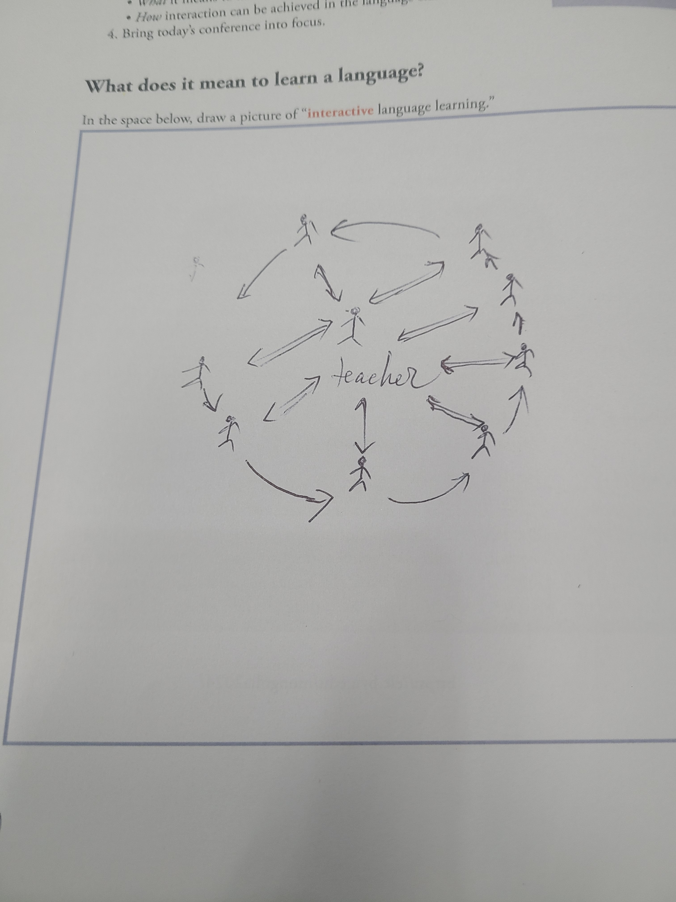

Slide 7
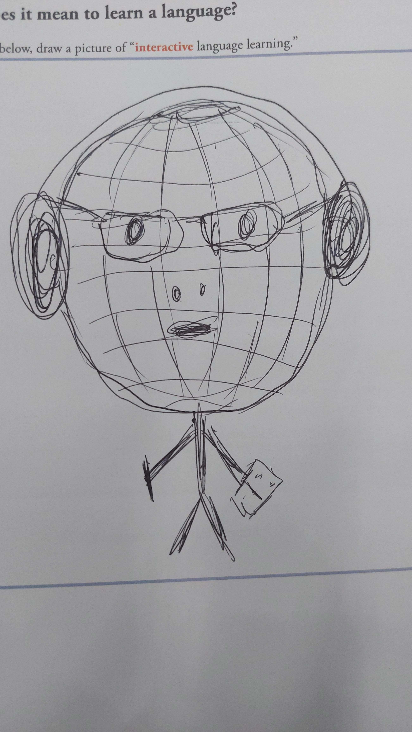
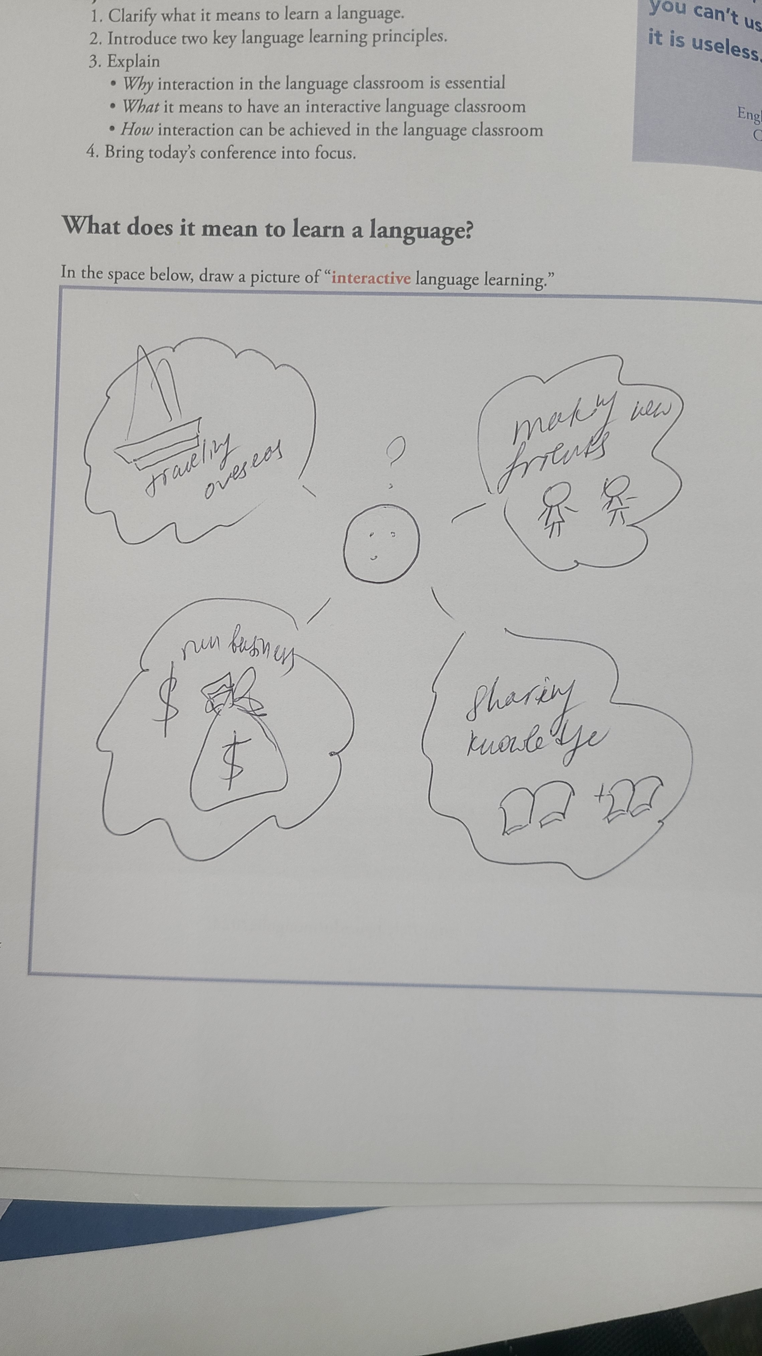
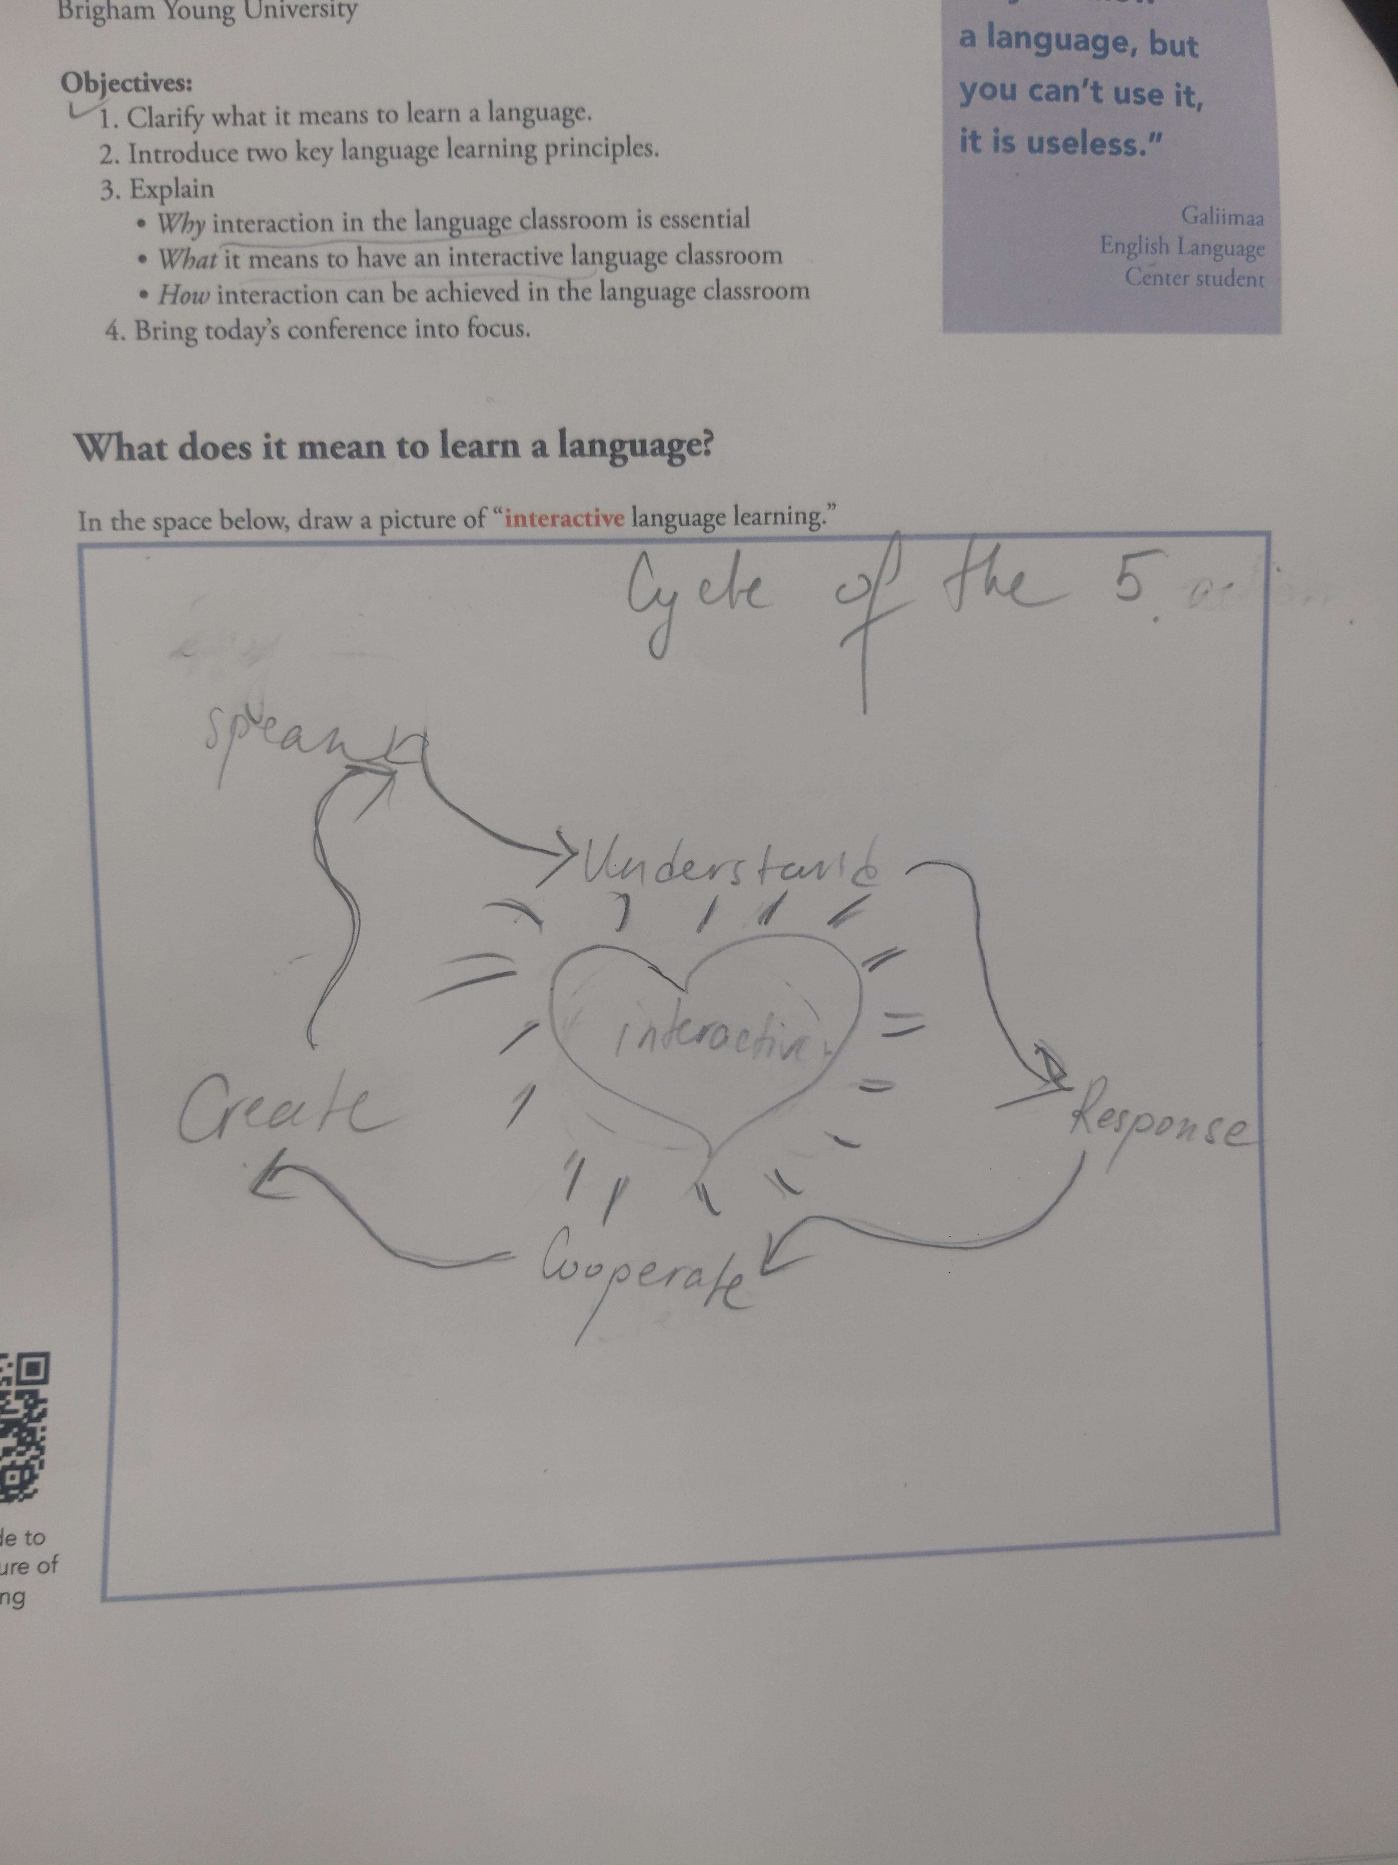

Slide 8
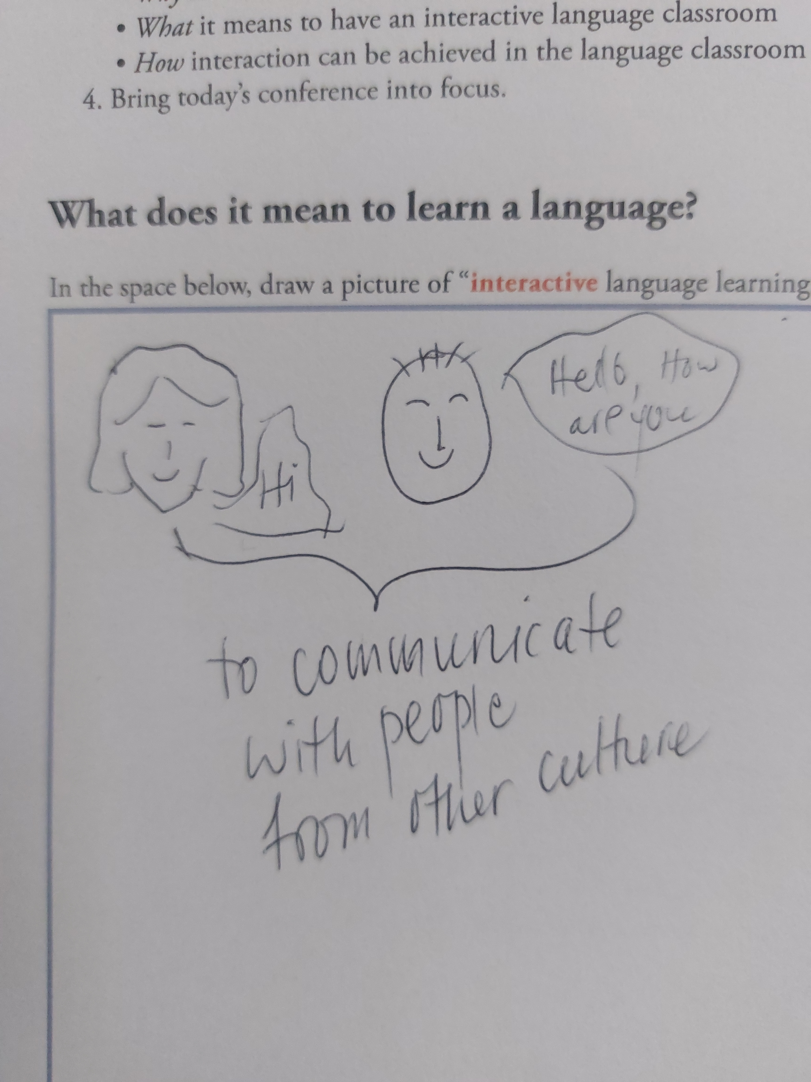
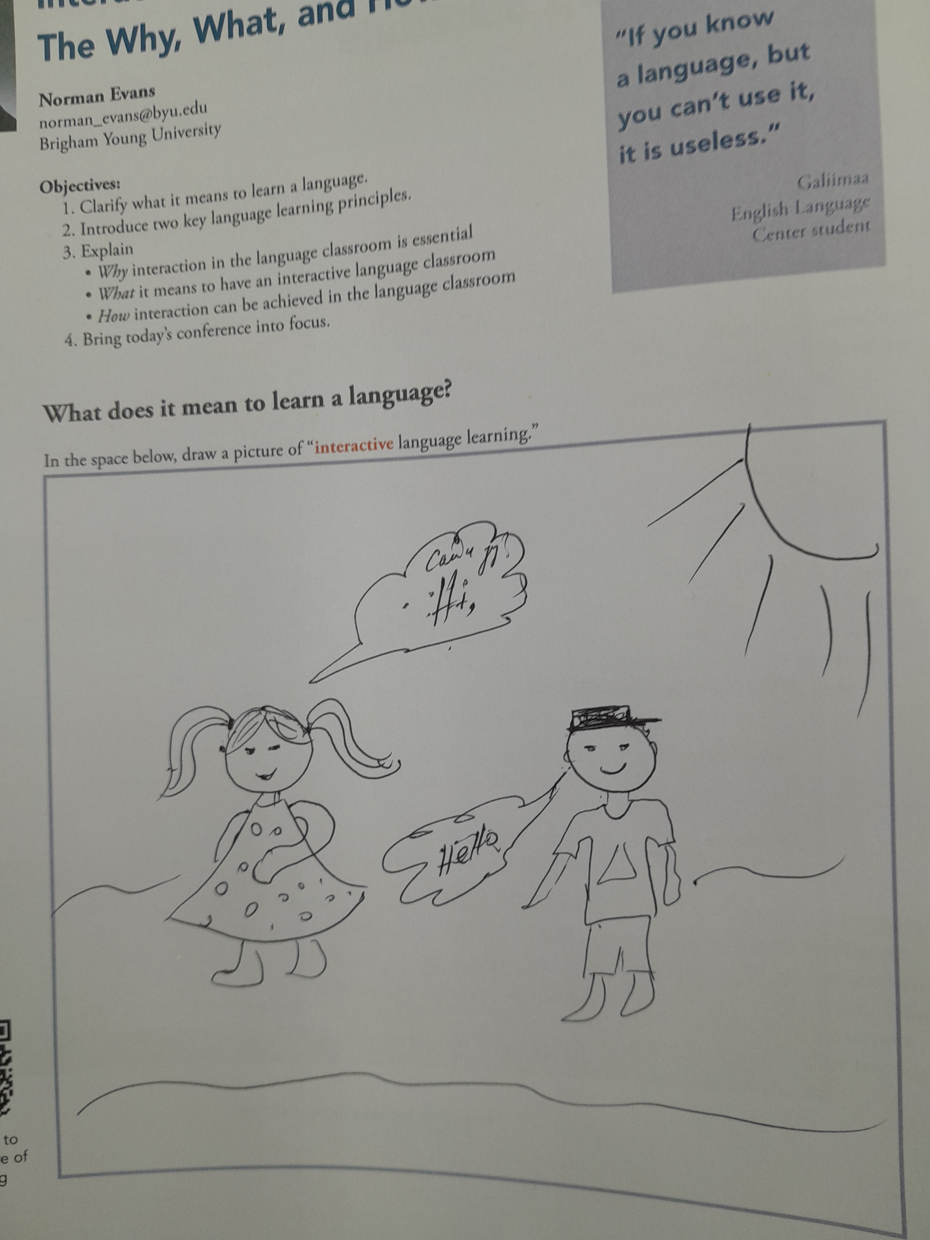
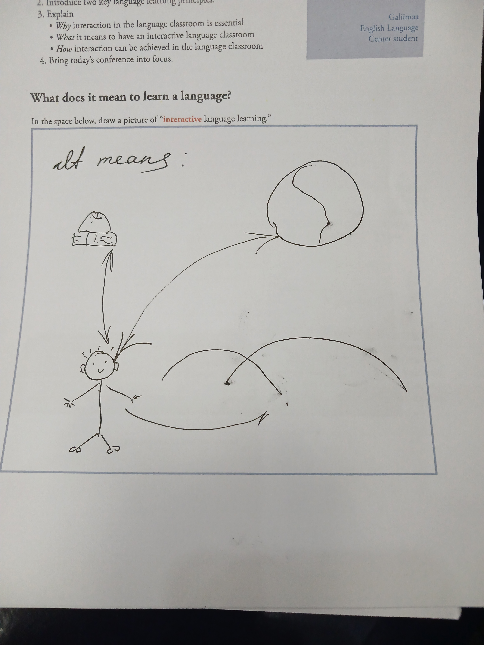
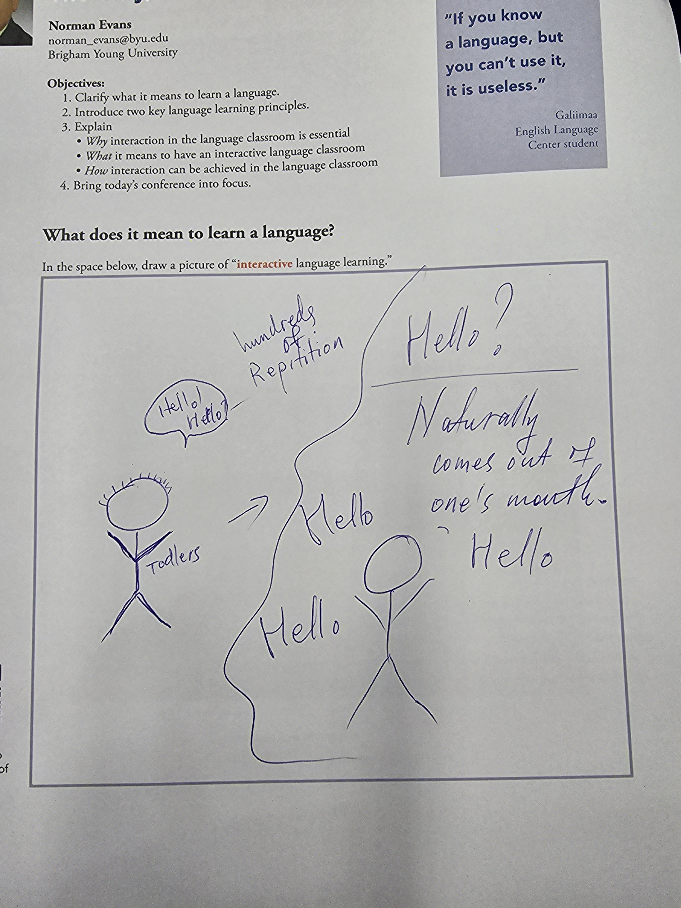

Slide 9
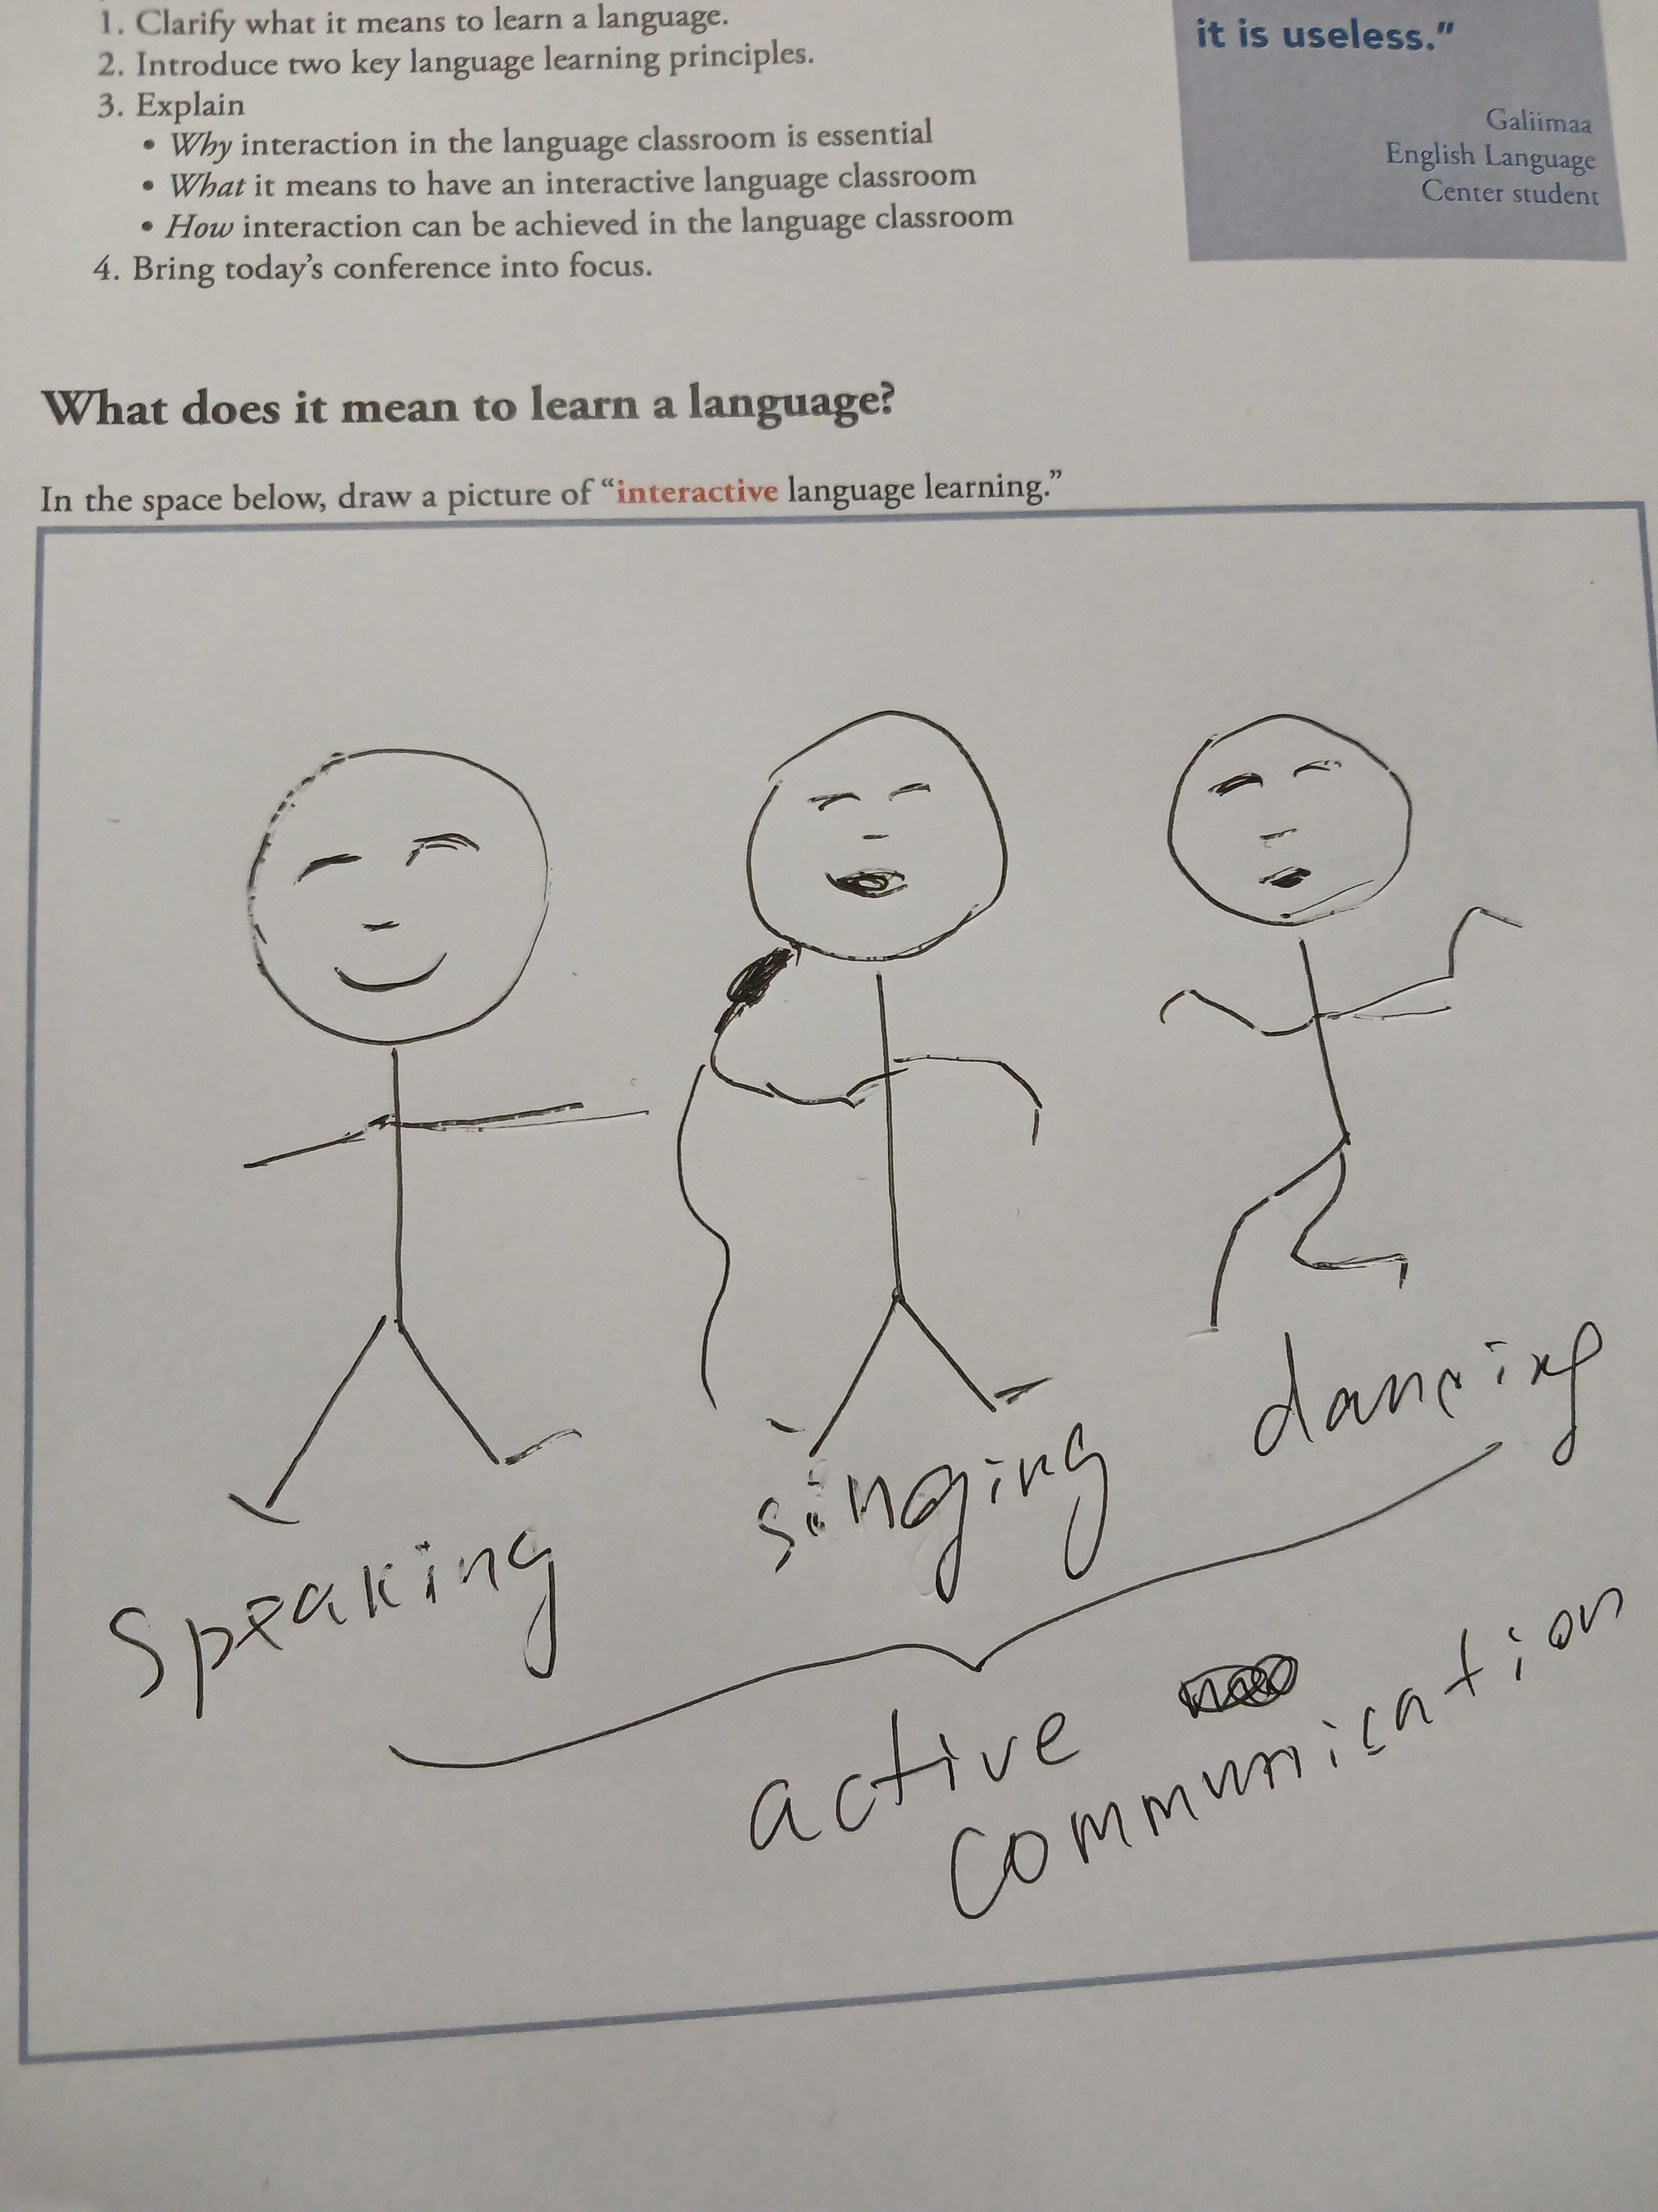
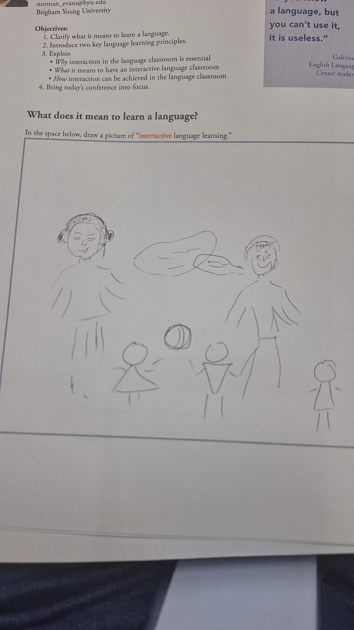

Slide 10

Let’s Review Your Expectations
Turn to page 16 in the program book.
Take 3 minutes to talk with the person next to you about your expectations and if they were met.

Slide 11
What did you take away from the workshops?
Workshop A Dr. Norman Evans Teacher and Student Interaction: Developing a Language Teaching Philosophy | Workshop B Andrea Gonzalez Interactive Grammar Instruction | Workshop C Karina Jackson Interactive Classroom Activities | Workshop D Dr. Ben McMurry Interactive Vocabulary and Reading
Stand up and share one thing you learned from each workshop with a different person.

Slide 12

Now what?

Slide 13

People often immerse themselves in dreams and fantasies about a desired future. Though such future fantasies are pleasant, they do not necessarily lead to the effort required to attain the desired future.
Oettingen & Reininger, 2016

Slide 14
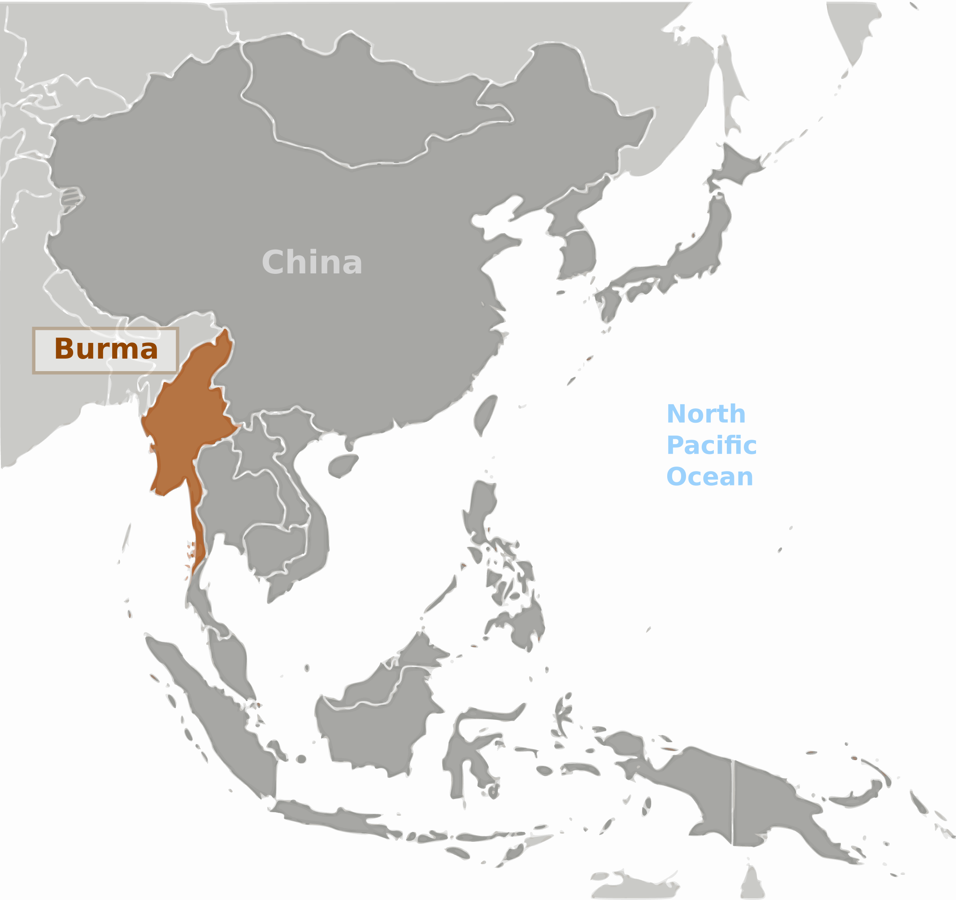
Long ago in Burma . . .
Notes:
Wife was worried about husband. He spent all his time trying to turn dirt into gold.

Slide 15
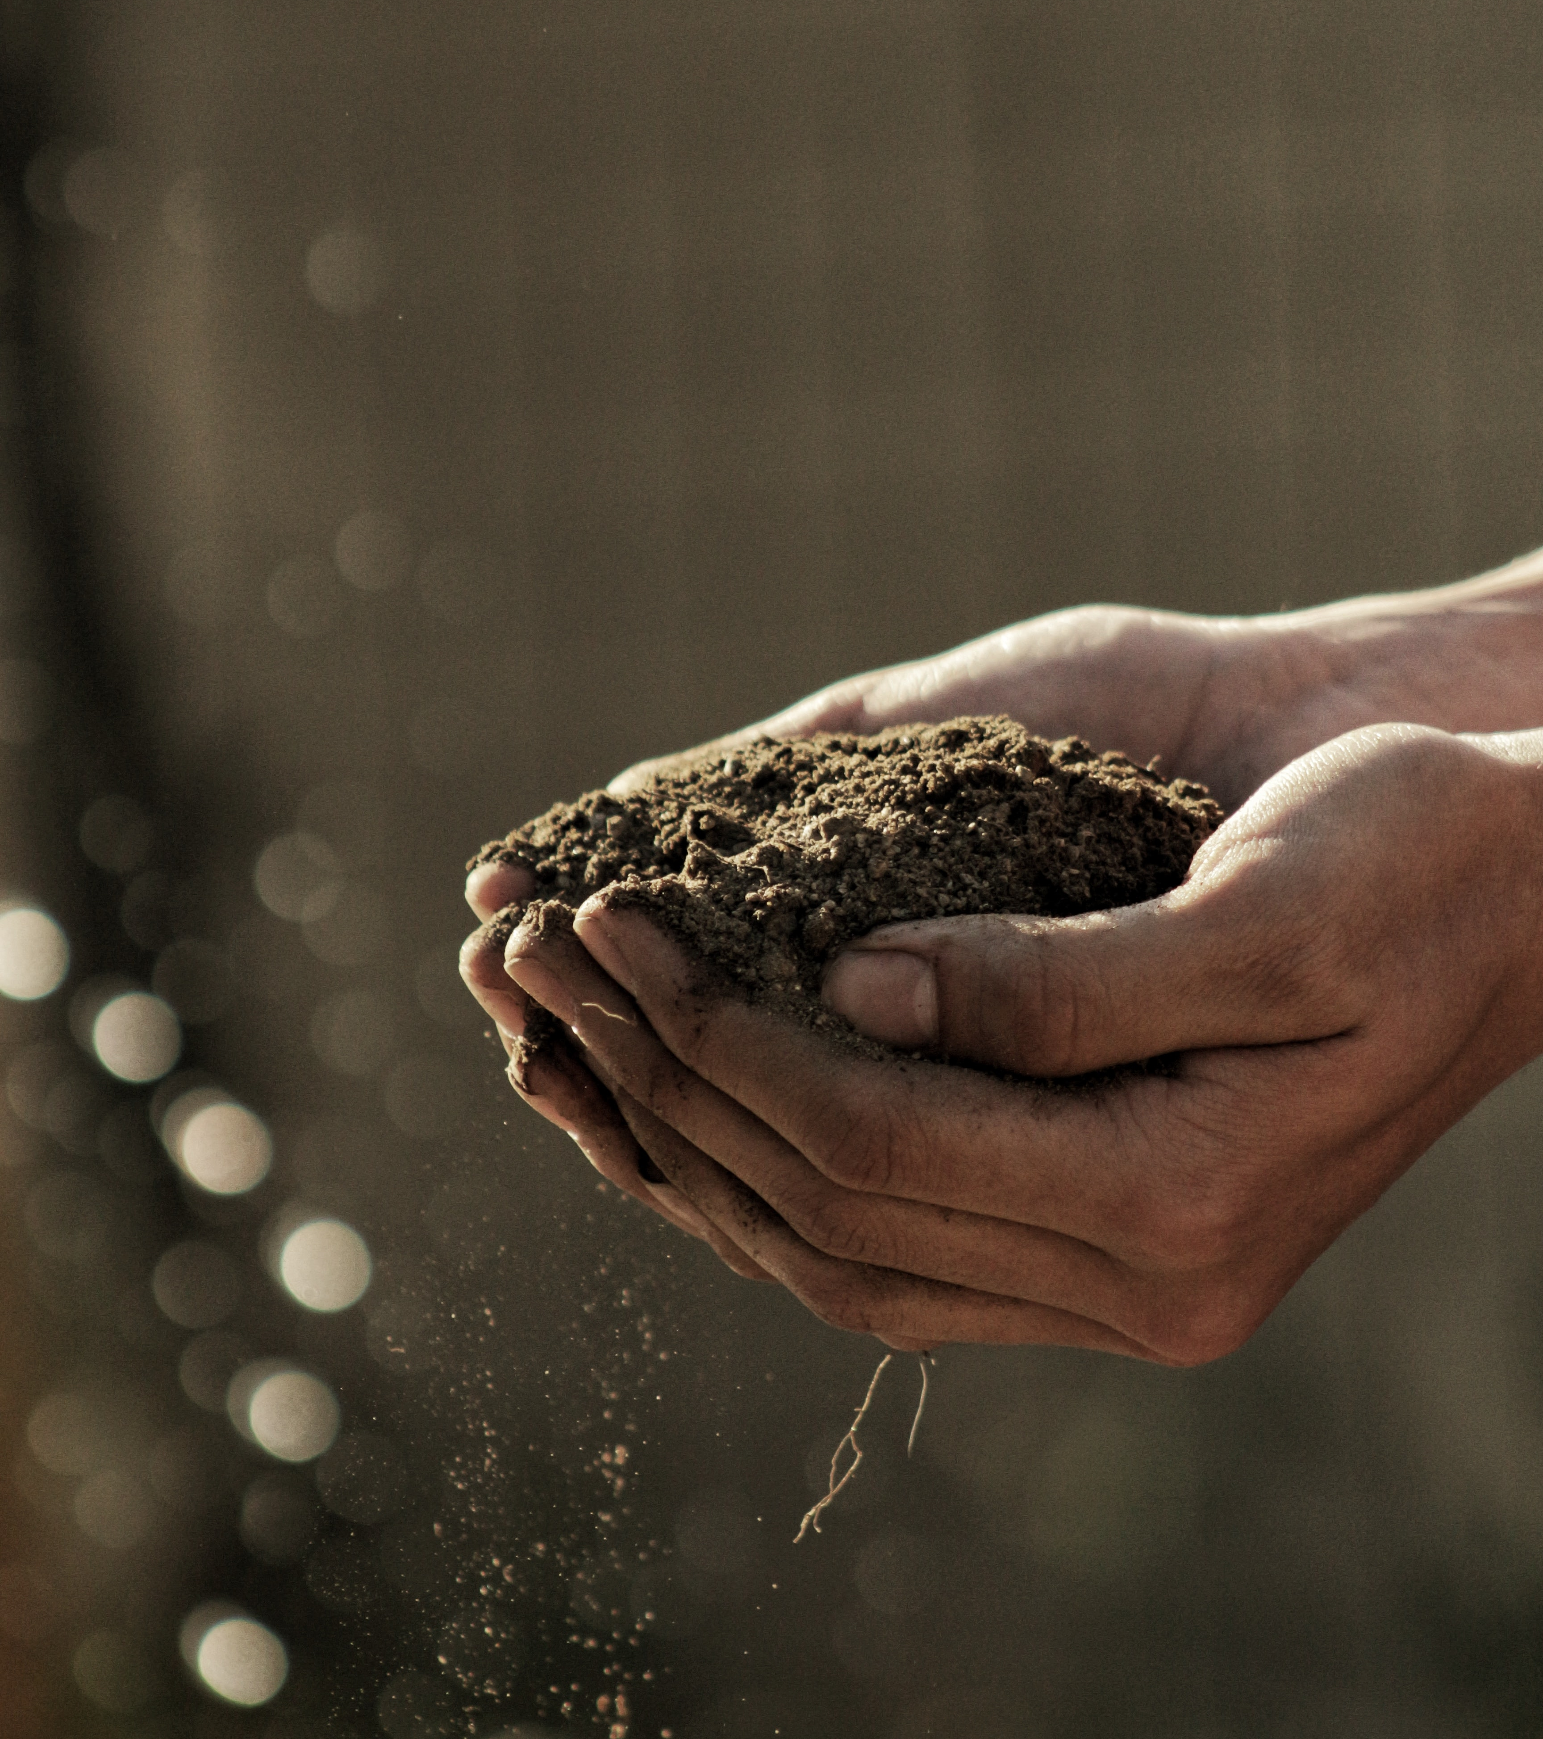

Dear Husband, I love you and I am worried about you. You spend all day trying to turn dirt into gold.
Dear Wife, I love you and I do this for you. One day we will be rich and you will thank me.

Slide 16
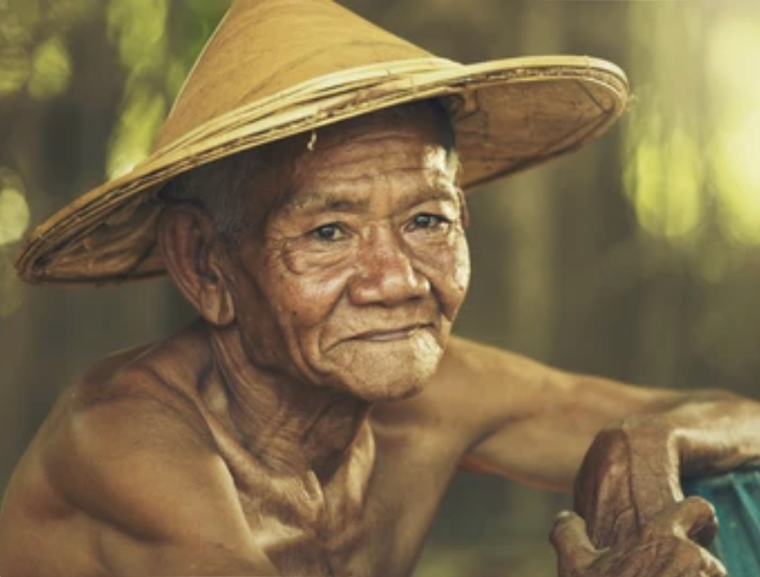

“Father, what should I do?”
“Don’t worry daughter. I will talk to him.”

Slide 17
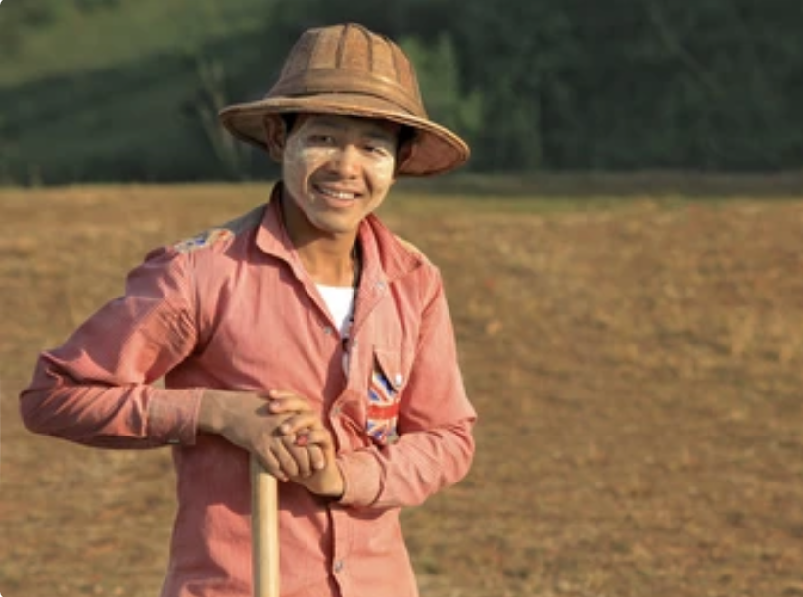
“Did you know that I know how to turn dirt into gold?”
“Father, tell me the secret.”

Slide 18
“There is a silver powder that grows on the back of banana Leaves. Collect two pounds of this silver.
“Father, that will take hundred of banana plants.”

Slide 20
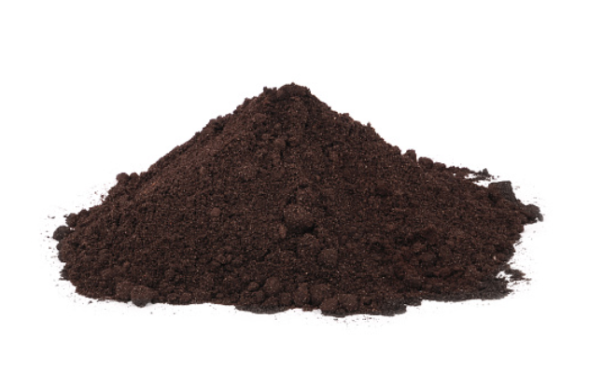
“Son, bring me some dirt. And bring me my daughter.”

Slide 21
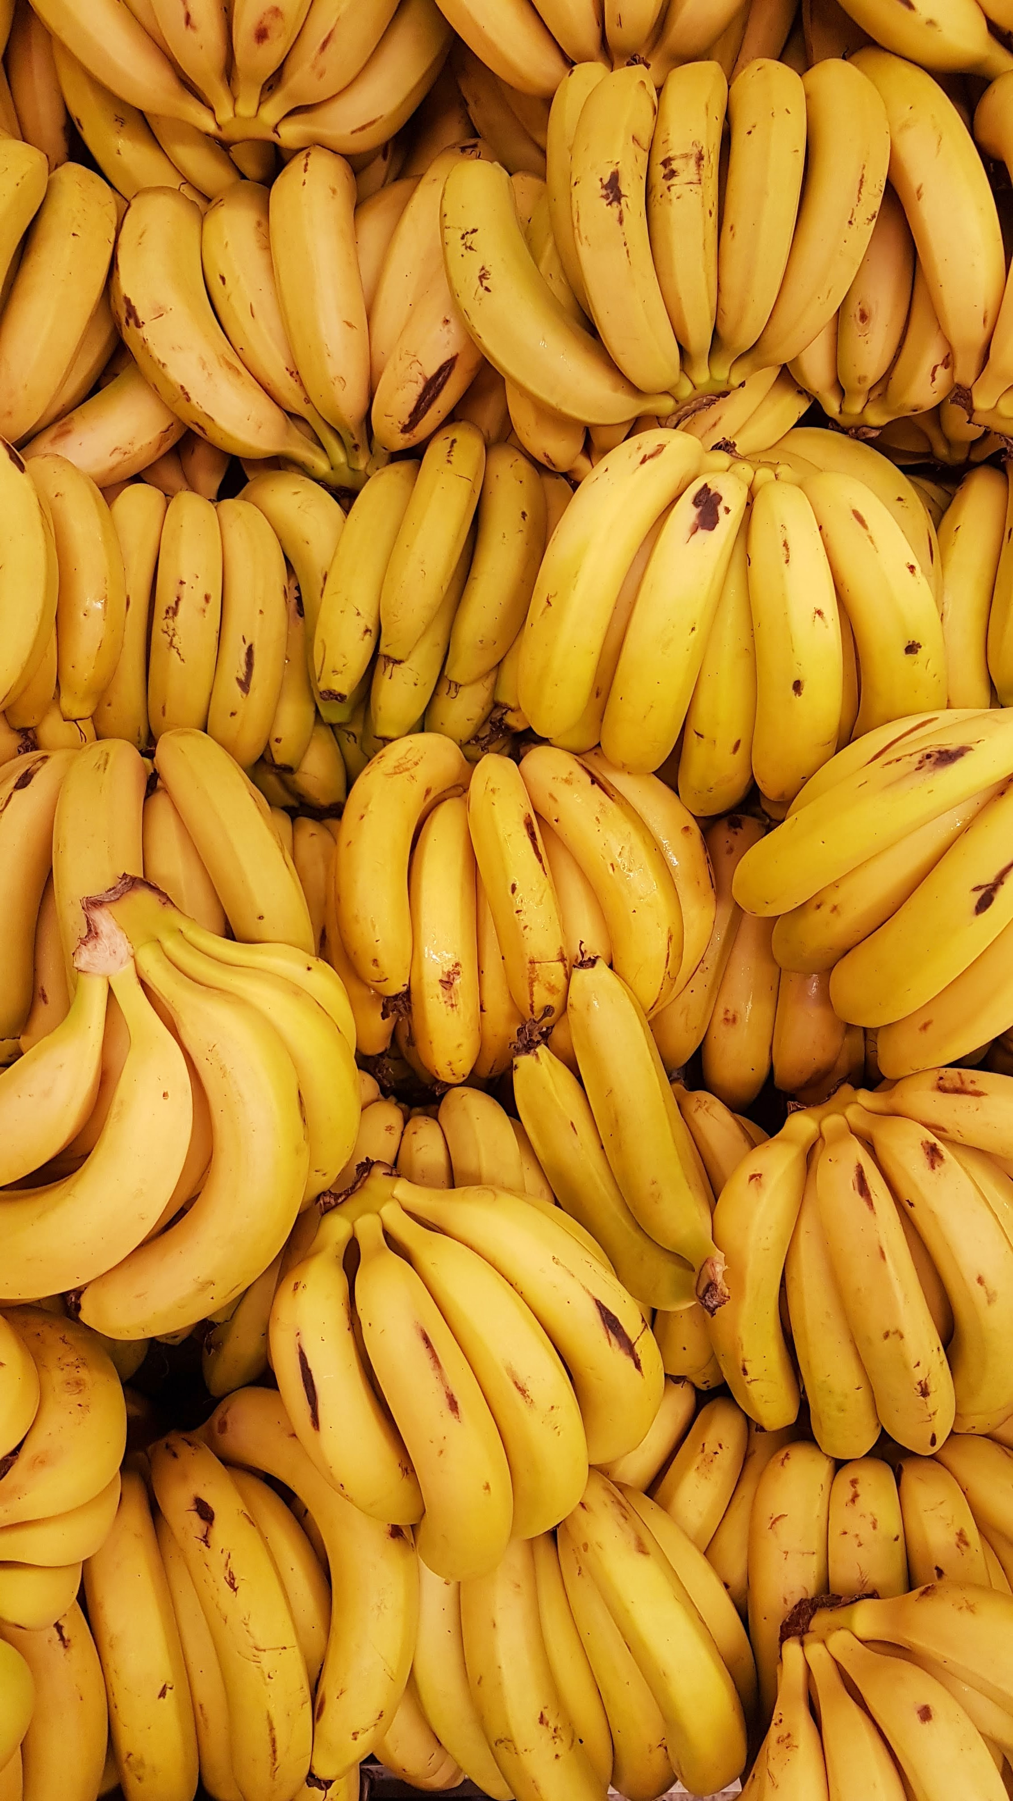
“Daughter, what did you do with the bananas?”

Slide 23
You can’t turn dirt into Gold — you have to work for it.

Slide 24
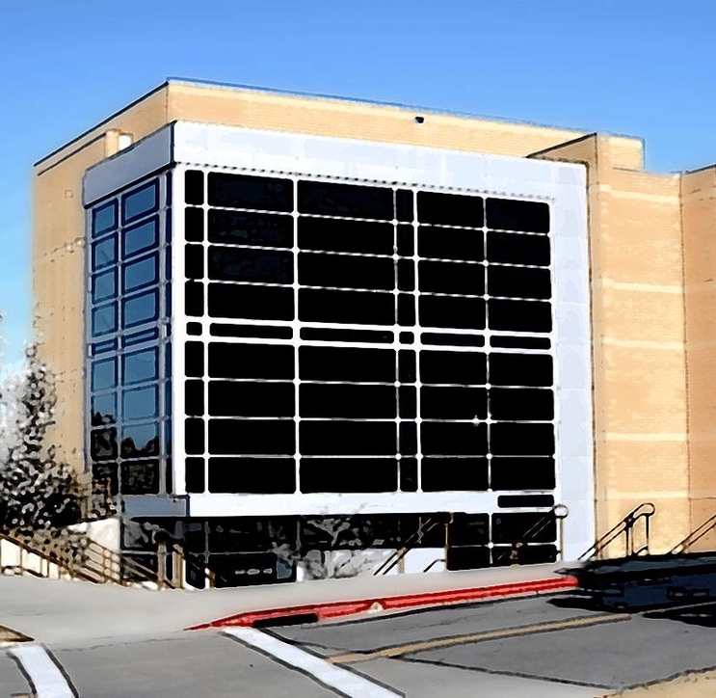
the ELC, your teachers, your classmates

Slide 25
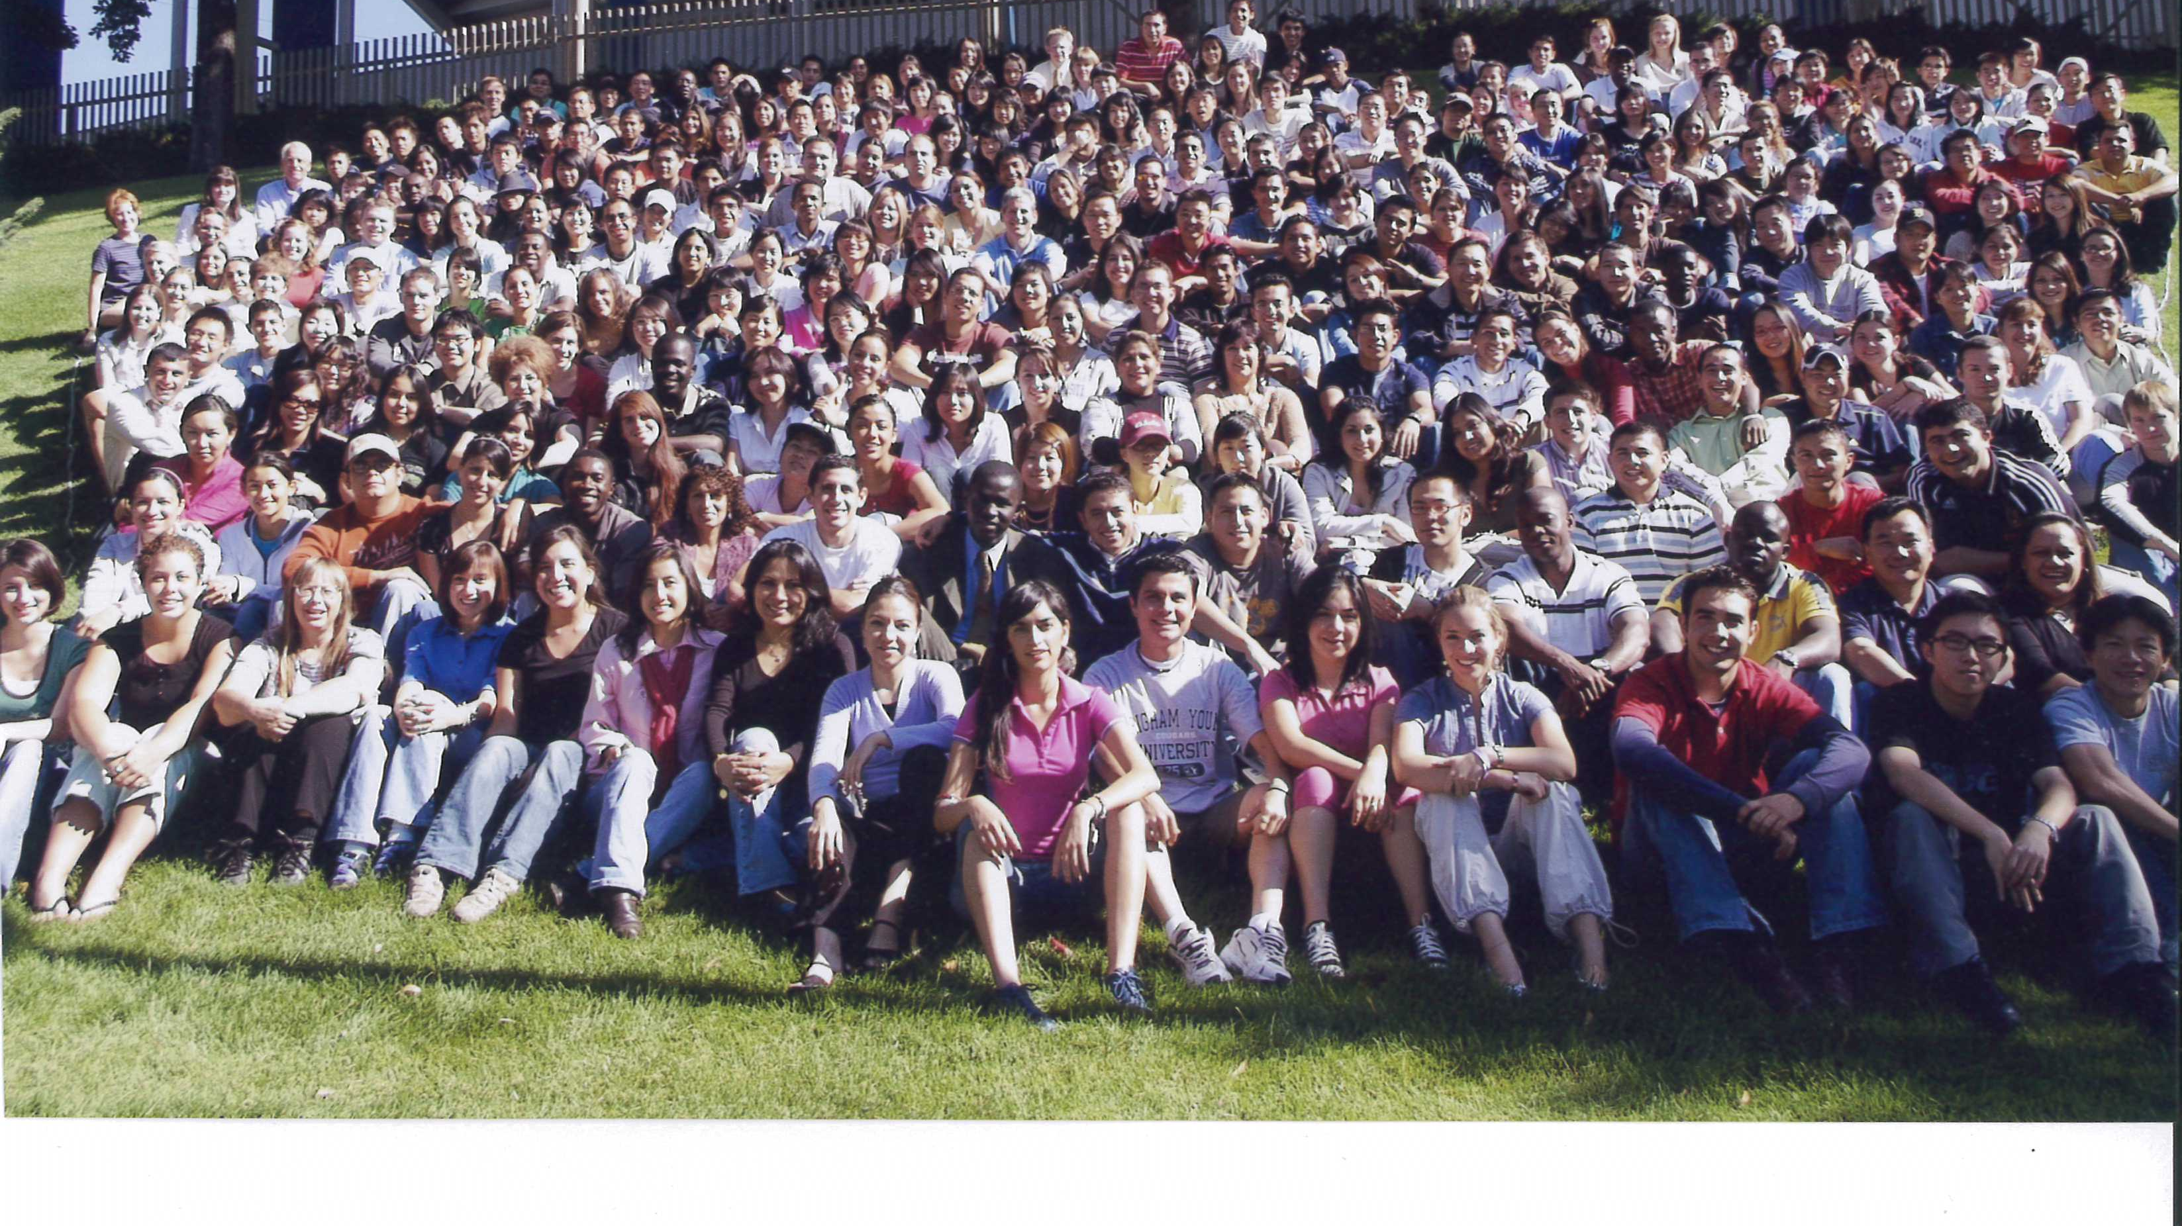
Learning is up to you.

Slide 26

What is ONE thing you would like to do or change in the next two weeks?

Slide 27

Examples
Play never have I ever
Match my teaching to my philosophy
Engage students in a variety of activities
Try task-based learning.
Use readers’ theater in my class.
Stop using grammar drills.

Slide 28
Share with the person next to you.

Slide 29
Pedagogical Practices

Slide 30
1. Rely on course outcomes

Slide 31
2. Plan lessons effectively

Slide 32
3. Optimize class time

Slide 33
4. Cultivate a positive learning environment

Slide 34
5. Evaluate learning effectively

Slide 35
6. Utilize homework strategically

Slide 36
7. Provide meaningful and timely feedback

Slide 37
8. Exemplify professionalism

